Slide 1
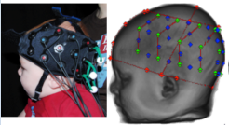
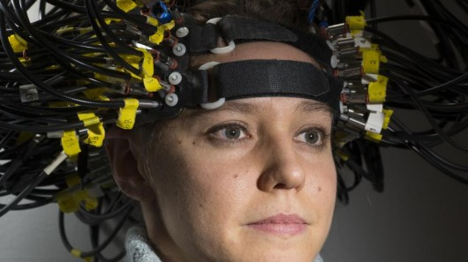
Development of Diffuse Optical Tomography Sensitivity in Infants: Brain Localization of NIRS Activity
John E. Richards
University of South Carolina

Slide 2
Collaborations with…
Sarah Lloyd-Fox, Clare Ewell, Mark Johnson, CBCD London
Papademetriou, M.D., Richards, J.E., Correira, T., Blasi, A., Lloyd-fox S., Johnson, M., & Elwell, C.E. (2013). Cortical mapping of 3D optical topography in infants. Advances in Experimental Medicine and Biology, 789:455-61. doi: 10.1007/978-1-4614-7411-1_61. PubMed PMID: 23852529.
Lloyd-Fox, S., Wu, R., Richards J.E., Elwell, C.E., & Johnson, M.H. (2013). Cortical activation to action perception is associated with action production abilities in young infants. Cerebral Cortex.
Lloyd-Fox, S., Richards, J.E., Blasi, A., Murphy, D., Elwell, C.E., & Johnson, M.H. (in press). Co-registering NIRS with underlying cortical areas in infants. Neurophotonics.
Lauren Emberson, Dick Aslin, Princeton, Haskins
Emberson, L.E., Richards, J.E., & Aslin, R.N. (2015). Top-down modulation in the infant brain: Learning-induced expectations rapidly affect the sensory cortex at 6-months. Proceedings of the National Academy of Sciences. doi:10.1073/pnas.1510343112
Emberson, L.E., Cannon, G., Palmeri, H., Richards, J.E., & Aslin, R.N. (2016). Using fNIRS to Examine Occipital and Temporal Responses to Stimulus Repetition in Young Infants: Evidence of Selective Frontal Cortex Involvement. Developmental Cognitive Neuroscience.
Emberson, L.E., Crosswhite, S., Richards, J.E., & Aslin, R.N. (2017). The lateral occipital cortex (LOC) is selective for object shape, not texture/color, at 6 months. Journal of Neuroscience, 37, 3698-3703; DOI: https://doi.org/10.1523/JNEUROSCI.3300-16.2017.
Katherine Perdue, Chuck Nelson, BCH, Boston
Perdue, K.L., Behrendt, H.F., Richards, J.E., Westerlund, A, Cataldo, J.K., & Nelson, C.A. (submitted). Neural and behavioral correlates of facial emotion processing in infancy: a simultaneous eye-tracking and fNIRS study. Neuroimaging
Sobanawartiny Wijeakumar, John Spencer, UEA, UK
Wijeakumar, S., Magnotta, V. A., & Spencer, J. P. (2017). Modulating perceptual complexity and load reveals degradation of the visual working memory network in ageing. Neuroimage, 157, 464-475. doi:10.1016/j.neuroimage.2017.06.019

Slide 3

Participant NIRS recorded on scalp; locate the optodes on a structural MRI

Slide 4
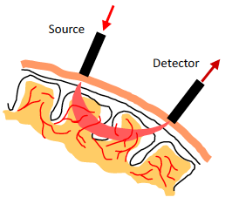
Participant NIRS recorded on scalp; light reflects from HbO2 & HHb

Slide 5
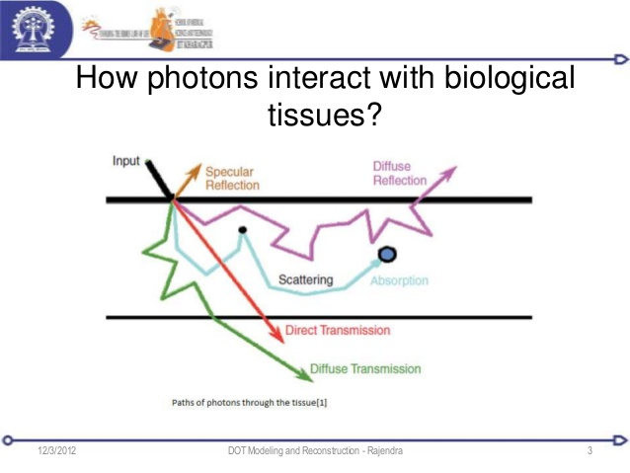
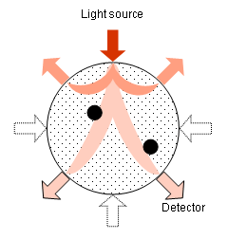
Simulate project 100M photons into segmented MRI, track path, record detector

Slide 6
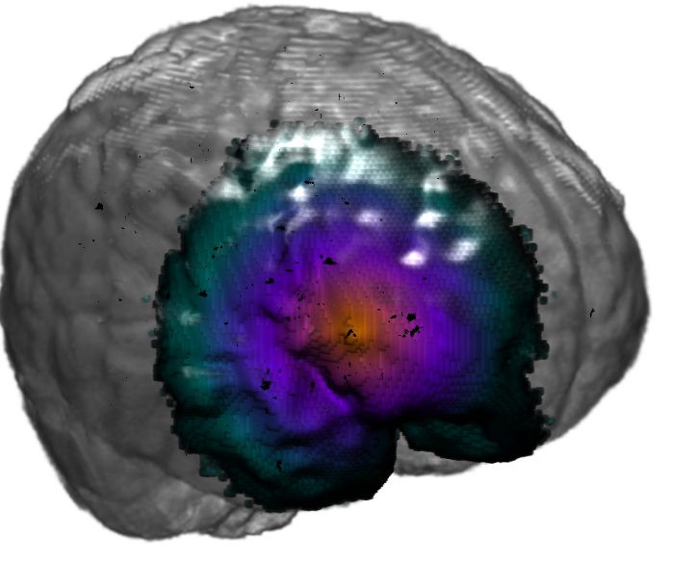
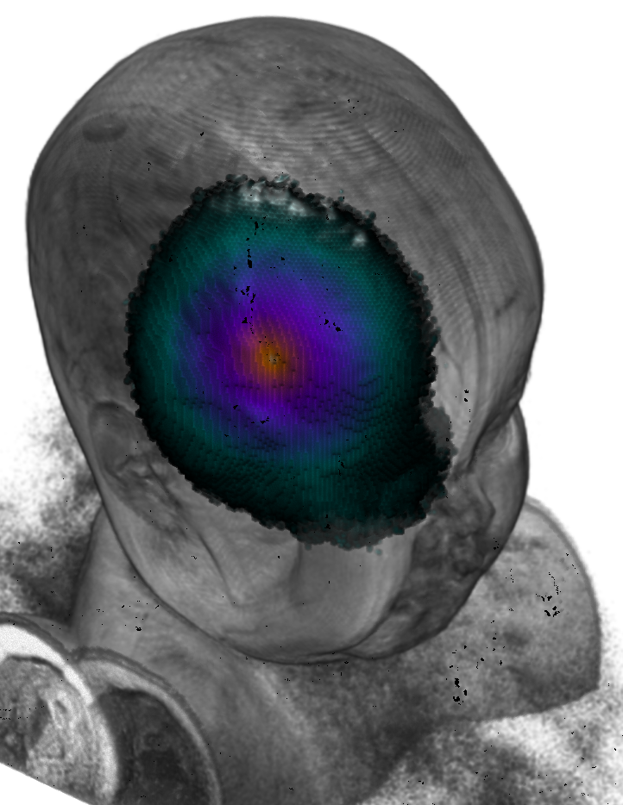
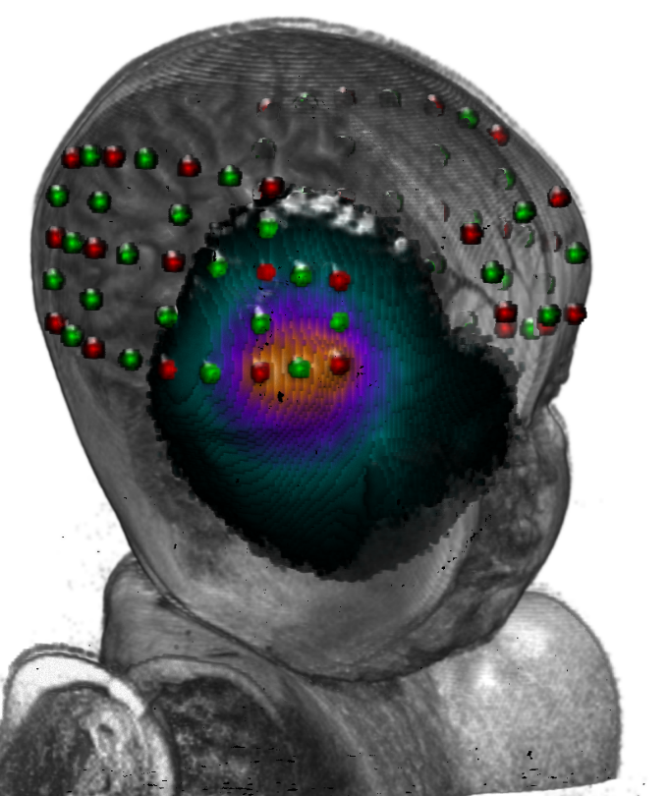
Photon-simulation DOT sensitivity for one source/detector

Slide 7
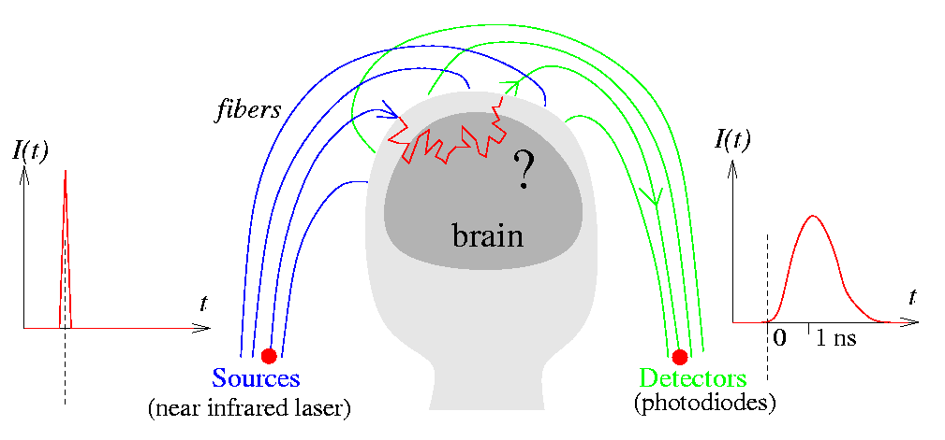
Light input, multiple source/detectors, path through brain

Slide 8
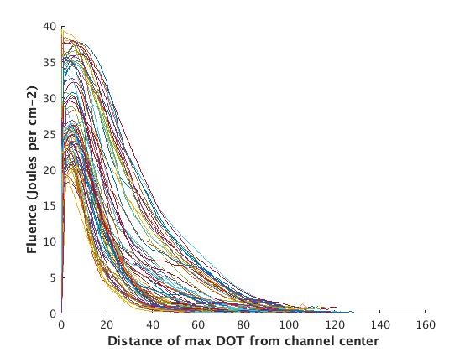
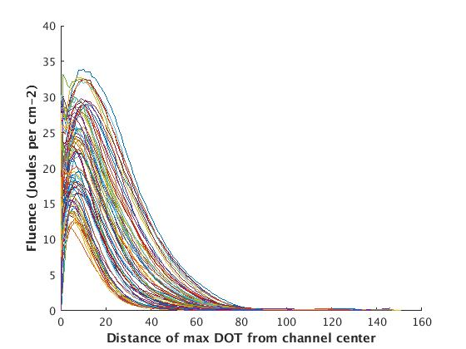
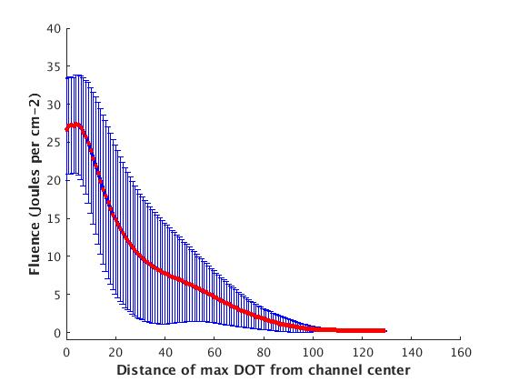
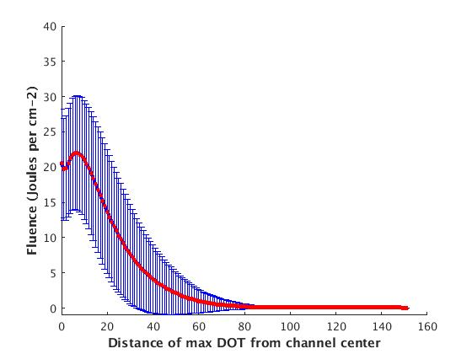
DOT Sensitivity Profile for A 6-month-old and Average 6-month olds
One 6-0Month Old
Avg DOT 6-0Months
Separate Channels
Separate Channels
Peak 6.8
Peak 7.0
Slope change 14.0
HHHW 19.8
Slope change 15.2
HHHW 23.5
Mean & Std Across Channels
Mean & Std Across Channels

Slide 9
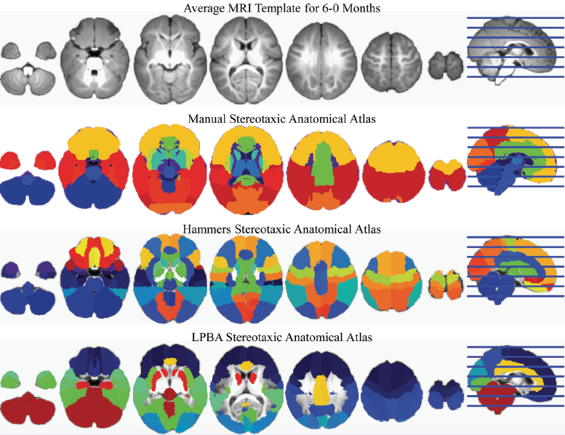
Stereotaxic Anatomical Atlas for Each MRI (individual, average template)

Slide 10
Optode-Brain-Atlas Co-Registration; Katherine Perdue, Chuck Nelson, et al….
Inferior frontal gyrus
Postcentral
Lateral orbitofrontal
Middle occipital
Superior temporal
Middle Frontal
Middle temporal
Precentral
Inferior temporal

Slide 11
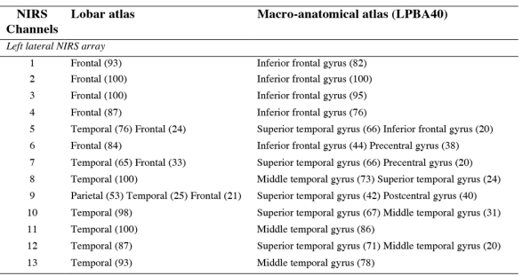
Optode Anatomical Lookup Table; Sarah Lloyd-Fox, Clare Elwell, Mark Johnson et a…

Slide 12
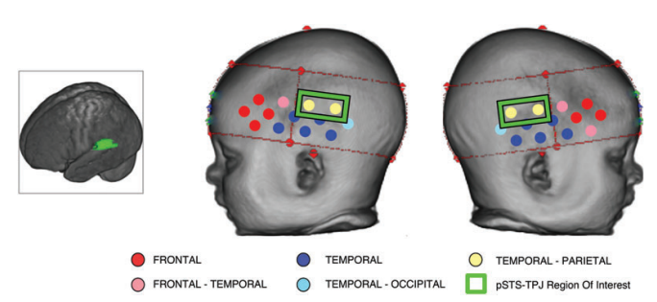
ROI Analysis (Temporal-Parietal Junction, “TPJ”); Lloyd-Fox, Ewell, Johnson

Slide 13
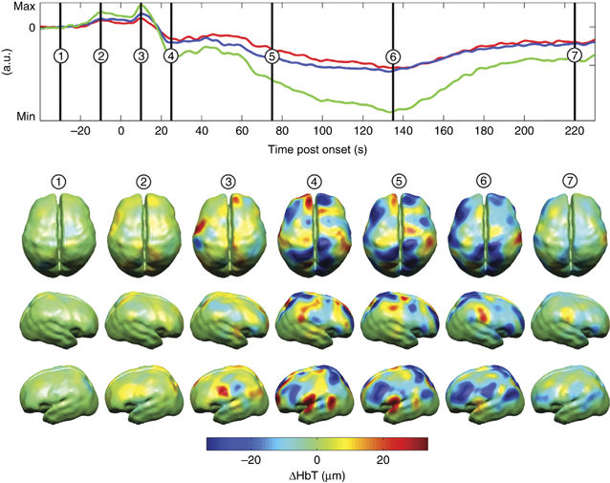
Inverse Modeling of NIRS-BOLD Time Course from DOT Sensitivity

