Slide 1


THE ROLE OF LOW-LEVEL VISUAL CUES ON THE NEURAL RESPONSES TO FACES IN INFANTS
Introduction
Background
Aims
Method
Stefania Conte, PhD
Postdoctoral Fellow
https://infantlab.sc.edu/
John E. Richards, PhD
Carolina Distinguished Professor
Sample
Stimuli and Procedure
Results
N290
P400
Source analysis
Infant
Development
Laboratory
Conclusion
Contacts

Slide 2
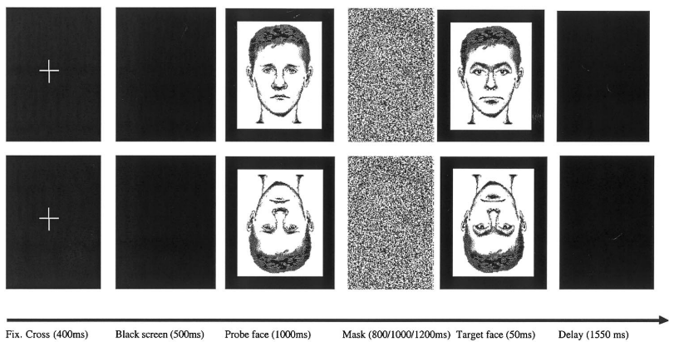
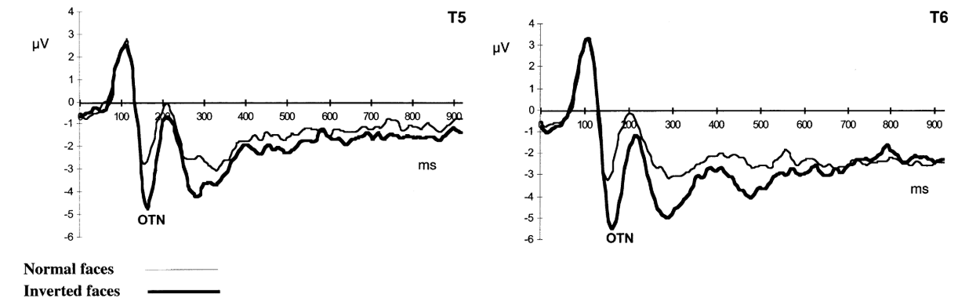
Background
Introduction
Rossion et al. (1999)

Slide 3
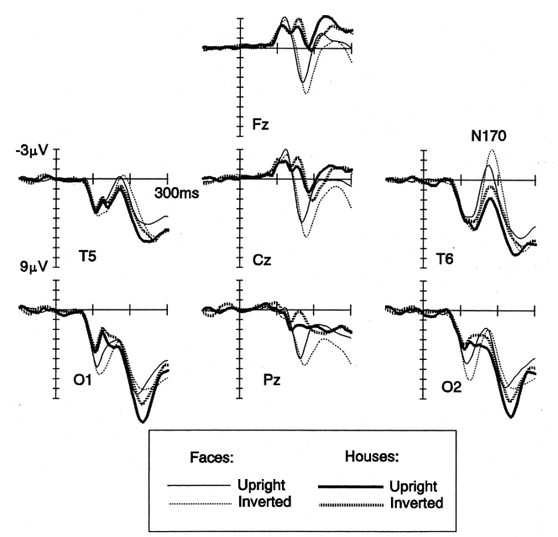
Introduction
Background
Eimer (2000)

Slide 4
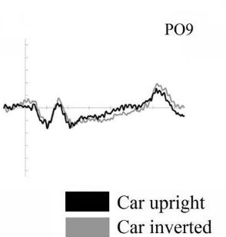
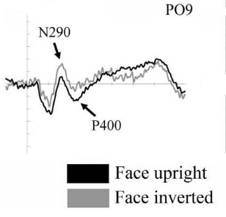
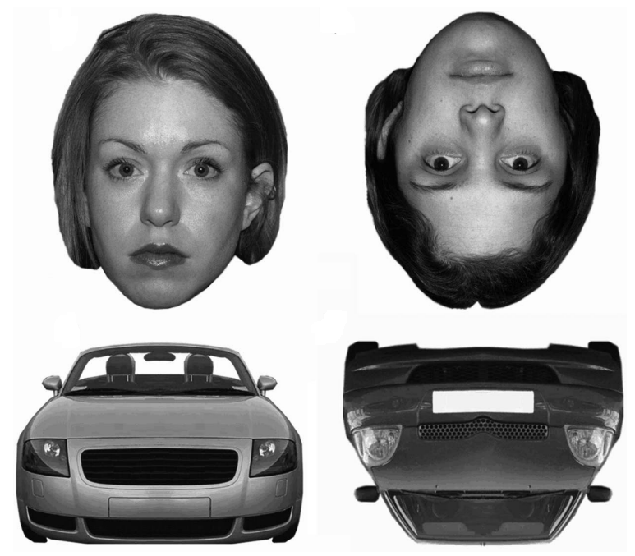
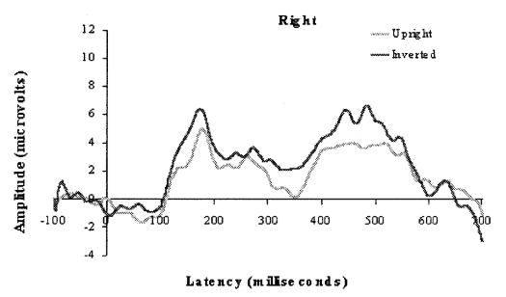
Introduction
Background
adapted from Peykarjou & Hoehl (2013)
P400
Halit et al. (2003)

Slide 5
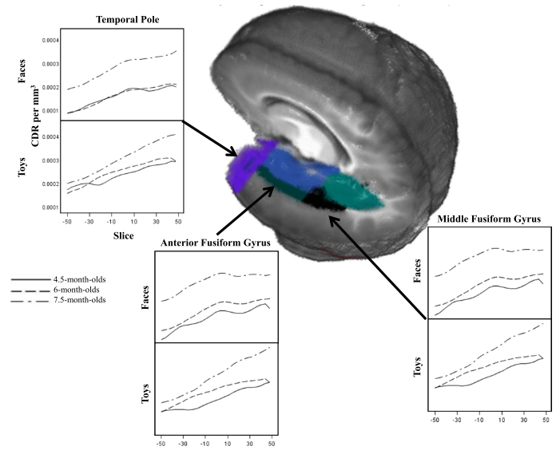
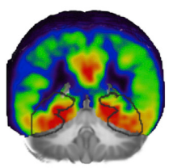
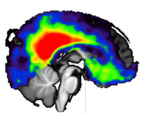
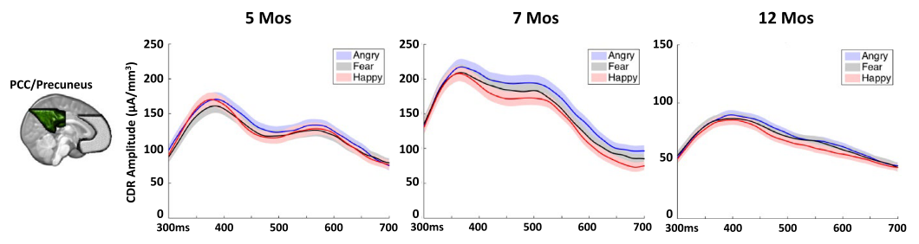
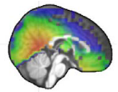
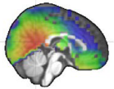
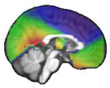
Introduction
Background
N290
Middle and Posterior Fusiform Gyri (mFG, pFG)
Guy et al. (2016)
Conte et al. (2020)
P400
Posterior Cingulate Cortex (pCC)
adapted from Xie et al. (2019)

Slide 6
Introduction
Aims
The N290 activity would be modulated by stimulus type (i.e., faces vs. houses) with larger negativity in response to faces
P400 responses would be sensitive to the orientation of faces
Investigate the effect of the stimulus inversion on the activity of face-sensitive ERPs in infancy (i.e., N290 and P400)
Explore the development of the ERP responses across the first year of life
Source localization of the N290 activity would be in the Fusiform Gyrus
Modulations of the P400 would occur in the Posterior Cingulate cortex
Explore the inversion effect on the neural generators of each ERP component using age appropriate head models for source analysis
Adult-like N290 and P400 functional characteristics by 12 months of age

Slide 7


Sample
12-month-old infants
M = 379.4 days
SD = 15.8 days
N = 14
8-month-old infants
M = 252.2 days
SD = 23.3 days
Method
N = 9
6-month-old infants
M = 192.7 days
SD = 8.1 days
N = 7
4.5-month-old infants
M = 143.6 days
SD = 7.9 days
N = 10
3-month-old infants
M = 103 days
SD = 8.6 days
N = 7

Slide 8
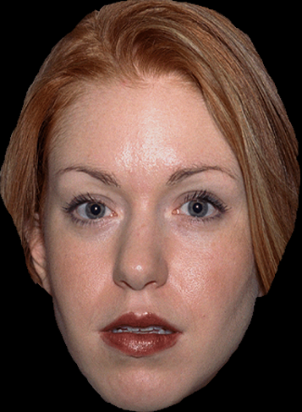


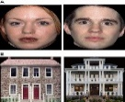
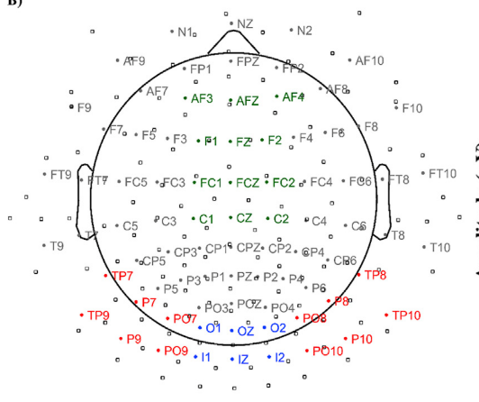
Method
Stimuli and Procedures
UF
UH
IF
IH
500
500 – 1500
Time (ms)
500
EEG ANALYSIS
Amplitude values around the peak of N290, and P400 ERP components over medial occipital (blue) and occipital lateral (red) ROIs

Slide 9
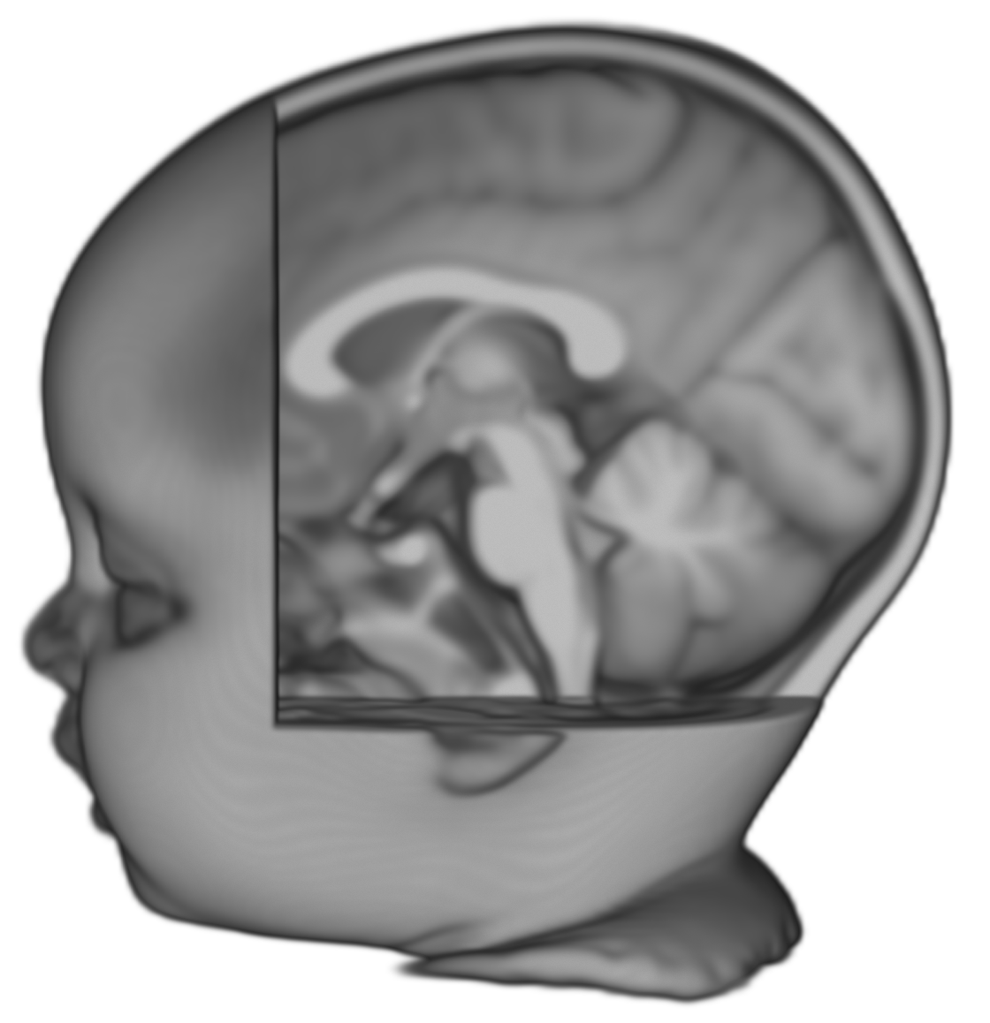
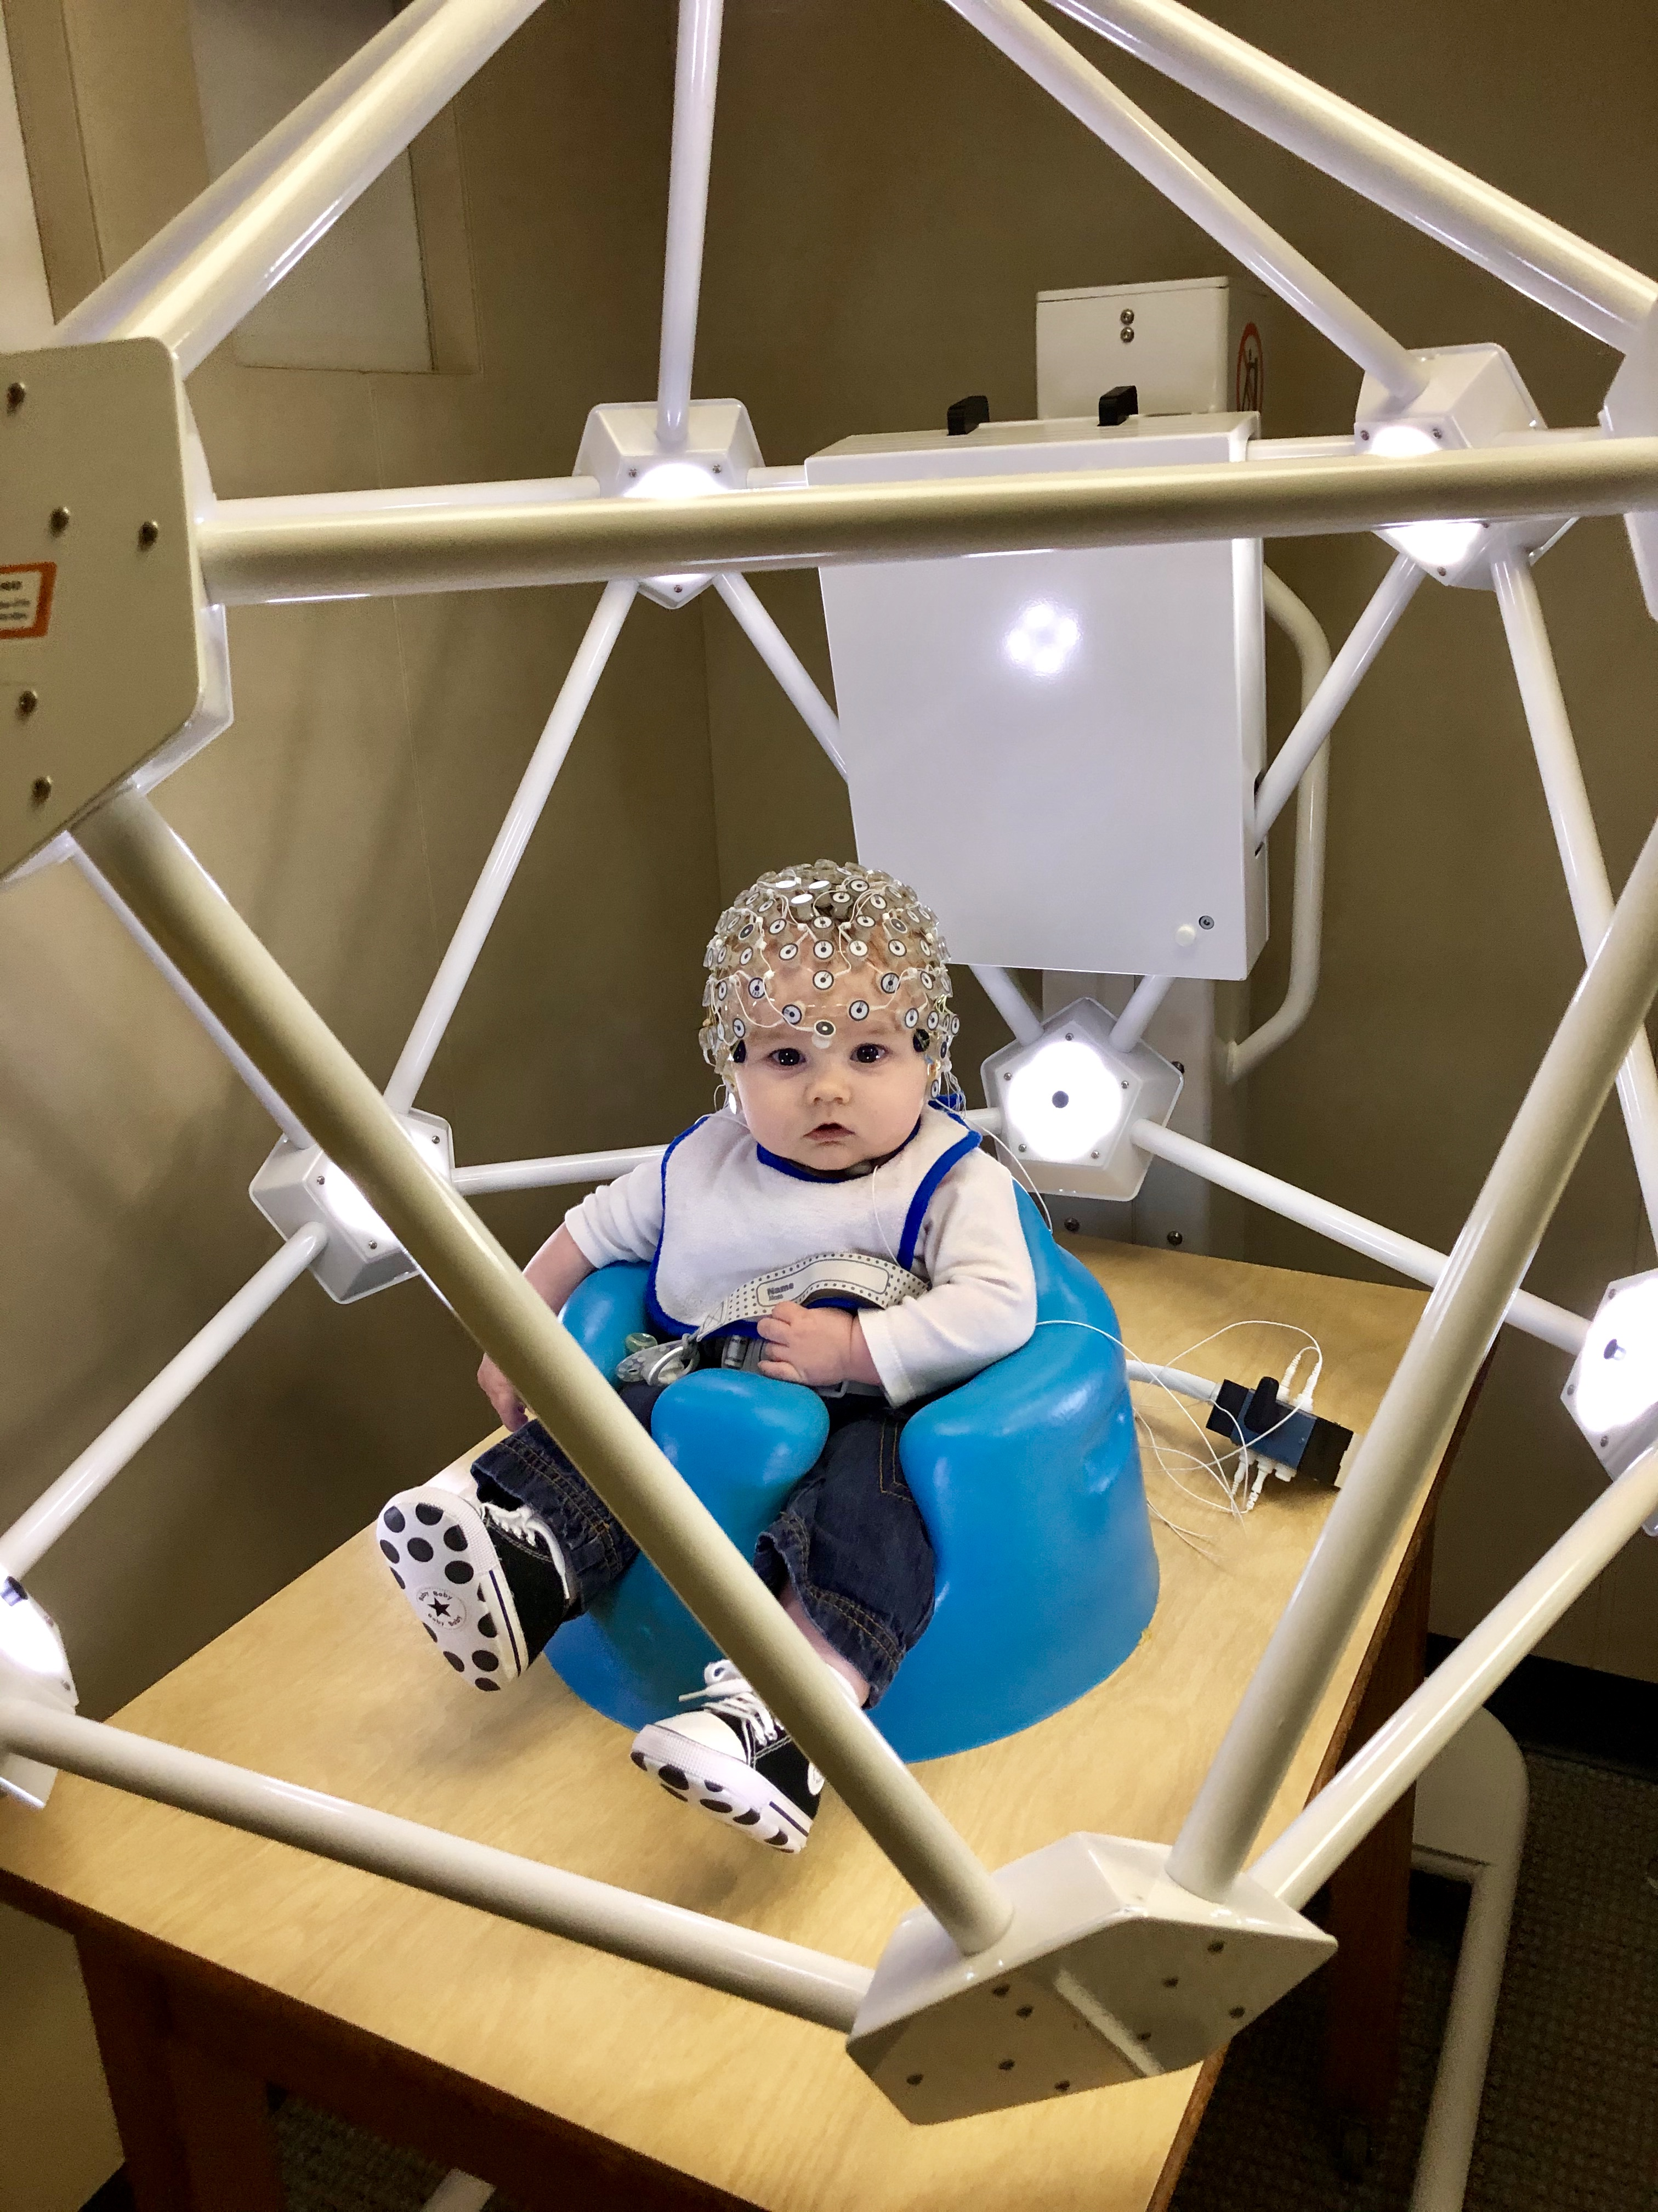
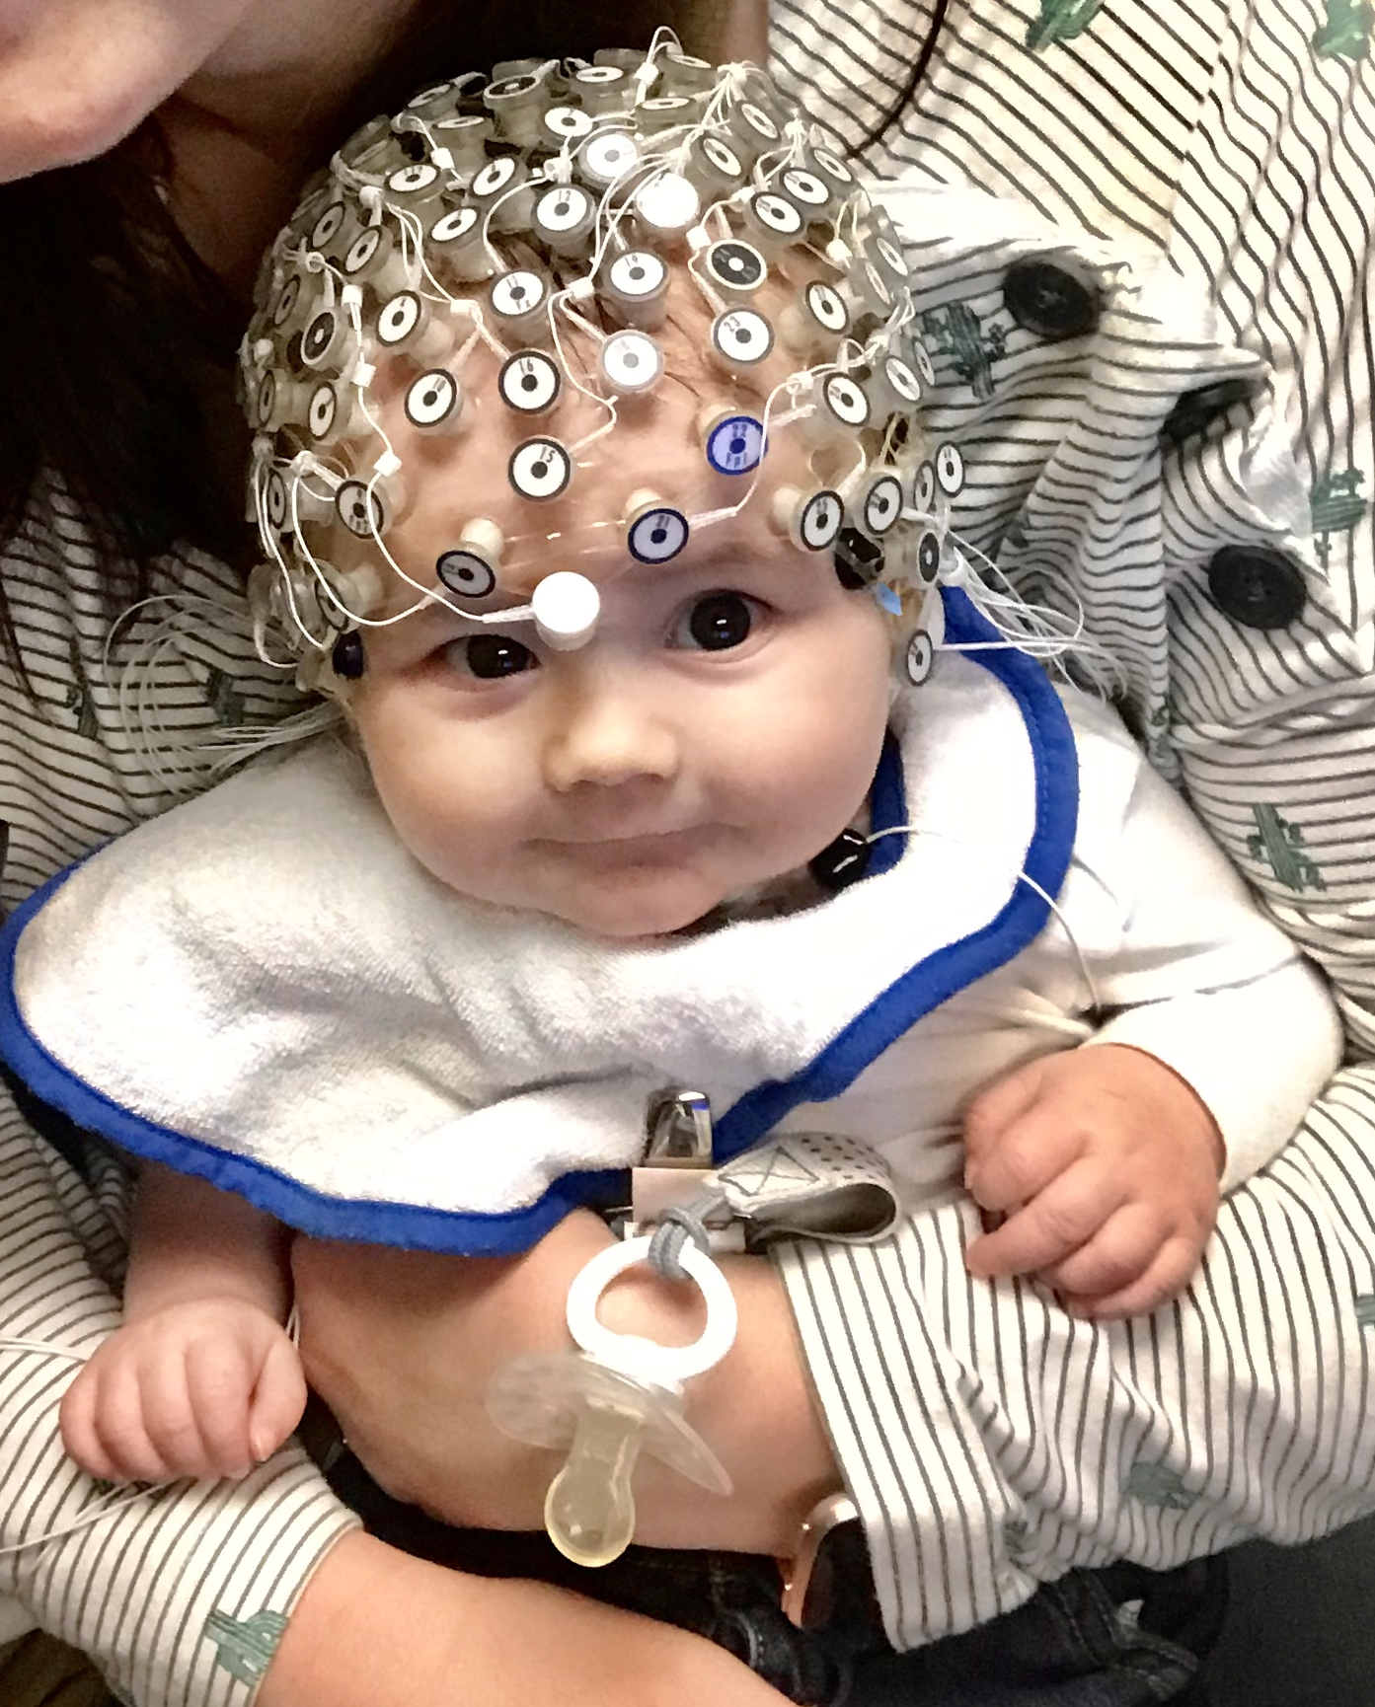
Method
Stimuli and Procedures
Geodesic Photogrammetry System (GPS) for accurate electrode locations
Amplitude around the peak of N290, and P400
Age-appropriate MRI templates
Fine Element Method (FEM) to create meshes for gray matter, white matter, CSF, dura, skull, muscle, eyes, nasal cavity, scalp
SOURCE ANALYSIS
Current Density Reconstruction (CDR) values estimated with eLORETA
(Pascual-Marqui, 2007)

Slide 10
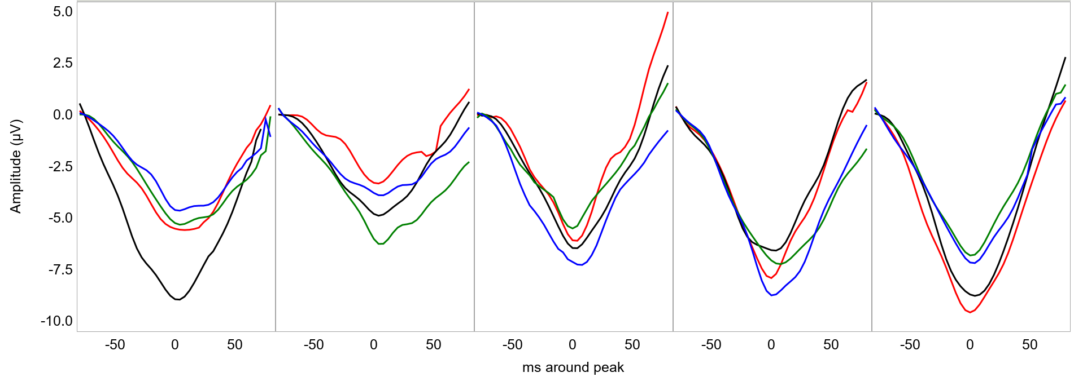
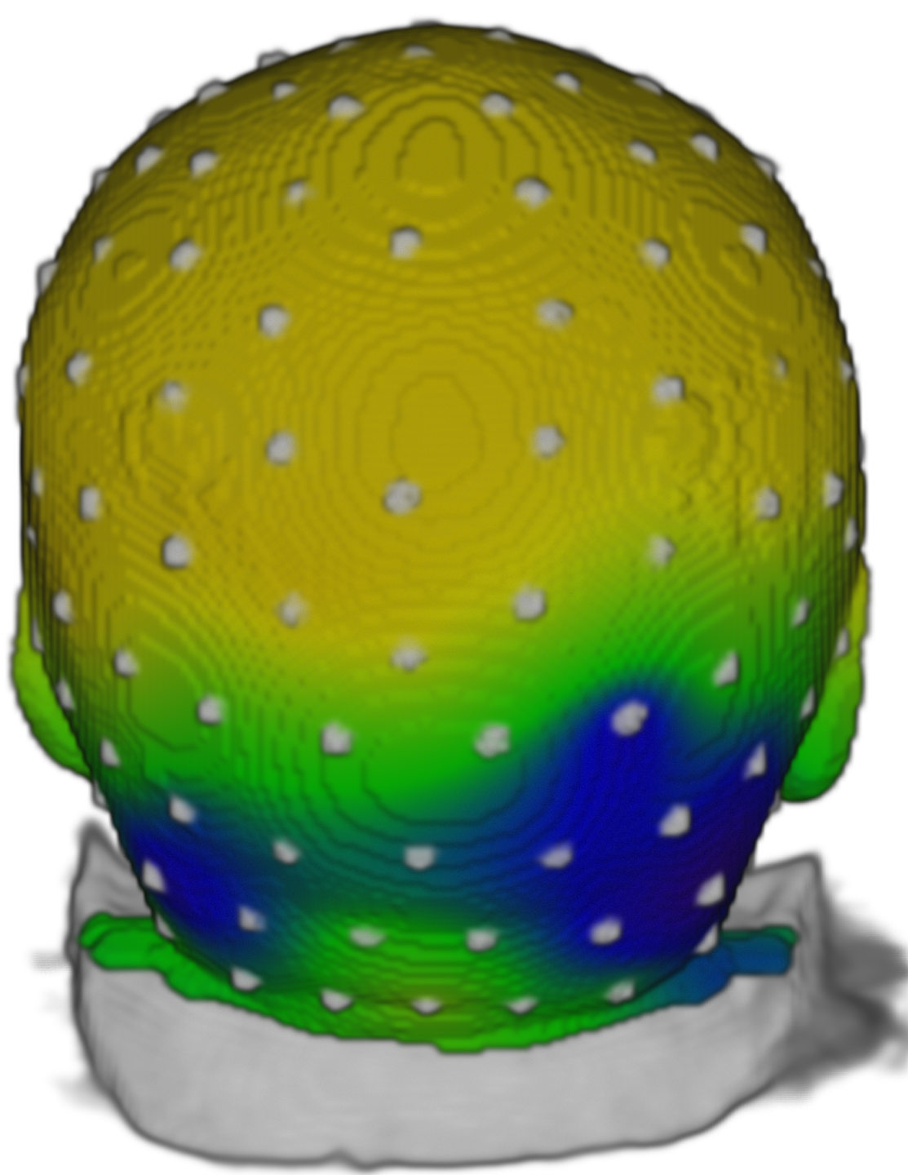
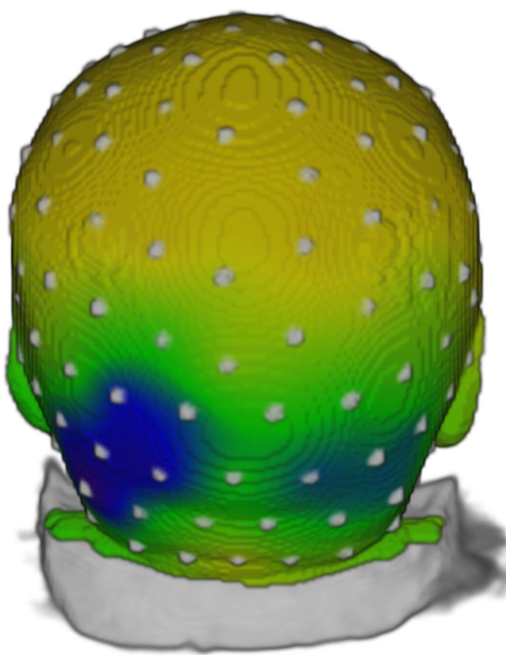
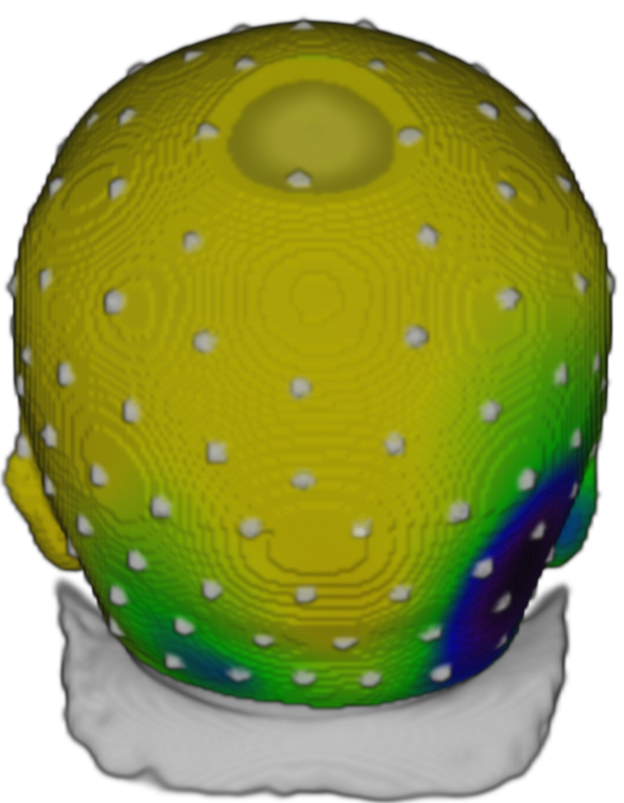
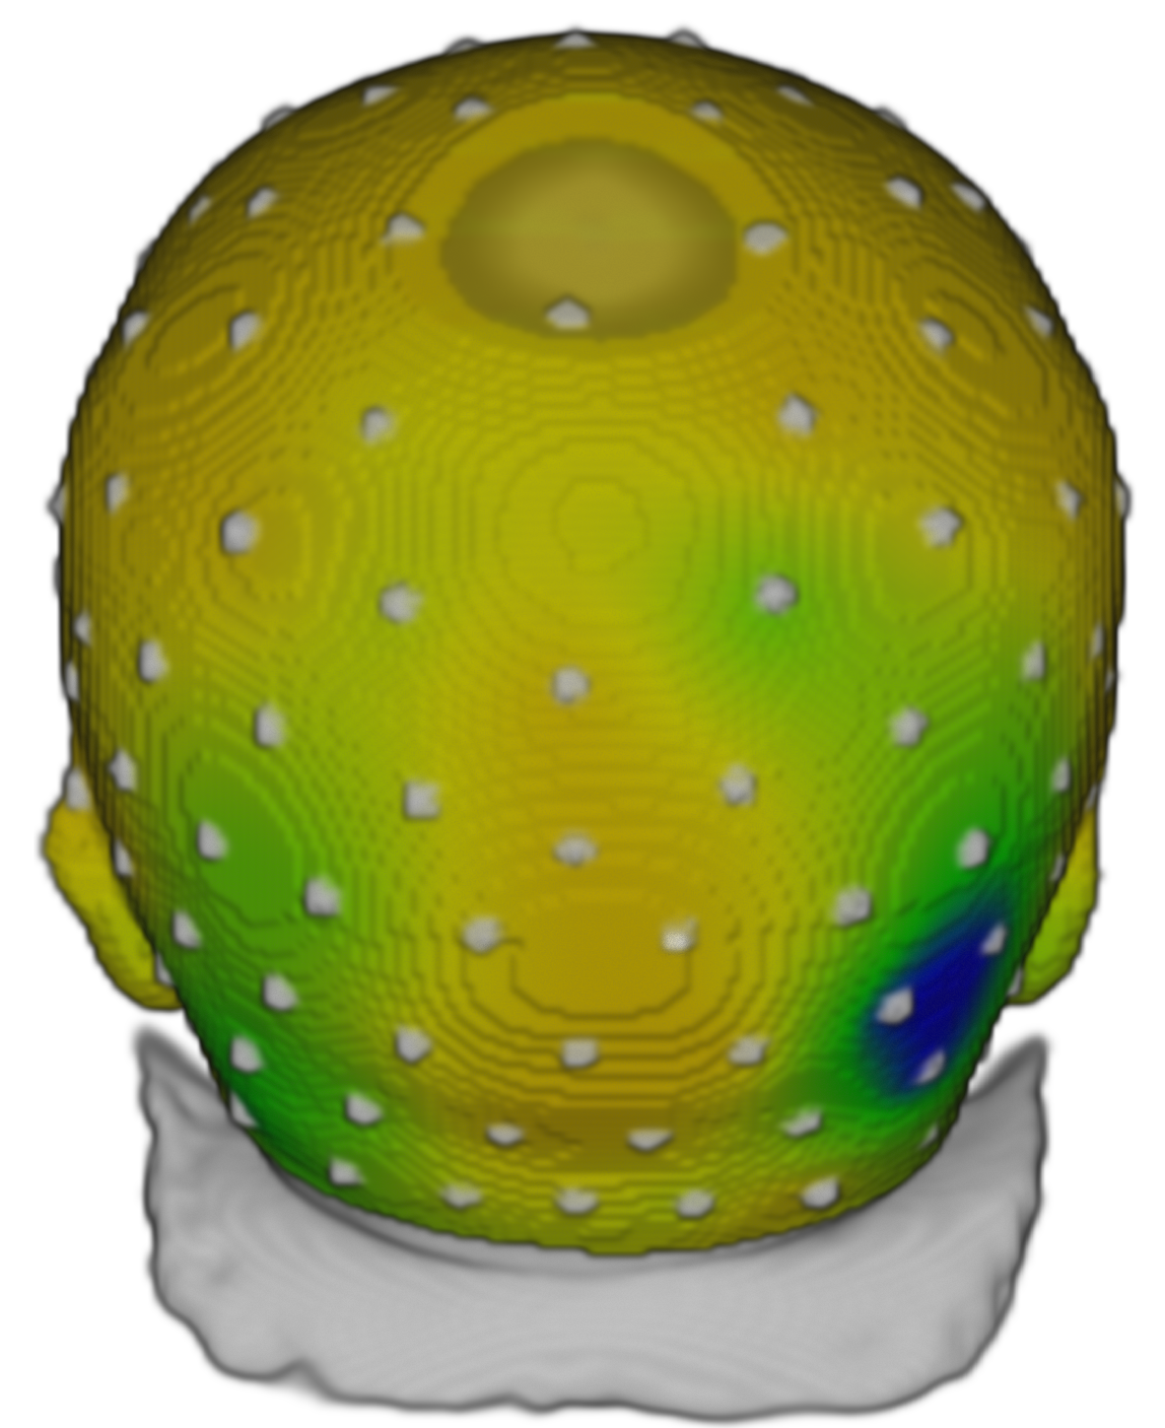
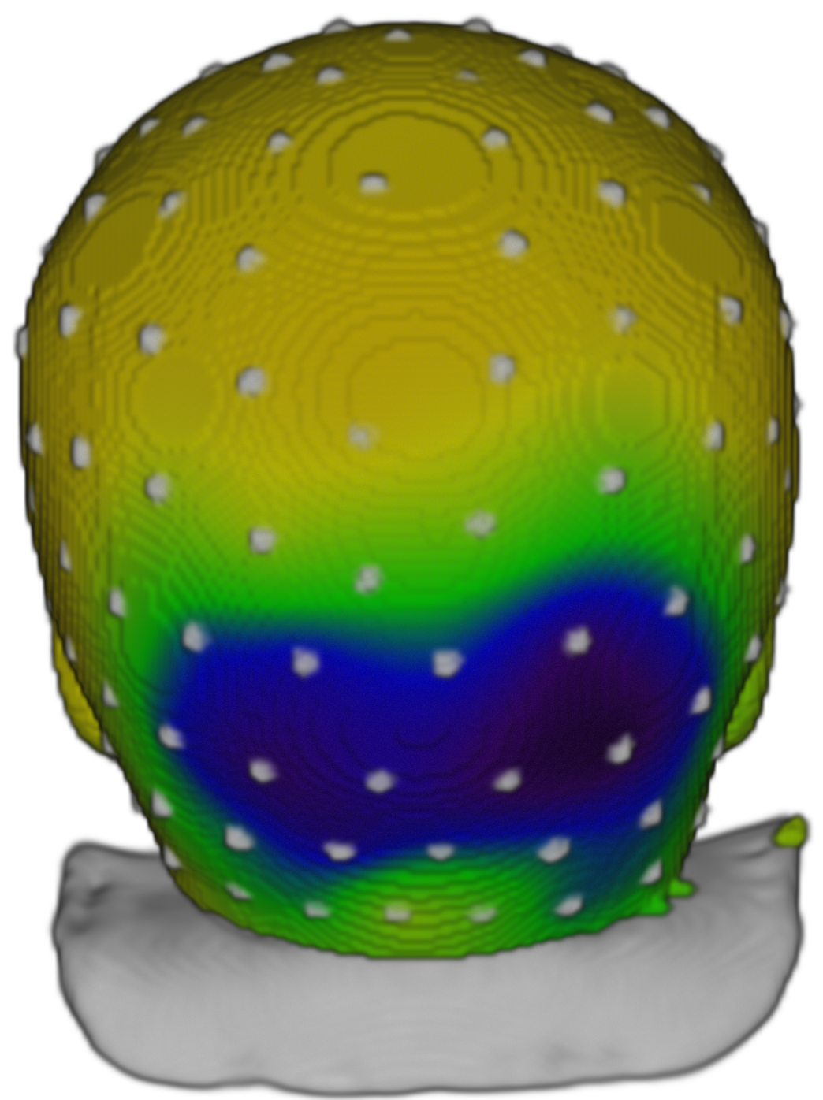
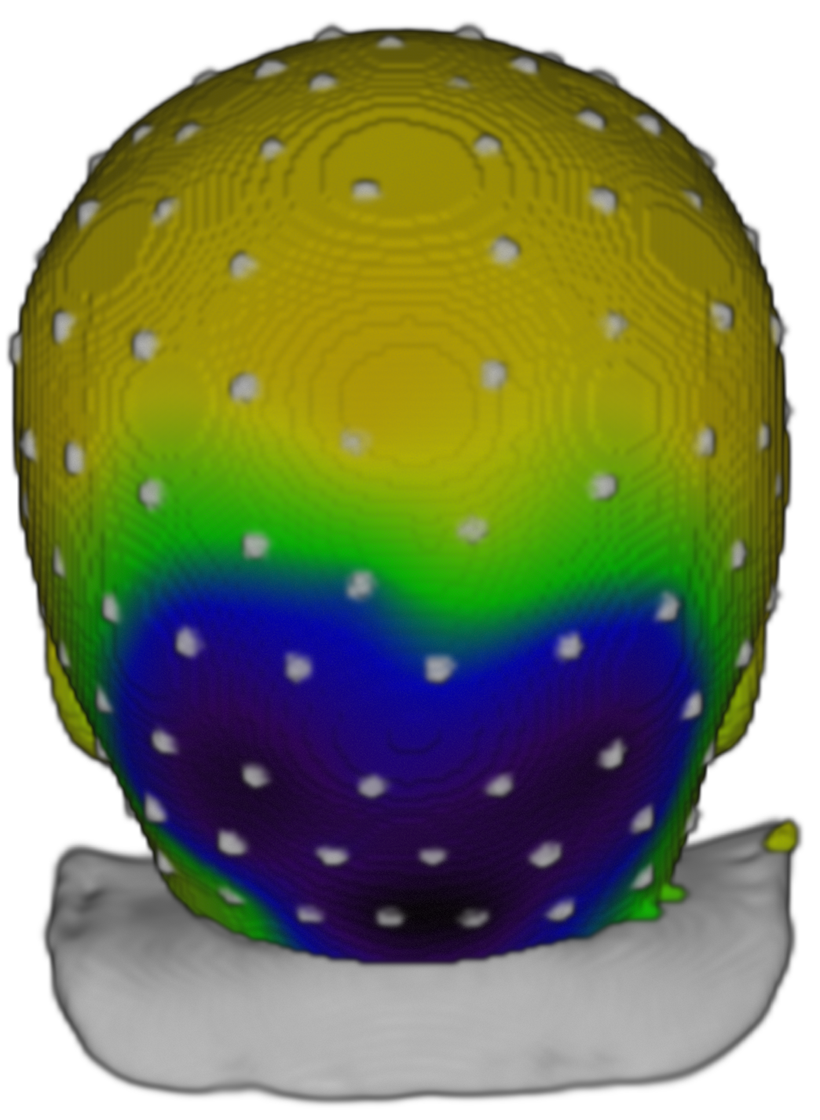
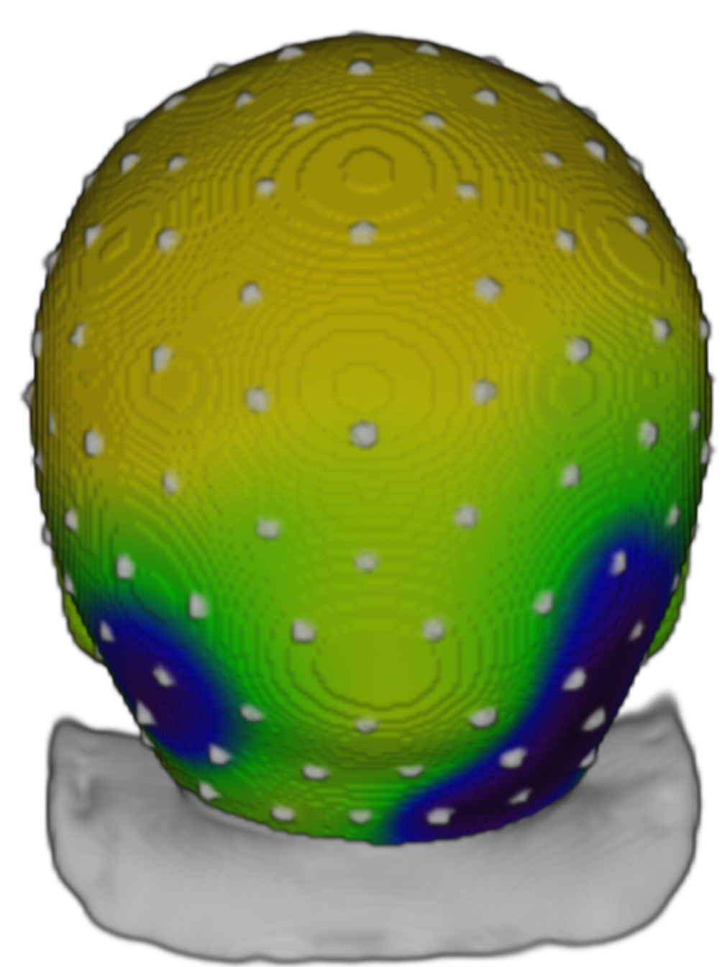
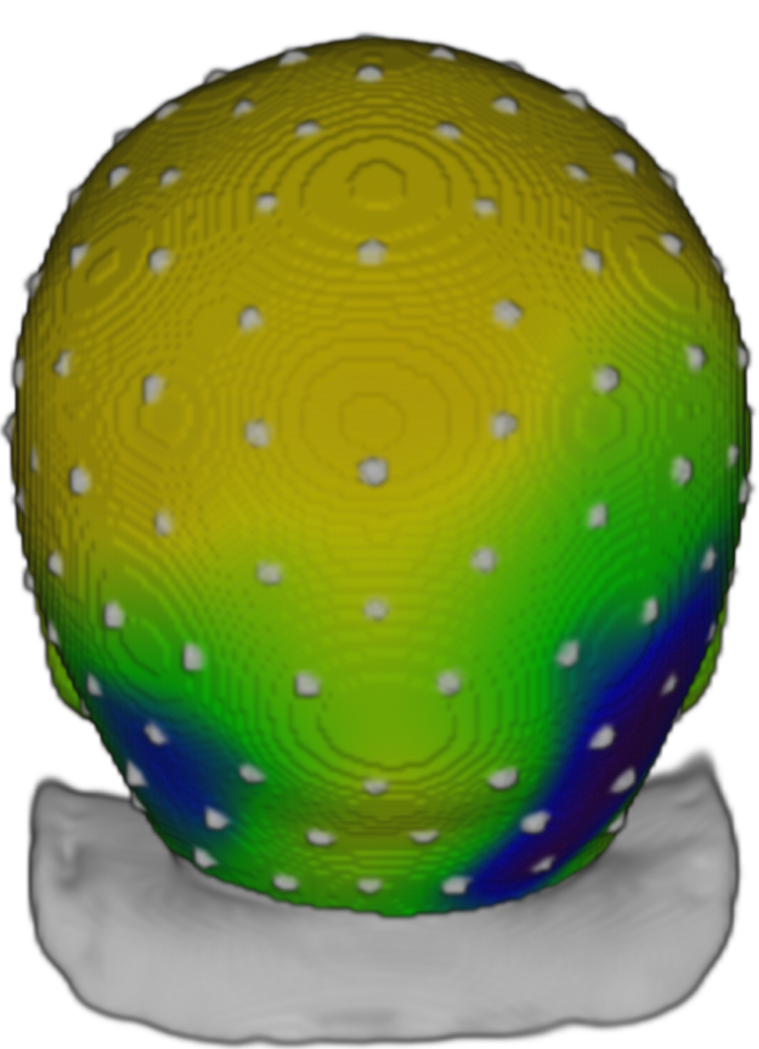
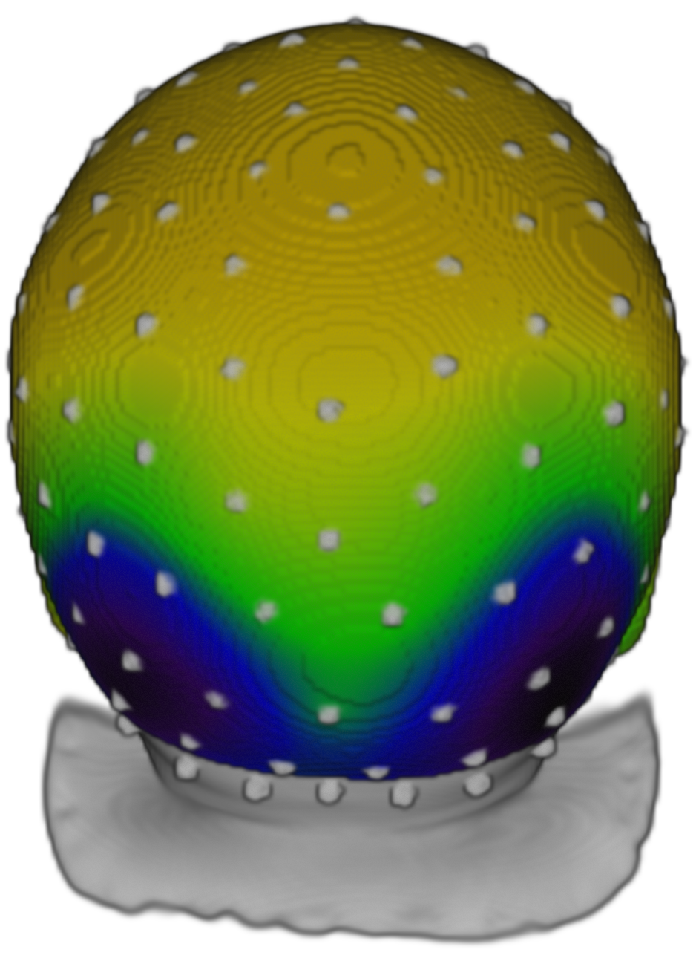
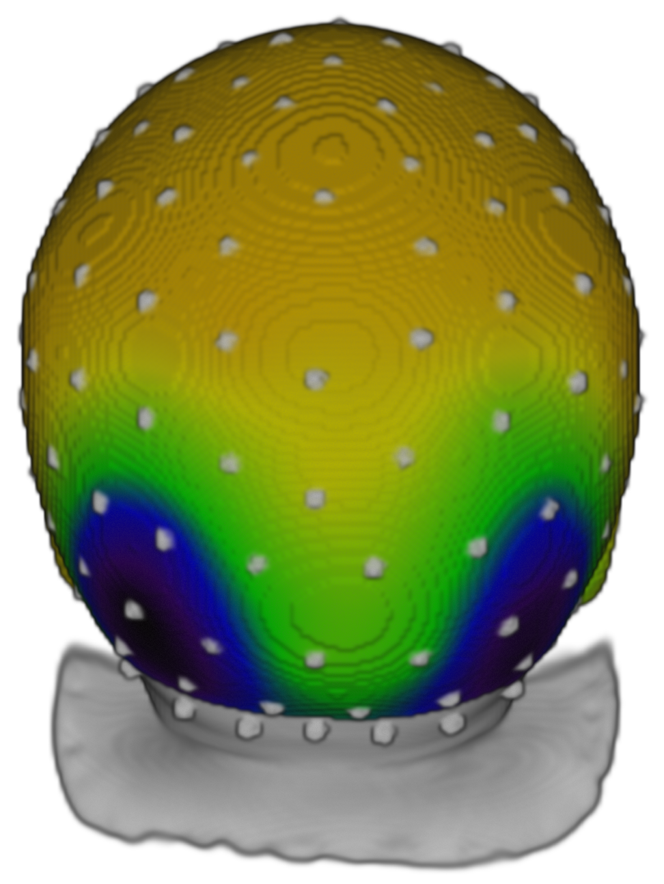
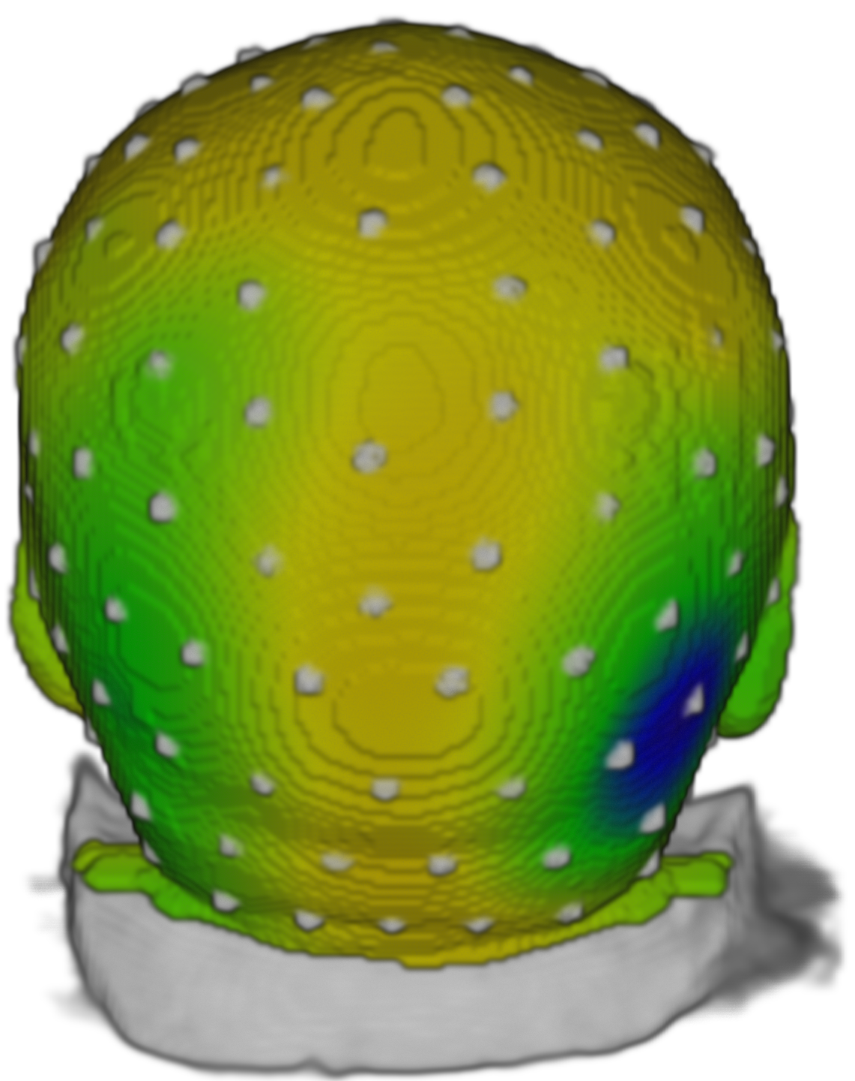
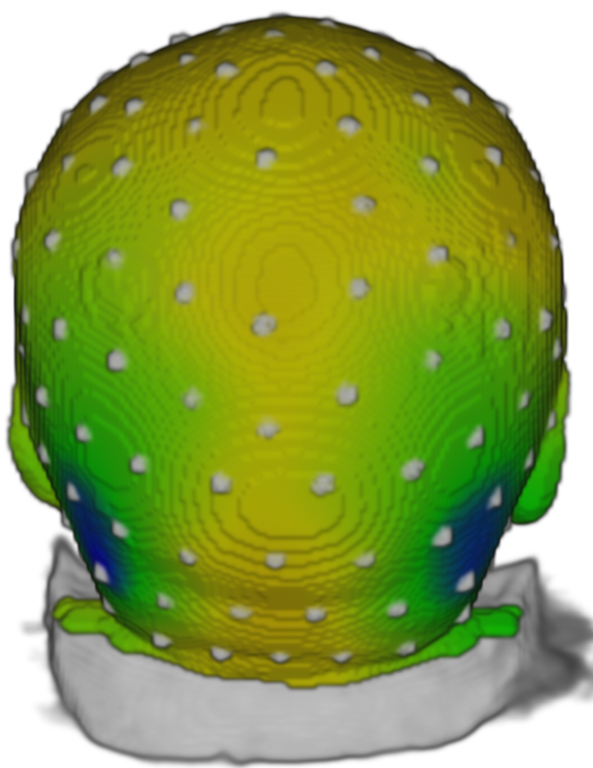
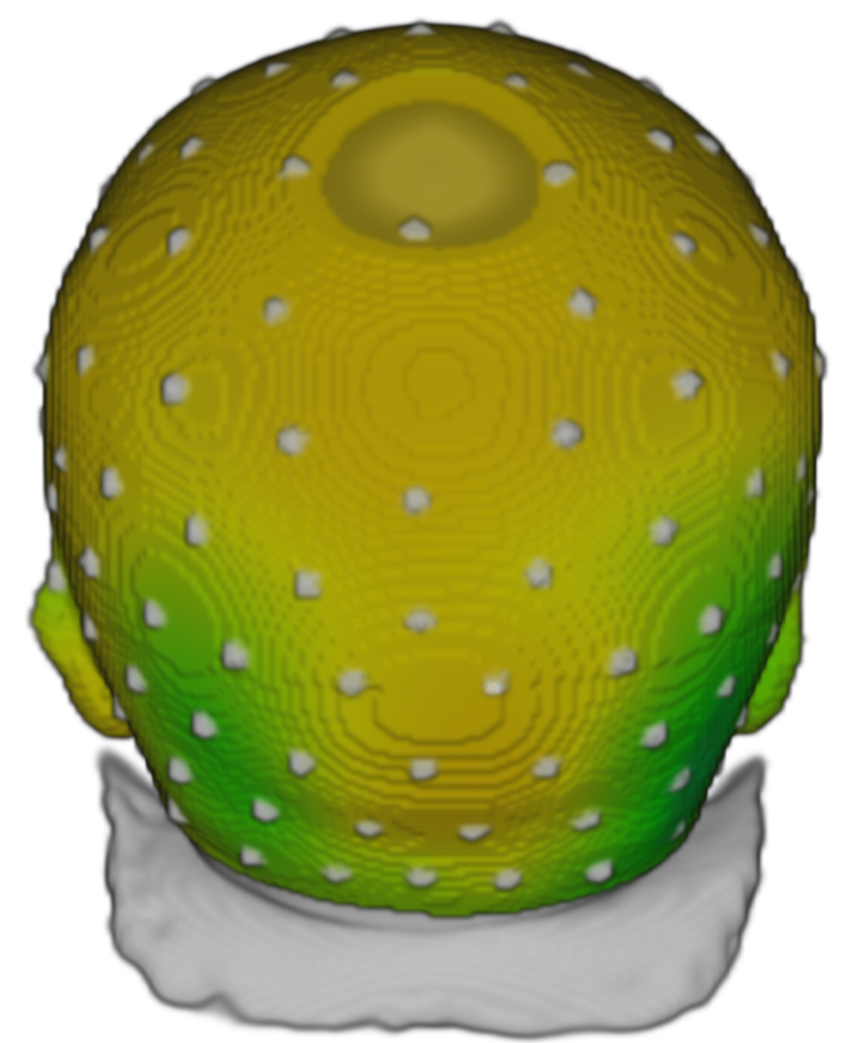
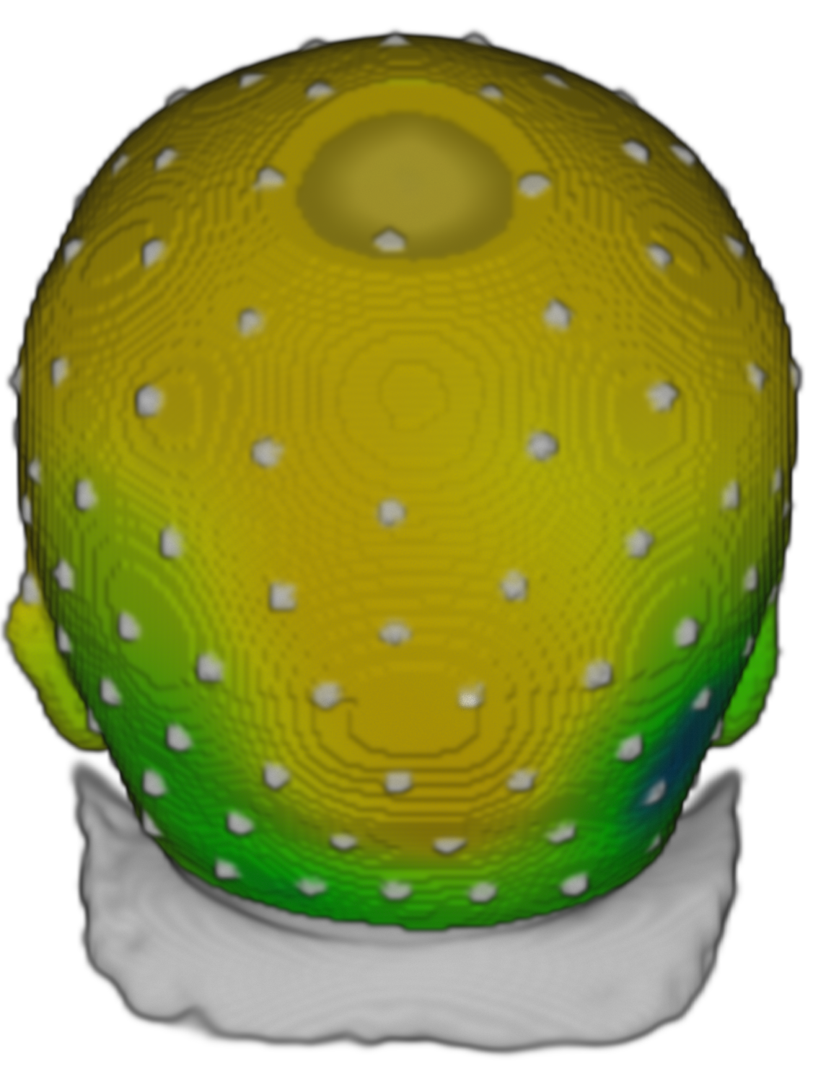
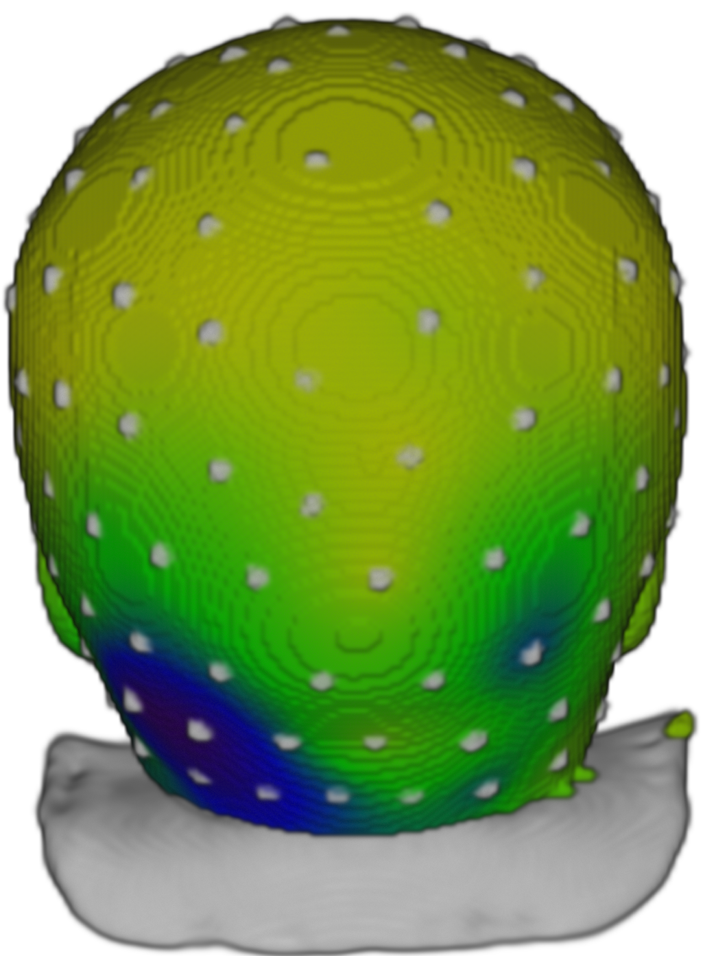
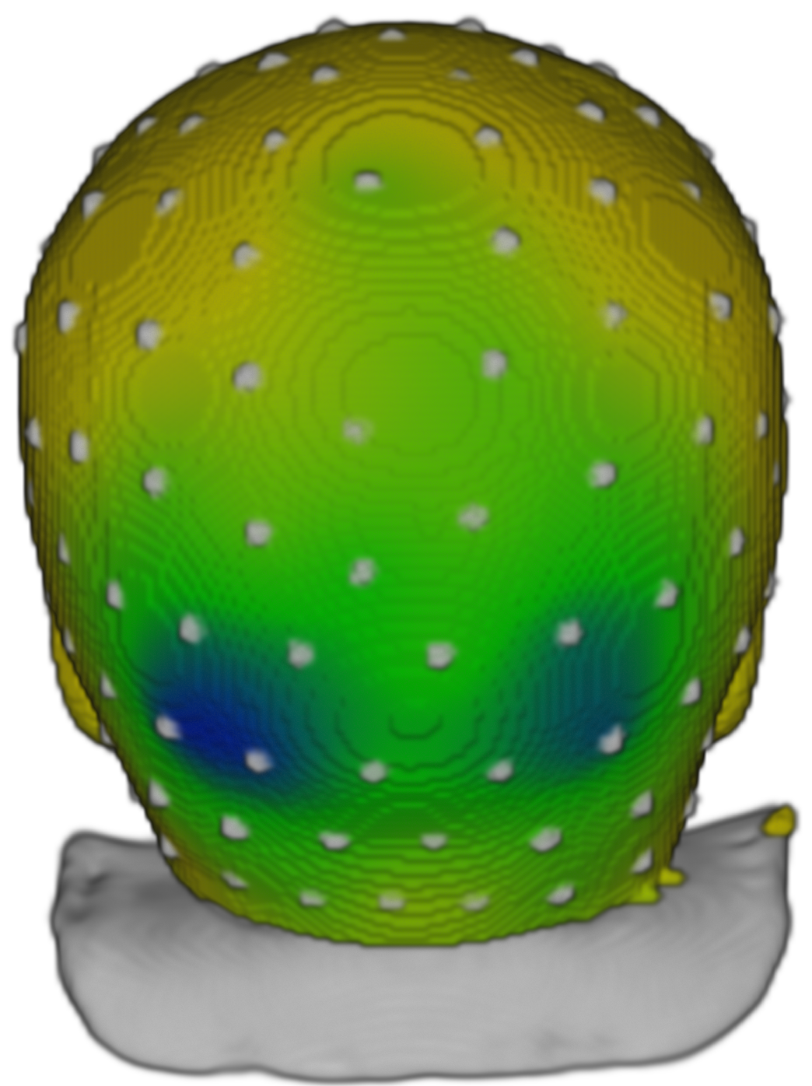
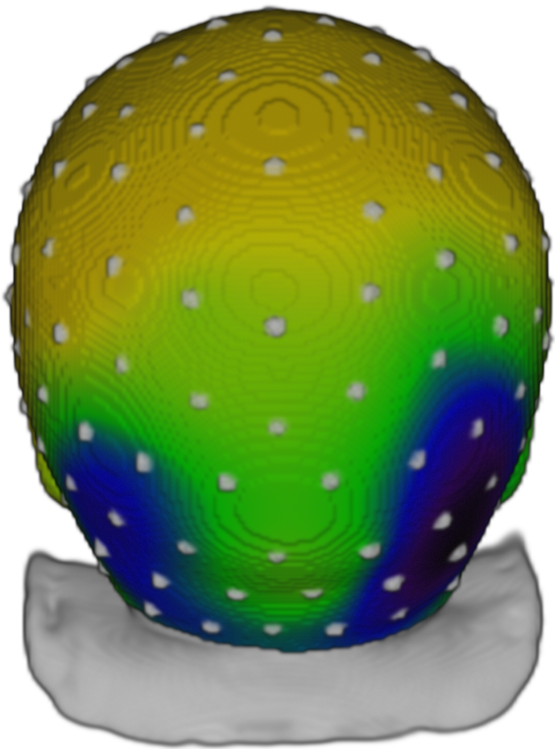
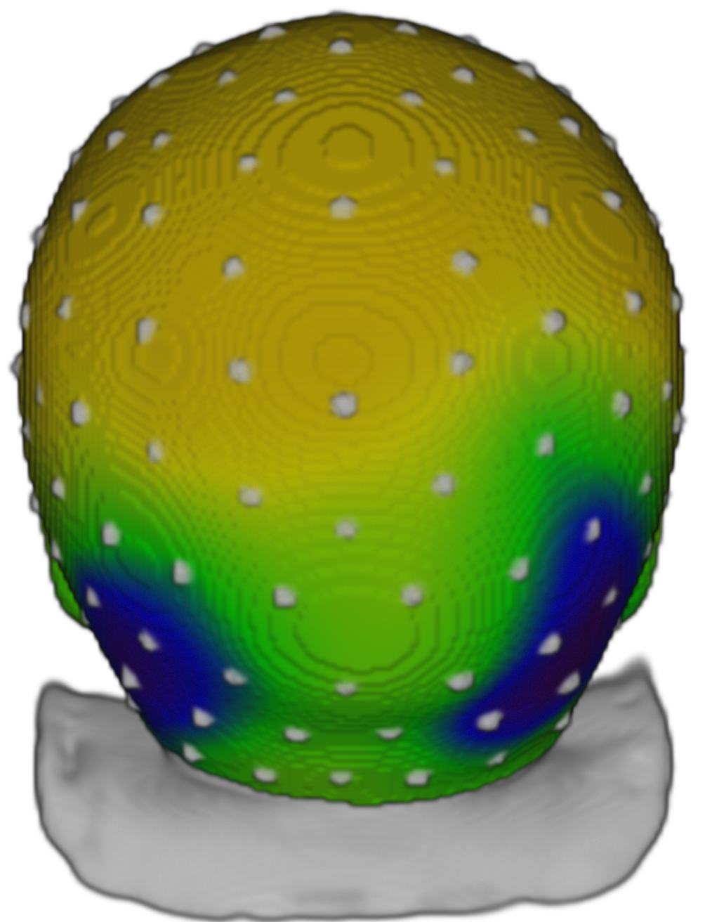
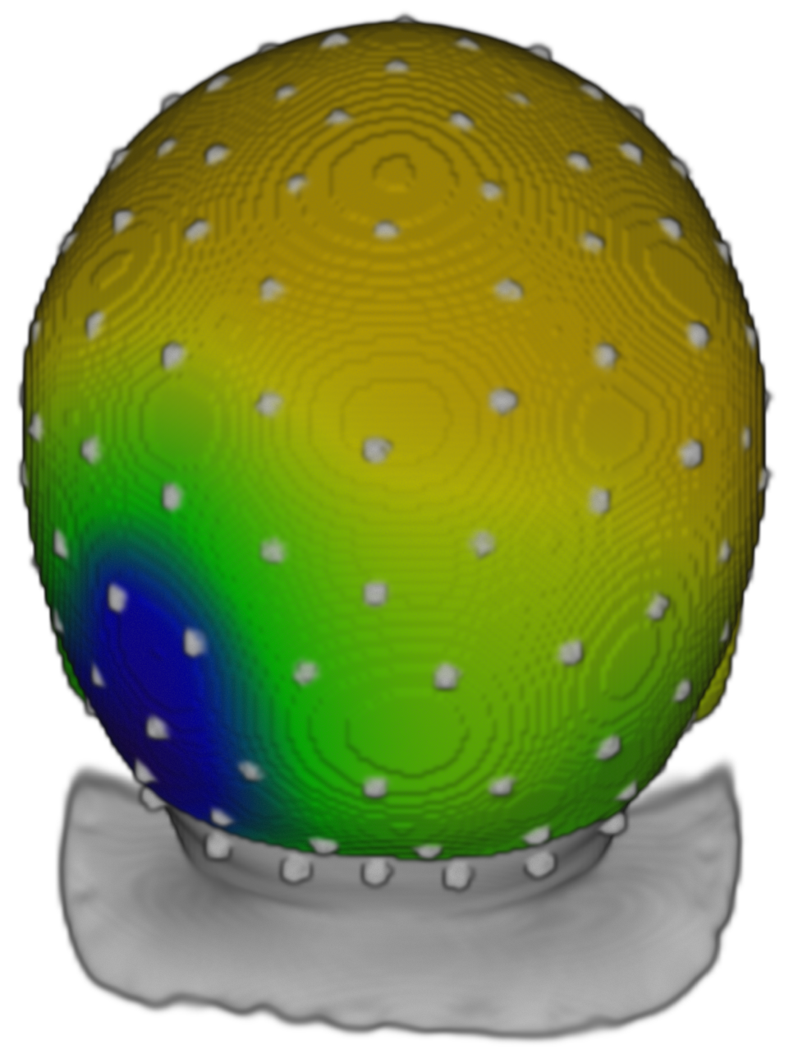
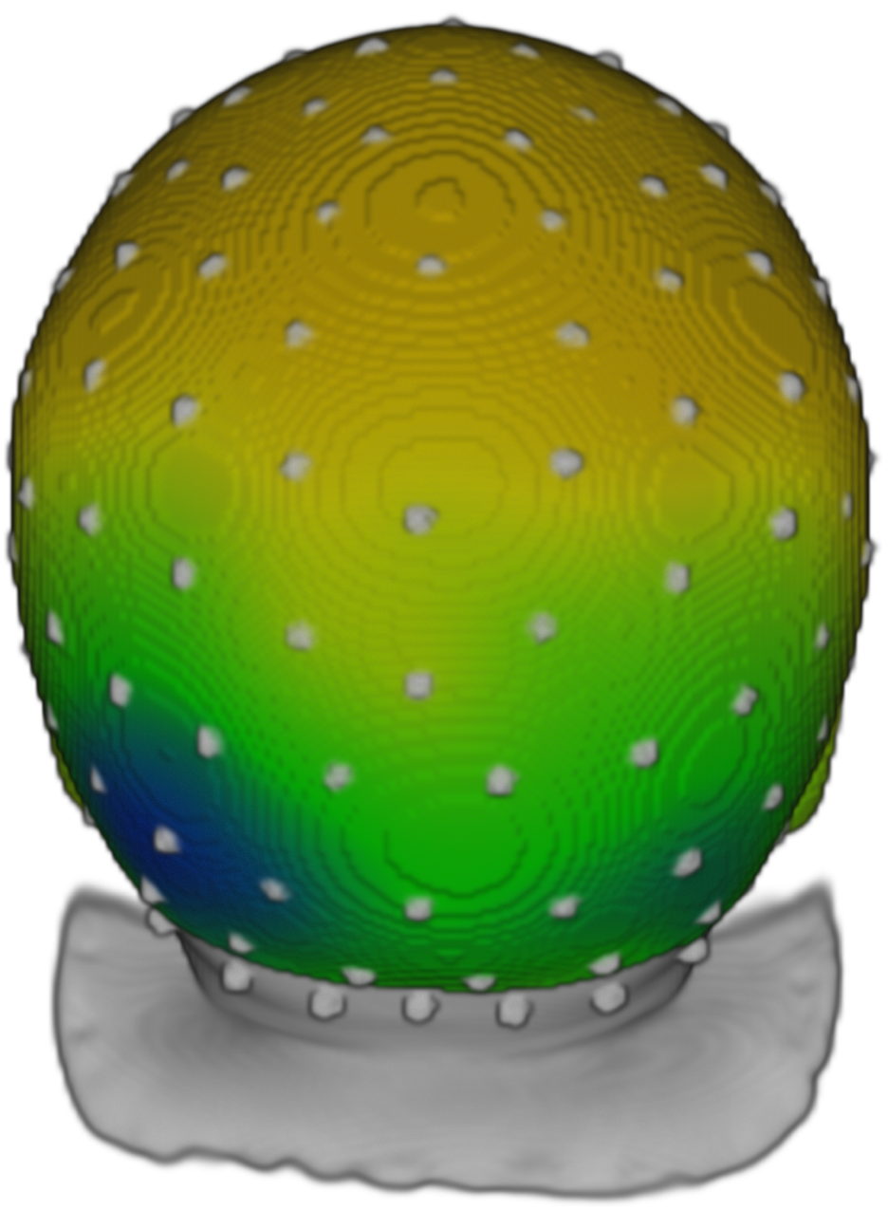
Results
3 mos
4.5 mos
6 mos
8 mos
12 mos
UF
IF
UH
IH
N290
Upright Inverted
Upright Inverted
Upright Inverted
Upright Inverted
Upright Inverted
Face
House
UF < UH
p < .0001
UF < IF
p = .0002
IF > IH
p < .0001
UF < IF
p < .0001
UH > IH
p < .0001
UH < IH
p = .0048
UF > UH
p = .0063
UF < UH
p < .0001
IF < IH
p < .0001

Slide 11
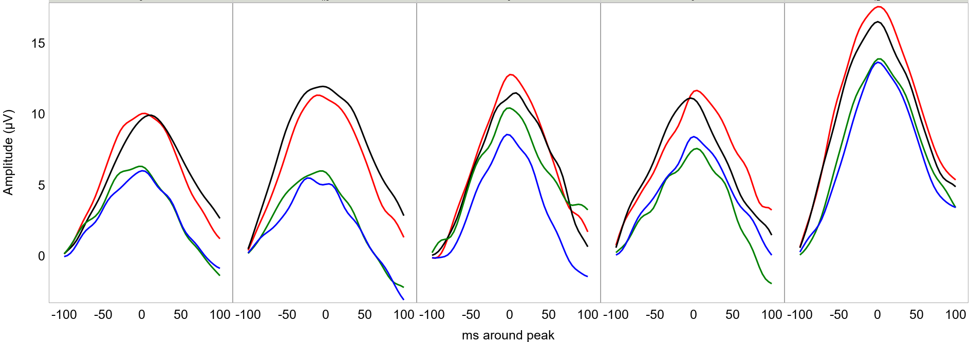
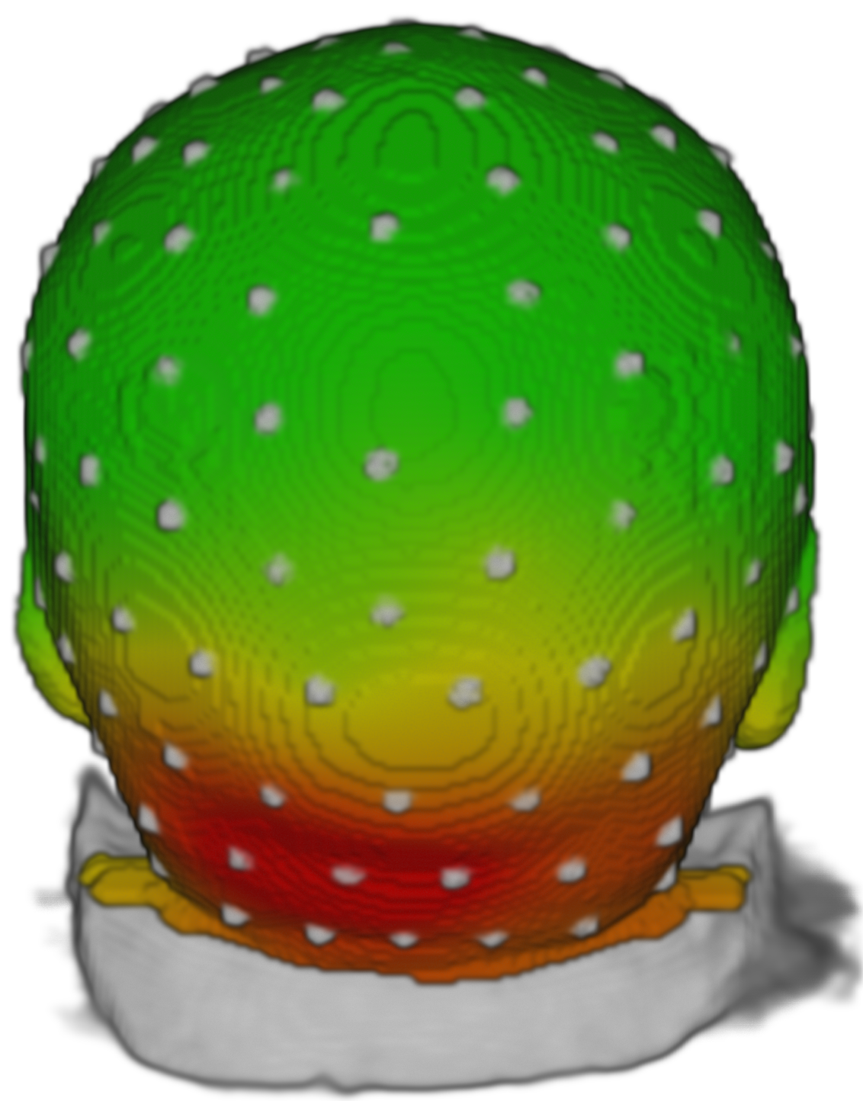
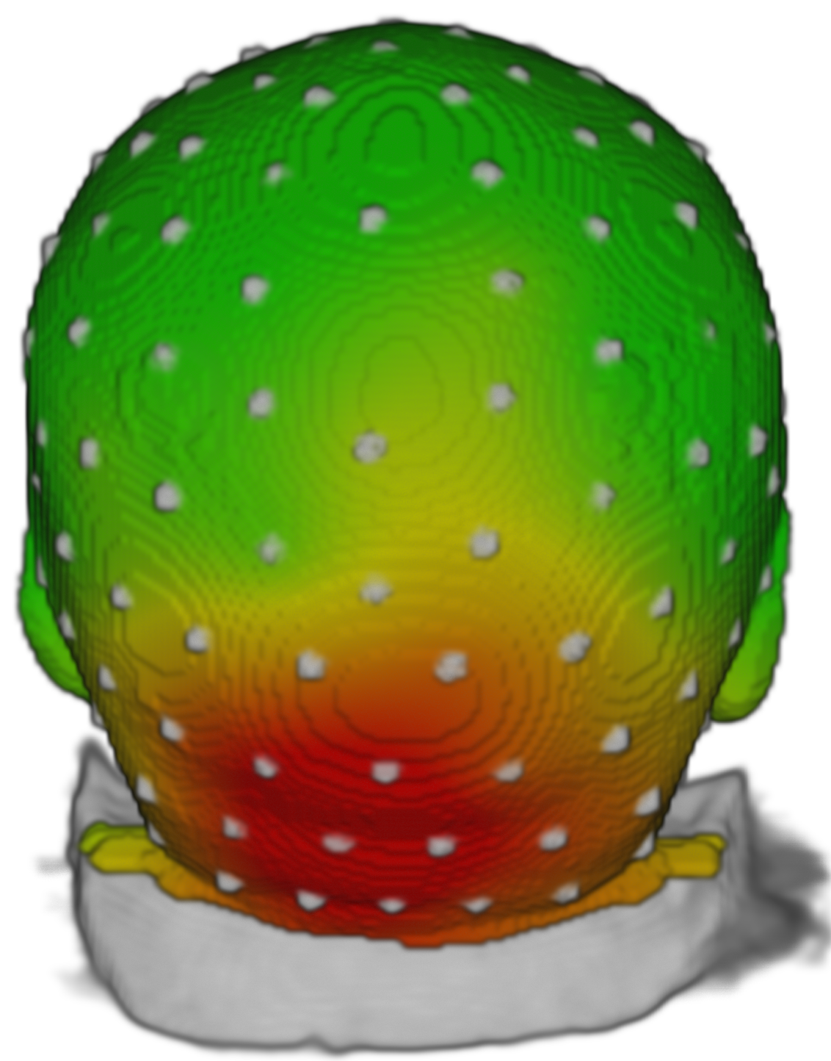
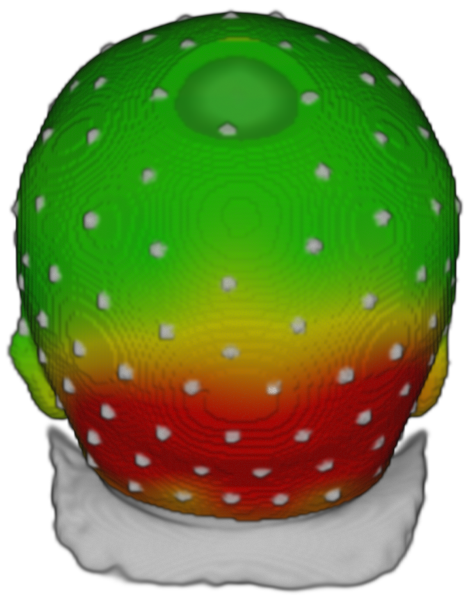
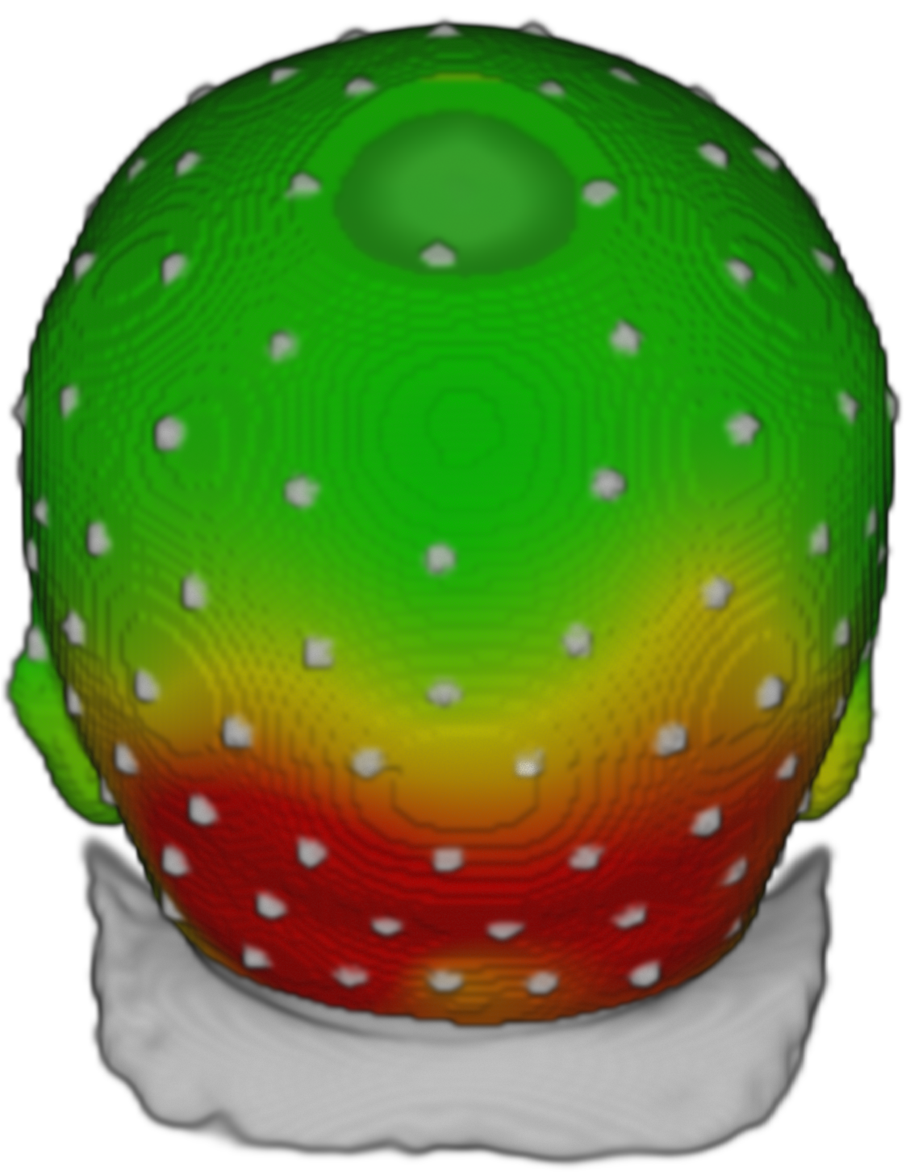
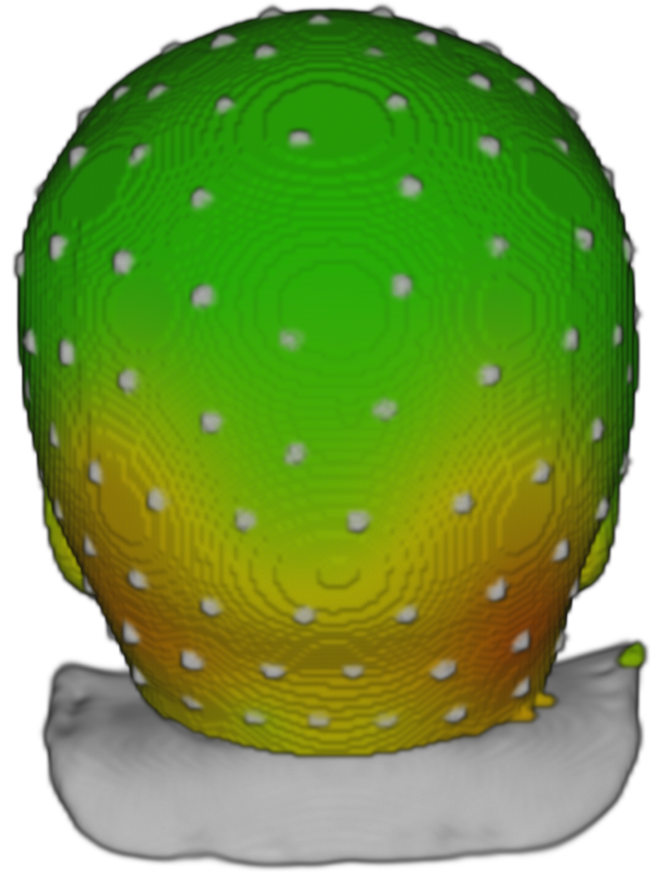
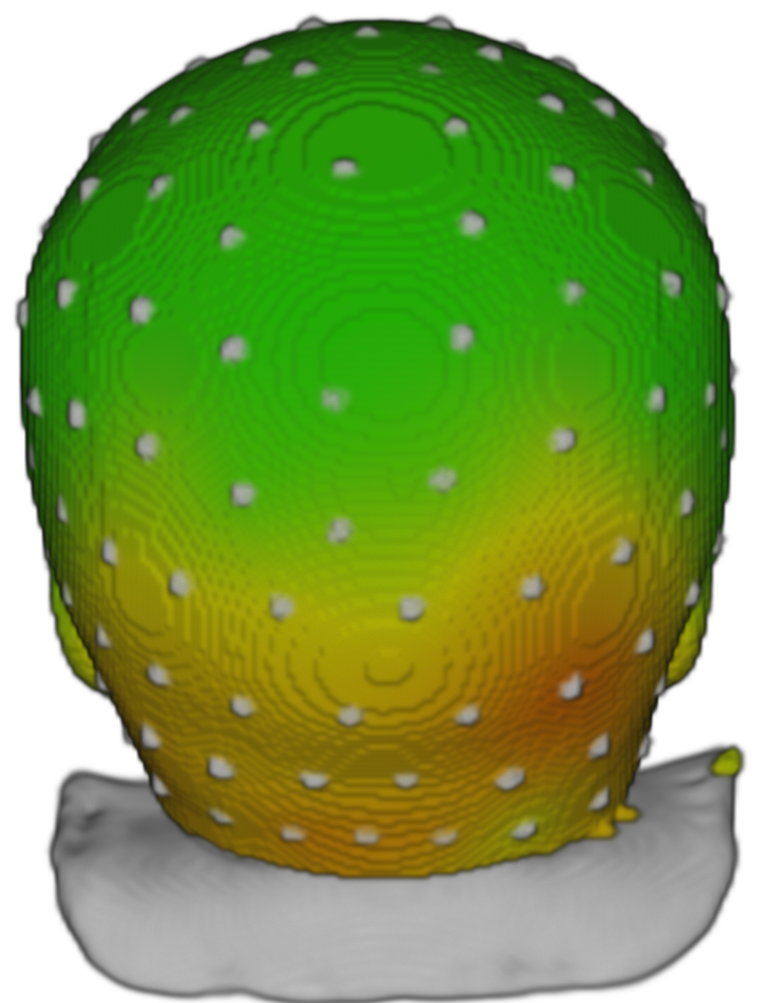
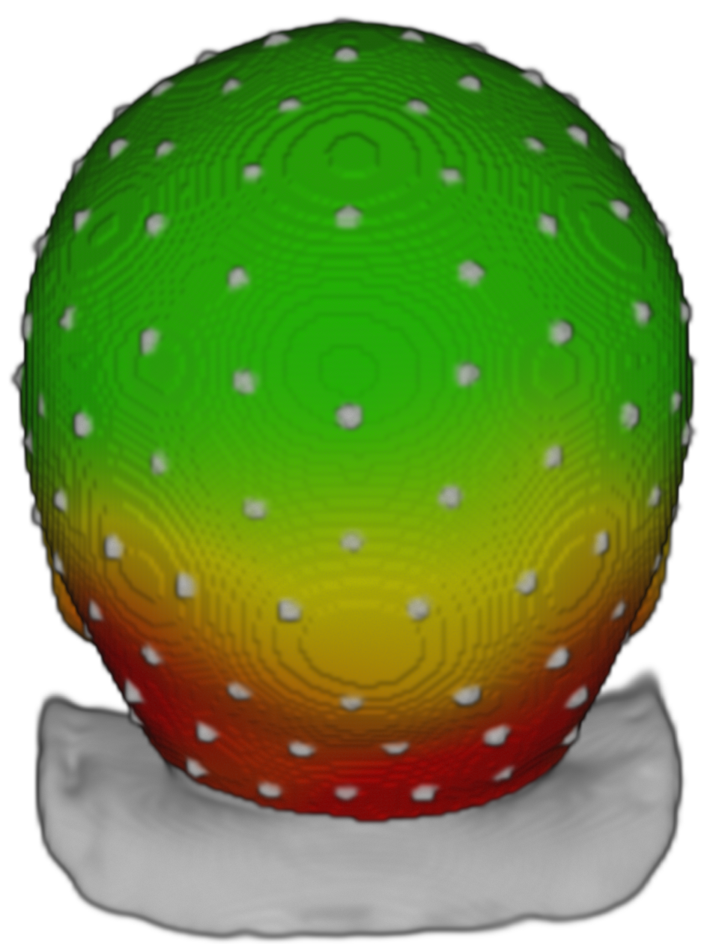
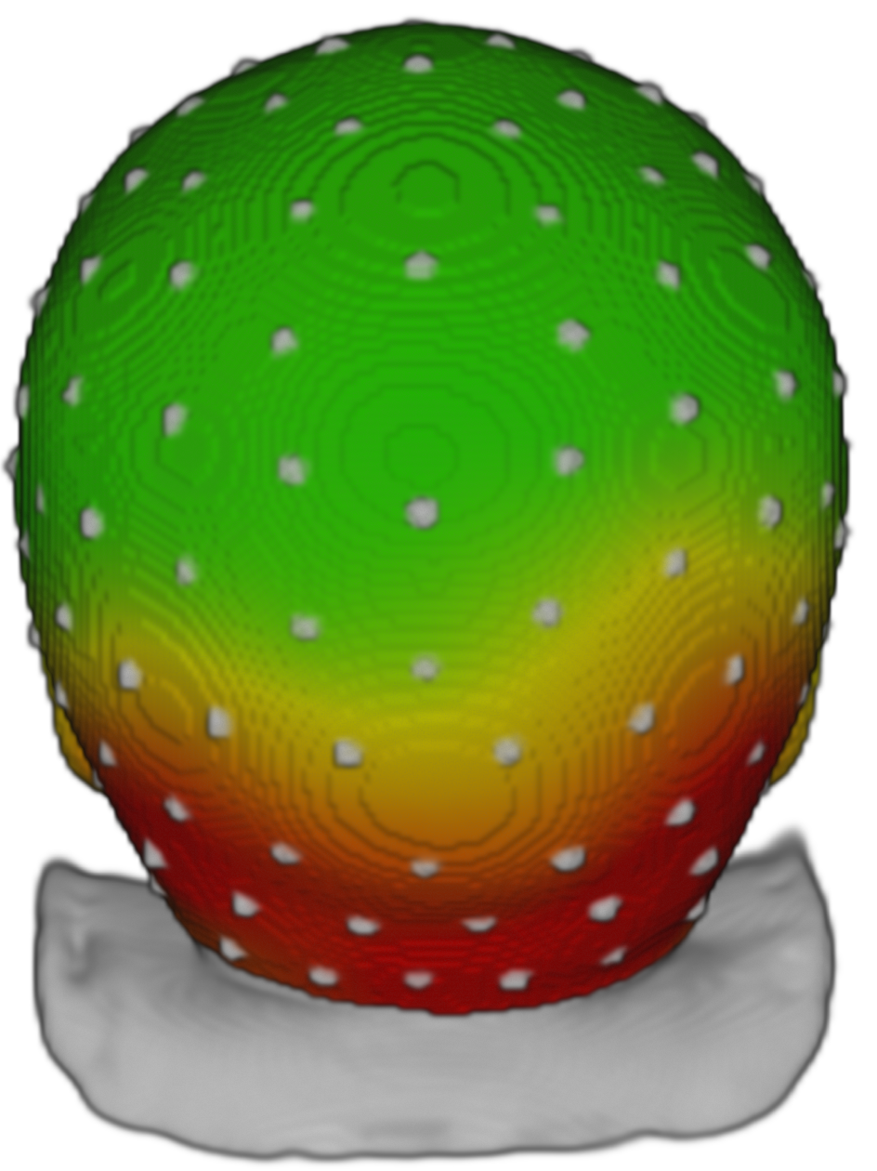












Results
P400
UF
IF
UH
IH
3 mos
4.5 mos
6 mos
8 mos
12 mos
Upright Inverted
Upright Inverted
Upright Inverted
Upright Inverted
Upright Inverted
Face
House
UF > UH
p < .0001
IF > IH
p < .0001
UF > UH
p < .0001
IF > IH
p < .0001
UF > UH
p < .0001
IF > IH
p = .0039
UF > UH
p < .0001
IF > IH
p < .0001
UF > UH
p < .0001
IF > IH
p < .0001
UF < IF
p = .0047

Slide 12


Results
Source Analysis
N290
12 mos
UH > IH
p < .0001
UF > UH
p < .0001
pCC
mFG
P400
12 mos
UF > UH
p = .0095
IF > UF
p = .0060
UH > IH
p = .0007
pCC
mFG
UF > UH
p < .0001
IF > UF
p < .0001

Slide 13



Preliminary findings suggest a larger N290 in response to upright faces than inverted faces in young infants (i.e., 3- and 4.5-month-olds)
Preliminary Results
By 12 months of age the N290 shows larger negativity in response to faces than houses, regardless of the stimulus orientation
Conclusion
Larger P400 amplitudes are recorded in response to faces than houses across ages. Only 12-month-old infants show a face-specific inversion effect with larger P400 amplitude in response to inverted than upright faces.
The middle Fusiform Gyrus (mFG) shows larger responses to upright faces than houses at 12 months of age. The P400 source shows an inversion effect for faces in the mFG and for both faces and houses in the posterior Cingulate Cortex (pCC).

Slide 14

References
Conte, S., Richards, J. E., Guy, M. W., Xie, W., & Roberts, J. E. (2020). Face-sensitive brain responses in the first year of life. NeuroImage, 211, 116602.
De Haan, M., Johnson, M. H., & Halit, H. (2003). Development of face-sensitive event-related potentials during infancy: A review. International Journal of Psychophysiology, 51(1), 45–58.
Eimer, M. (2000). Effects of face inversion on the structural encoding and recognition of faces - Evidence from event-related brain potentials. Cognitive Brain Research, 10(1–2), 145–158.
Guy, M. W., Richards, J. E., Tonnsen, B. L., & Roberts, J. E. (2018). Neural correlates of face processing in etiologically-distinct 12-month-old infants at high-risk of autism spectrum disorder. Developmental Cognitive Neuroscience, 29, 61–71.
Guy, M. W., Zieber, N., & Richards, J. E. (2016). The Cortical Development of Specialized Face Processing in Infancy. Child Development, 87(5), 1581–1600.
Halit, H., De Haan, M., & Johnson, M. H. (2003). Cortical specialisation for face processing: Face-sensitive event-related potential components in 3- and 12-month-old infants. NeuroImage, 19(3), 1180–1193.
Peykarjou, S., & Hoehl, S. (2013). Three-Month-Olds’ Brain Responses to Upright and Inverted Faces and Cars. Developmental Neuropsychology, 38(4), 272–280.
Rossion, B., Delvenne, J. F., Debatisse, D., Goffaux, V., Bruyer, R., Crommelinck, M., & Guérit, J. M. (1999). Spatio-temporal localization of the face inversion effect: An event-related potentials study. Biological Psychology, 50(3), 173–189.
Xie, W., McCormick, S. A., Westerlund, A., Bowman, L. C., & Nelson, C. A. (2019). Neural Correlates of Facial Emotion Processing in Infancy. Developmental Science.
Interested in our research?
Infant Development Laboratory
https://infantlab.sc.edu/
Questions?
contes@mailbox.sc.edu
Contacts

