Slide 1

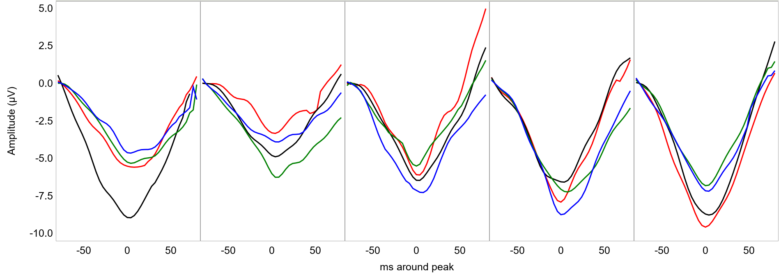



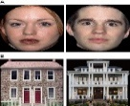
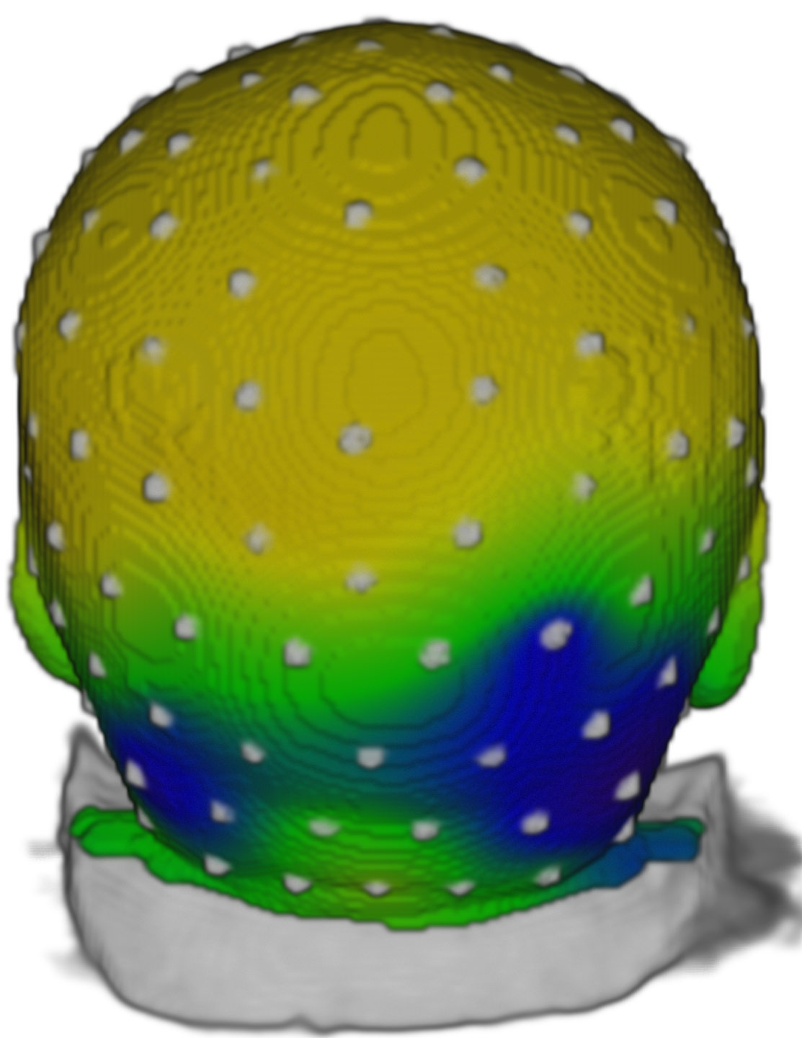
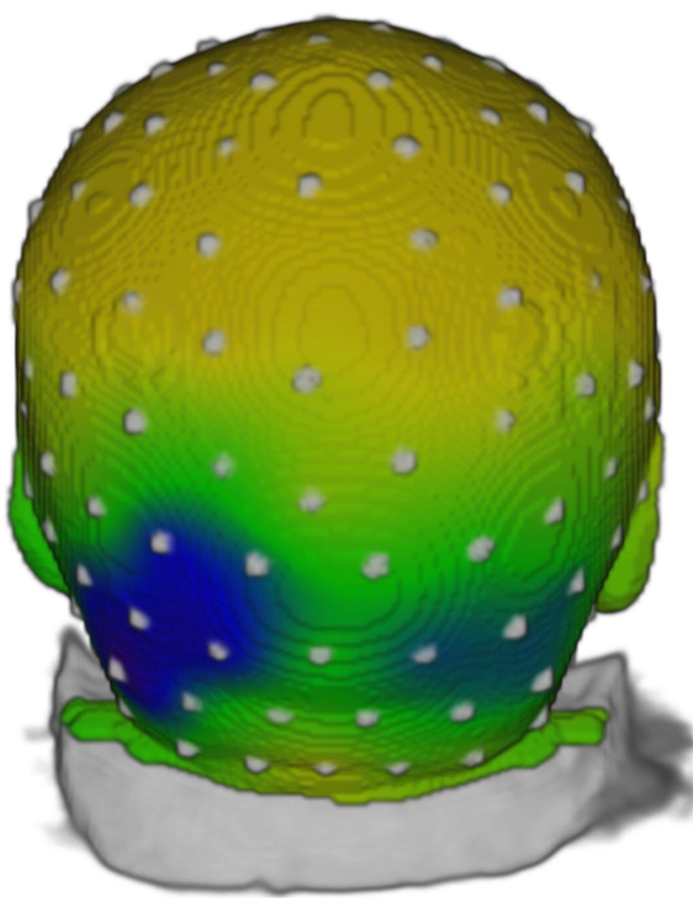
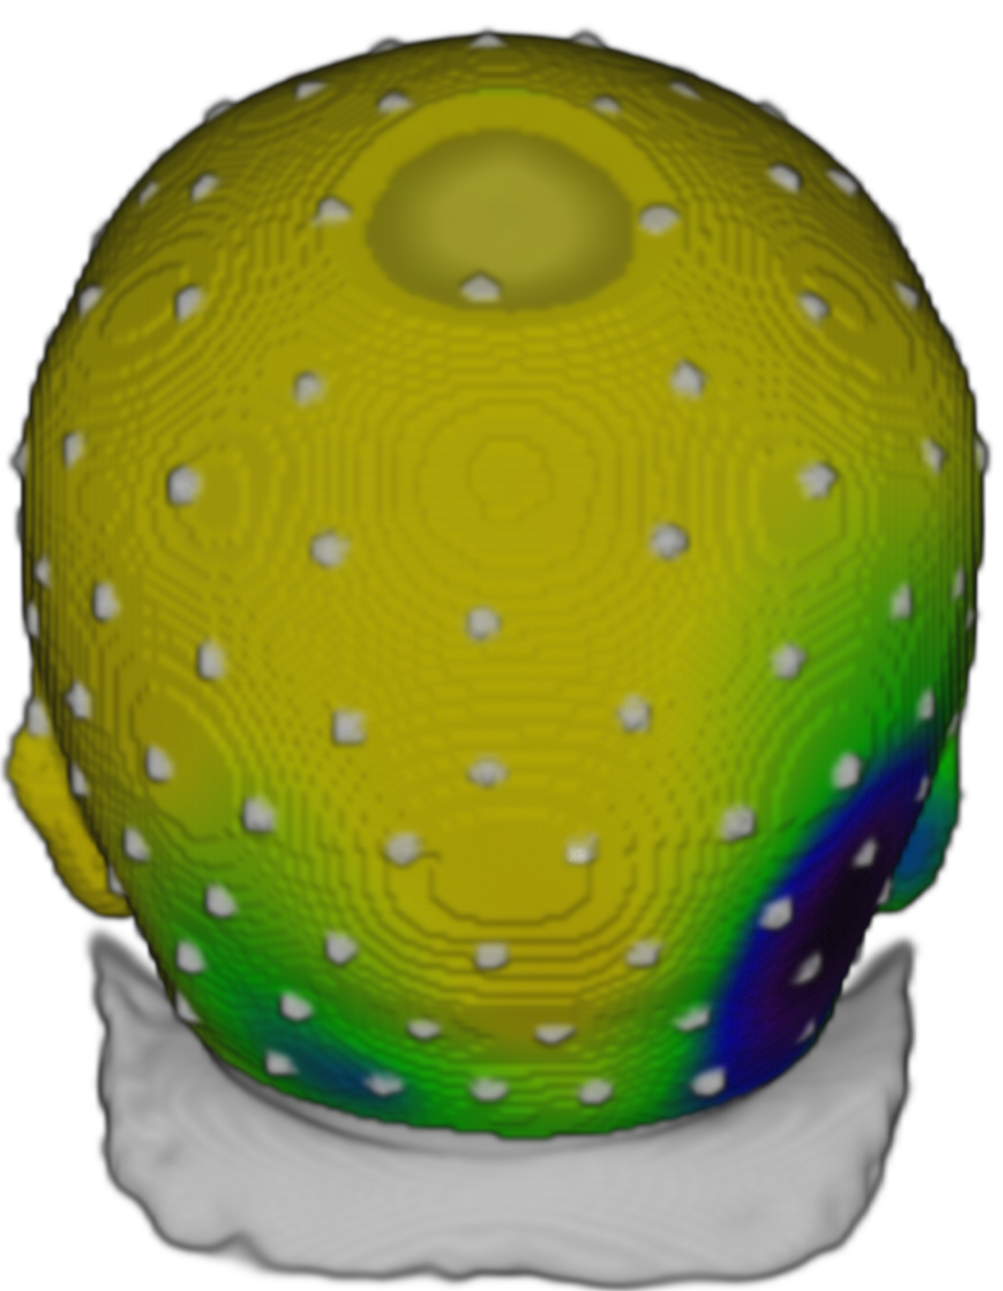
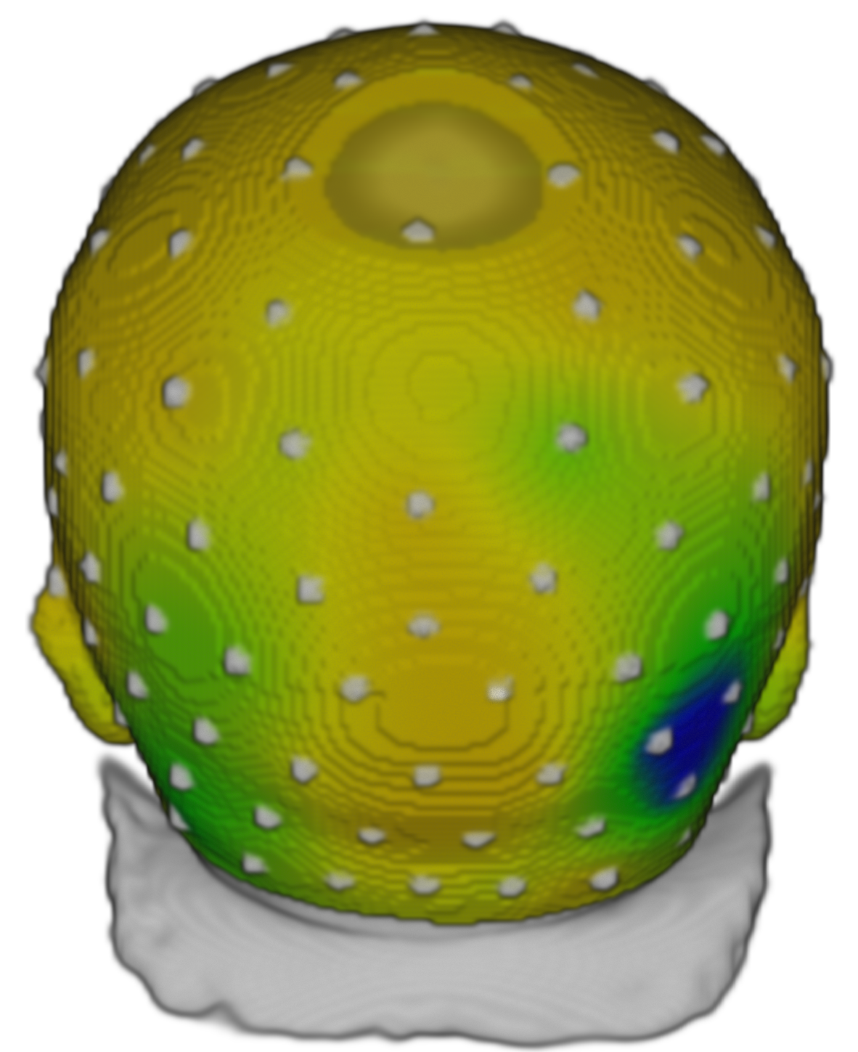
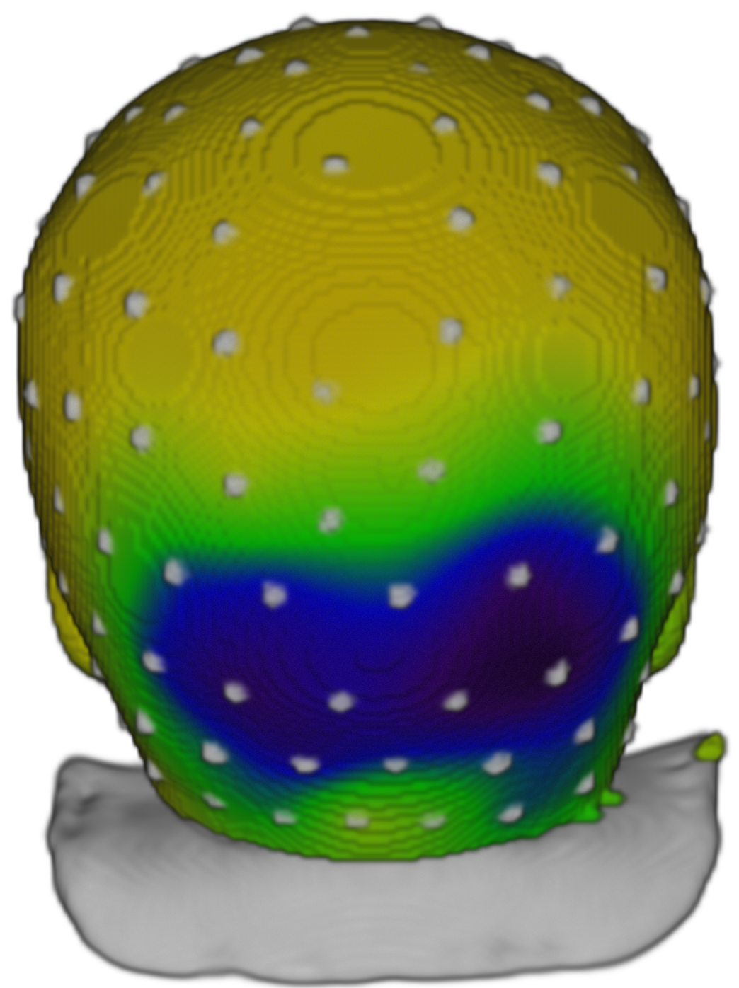
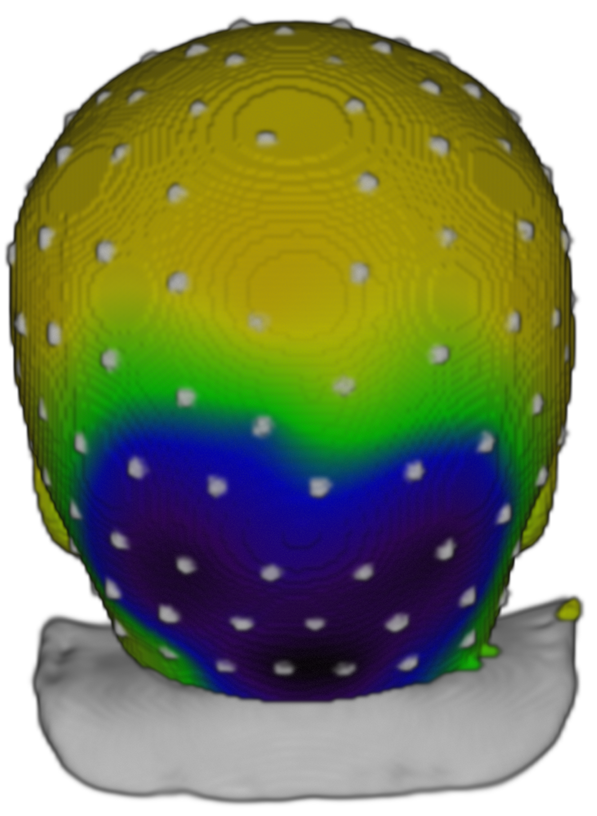
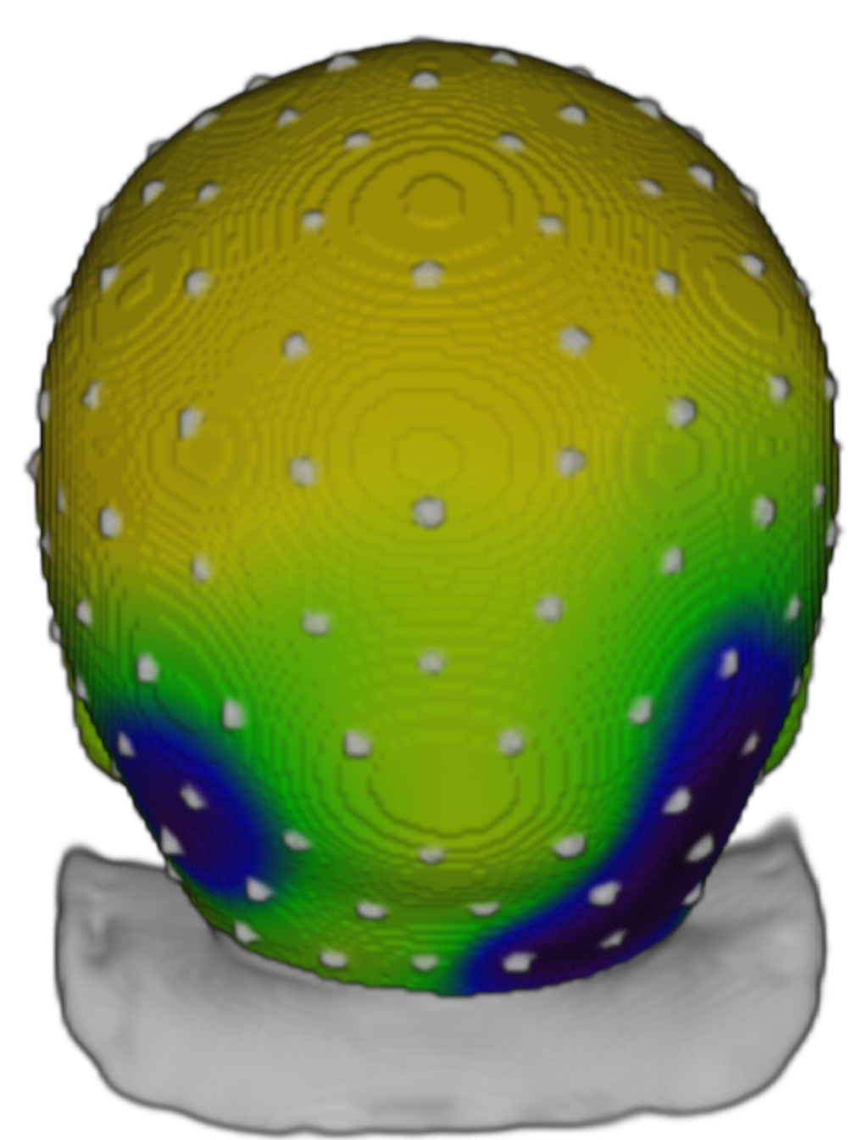
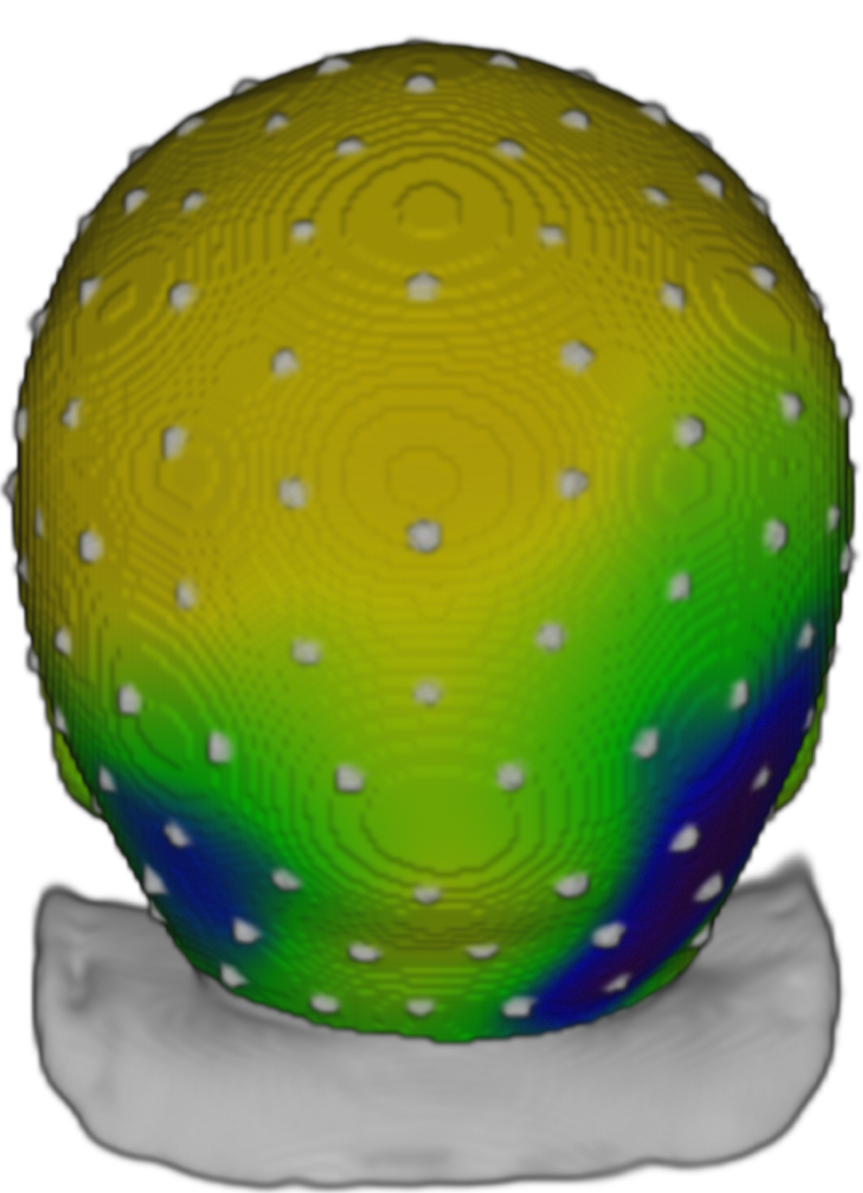
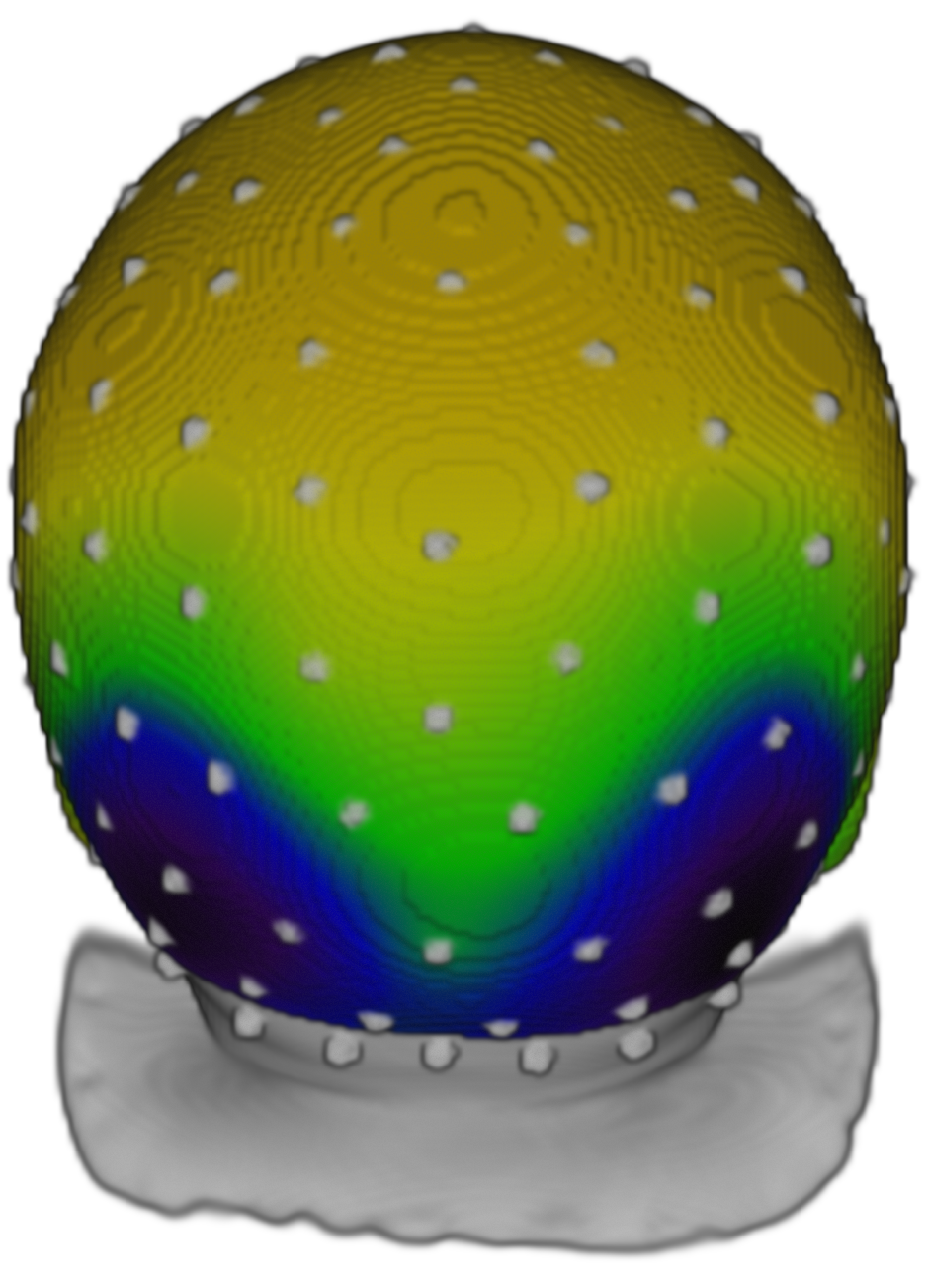
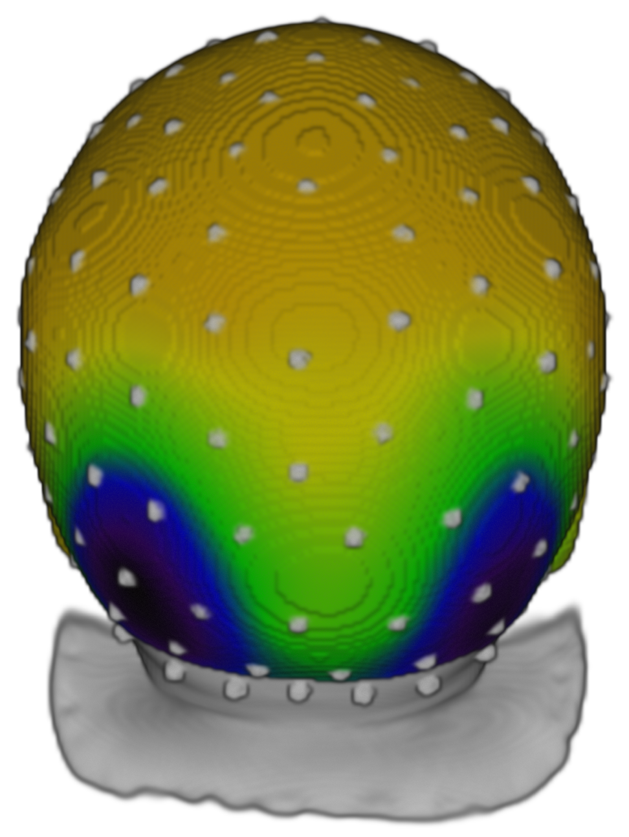
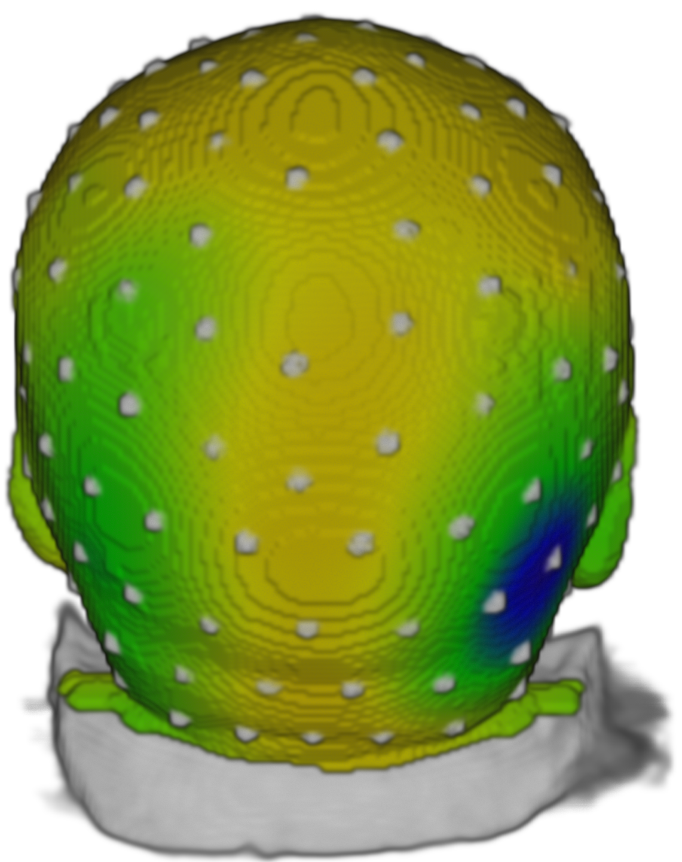
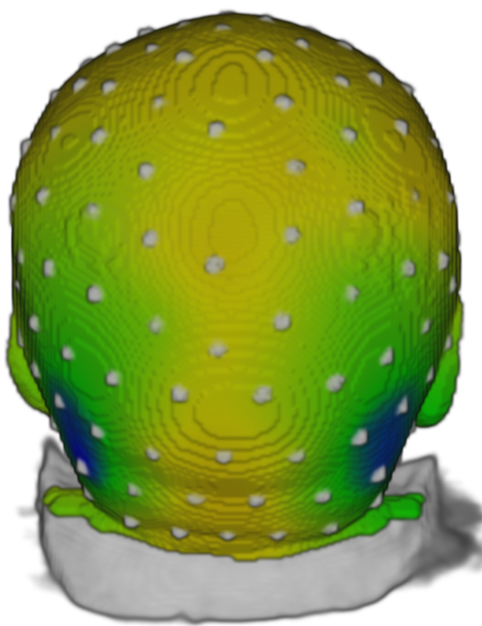
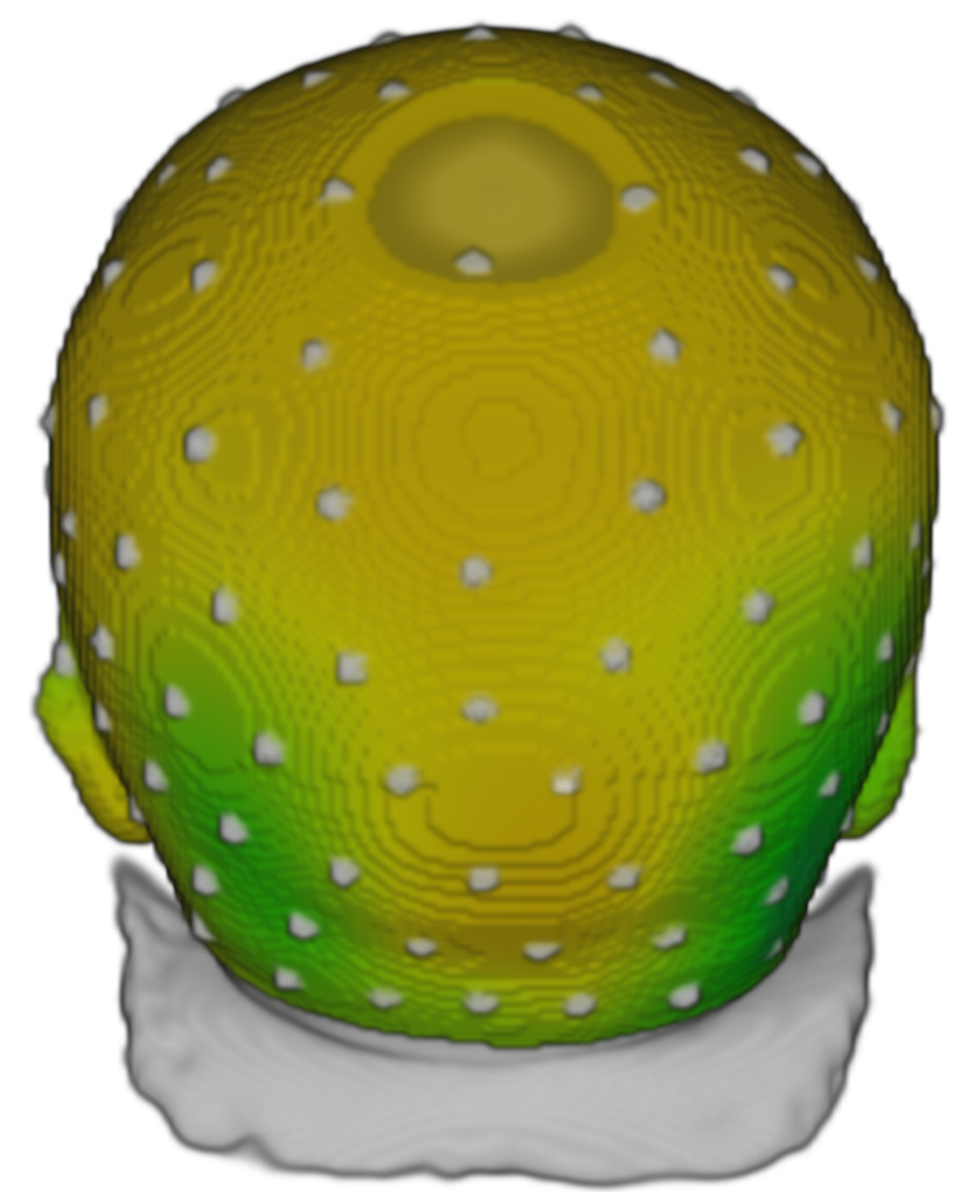
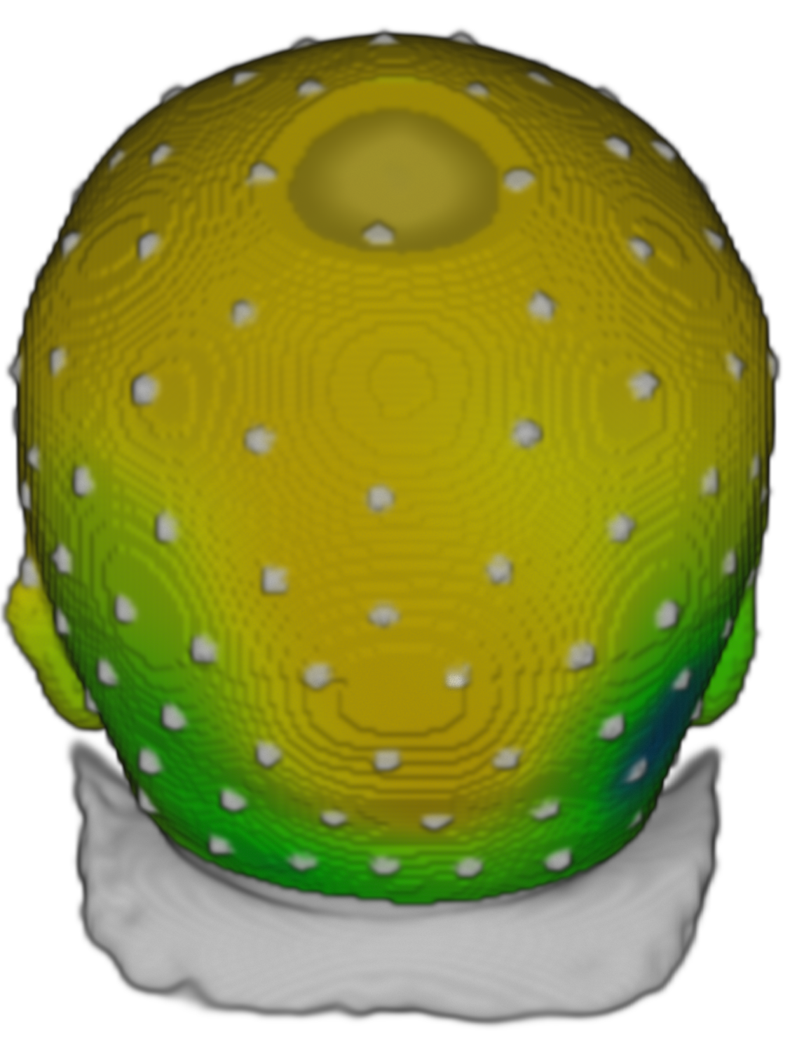
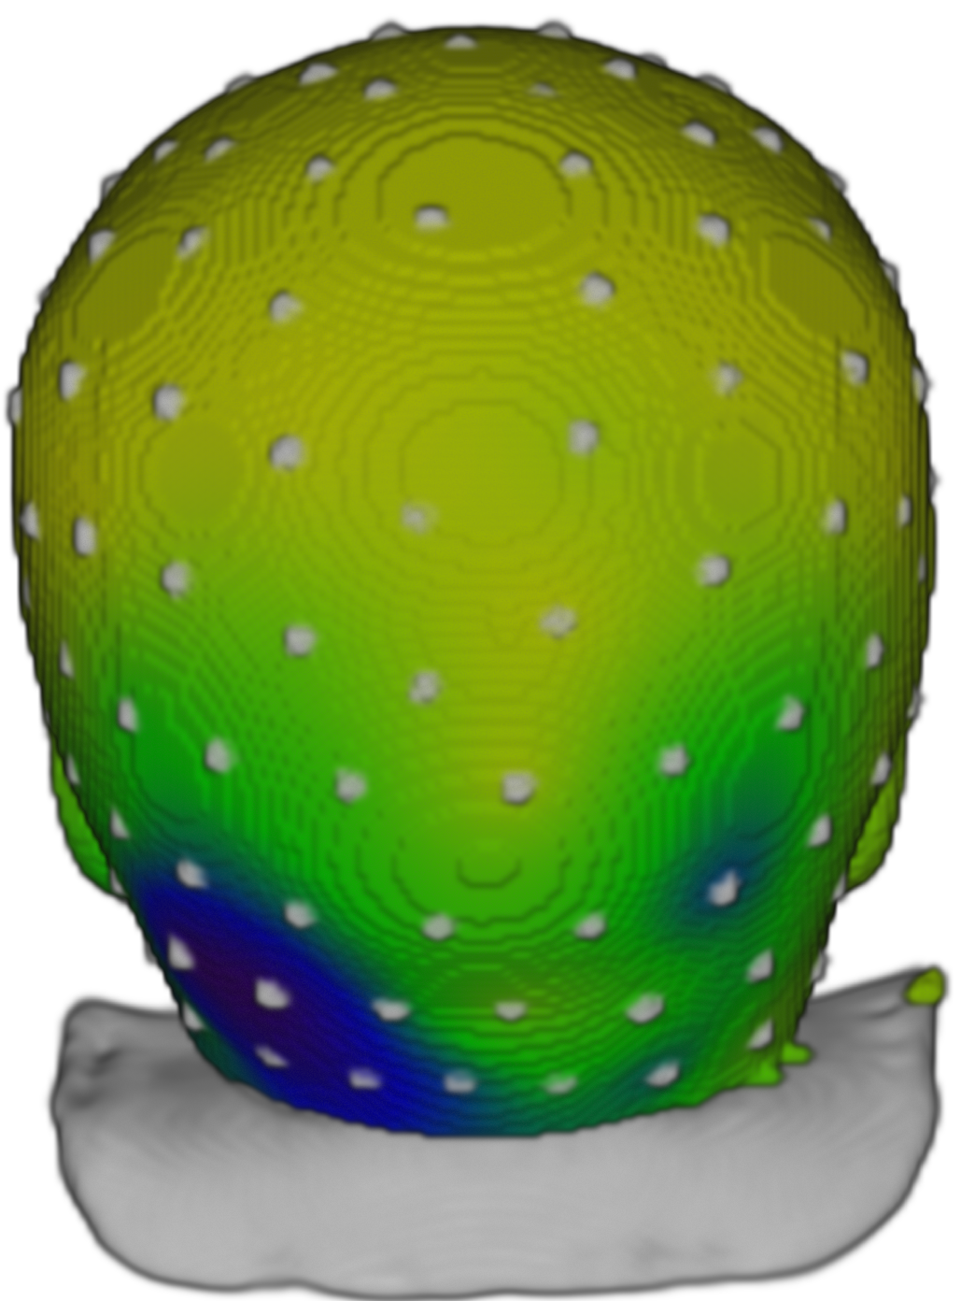
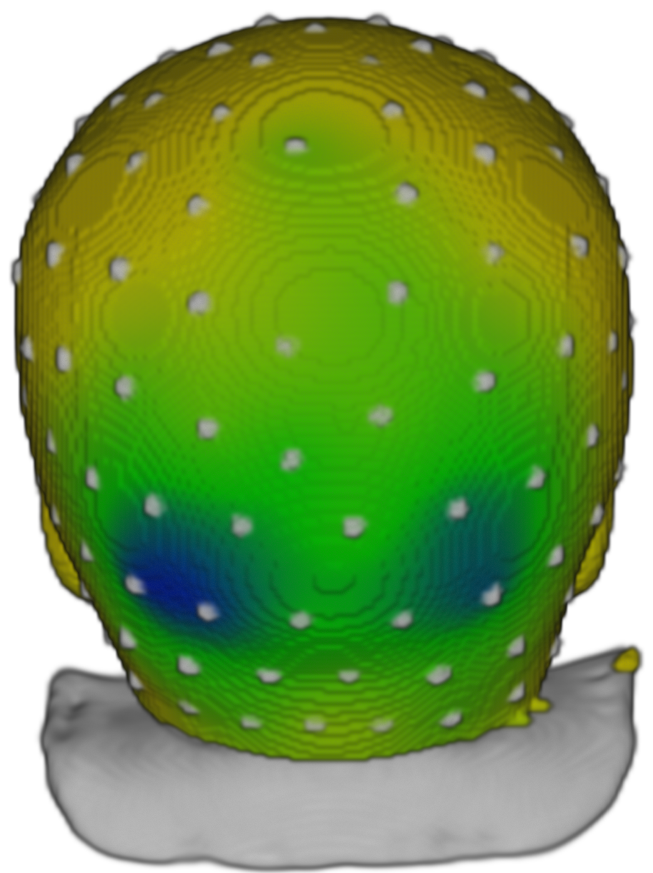
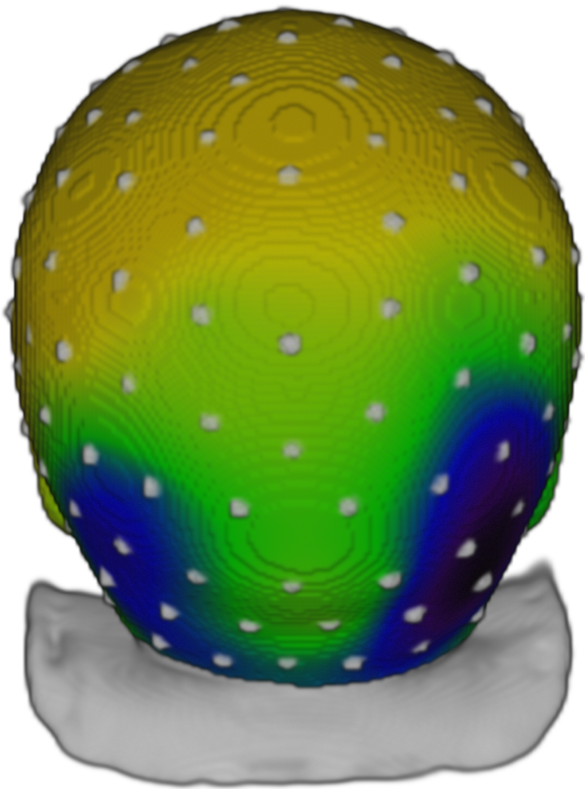
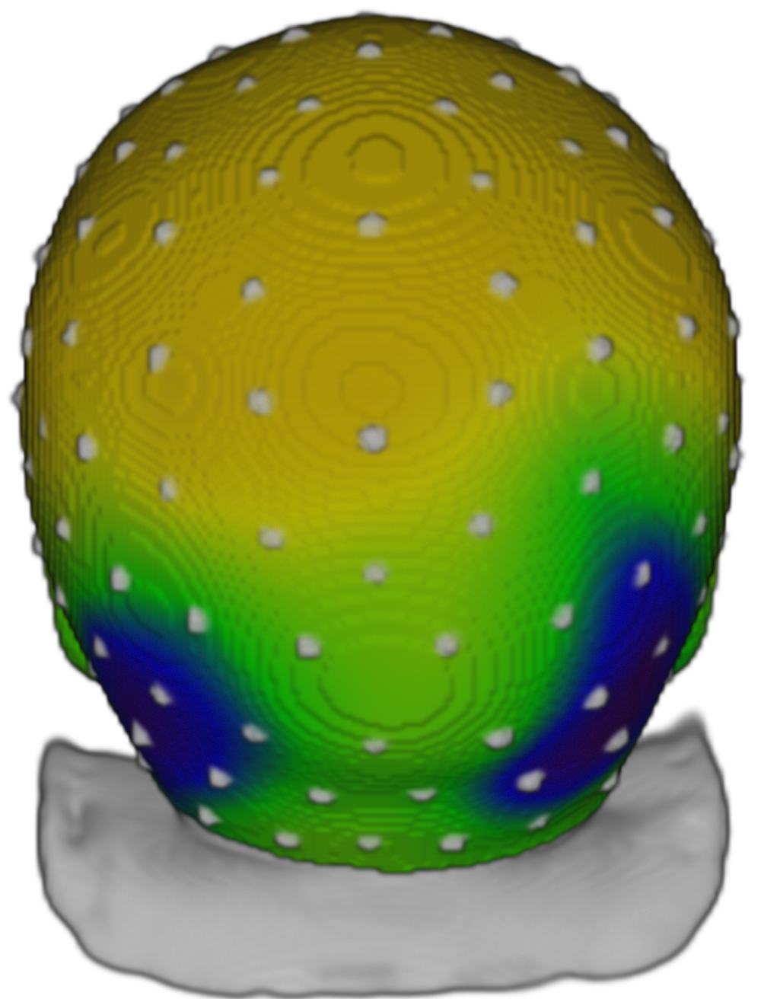
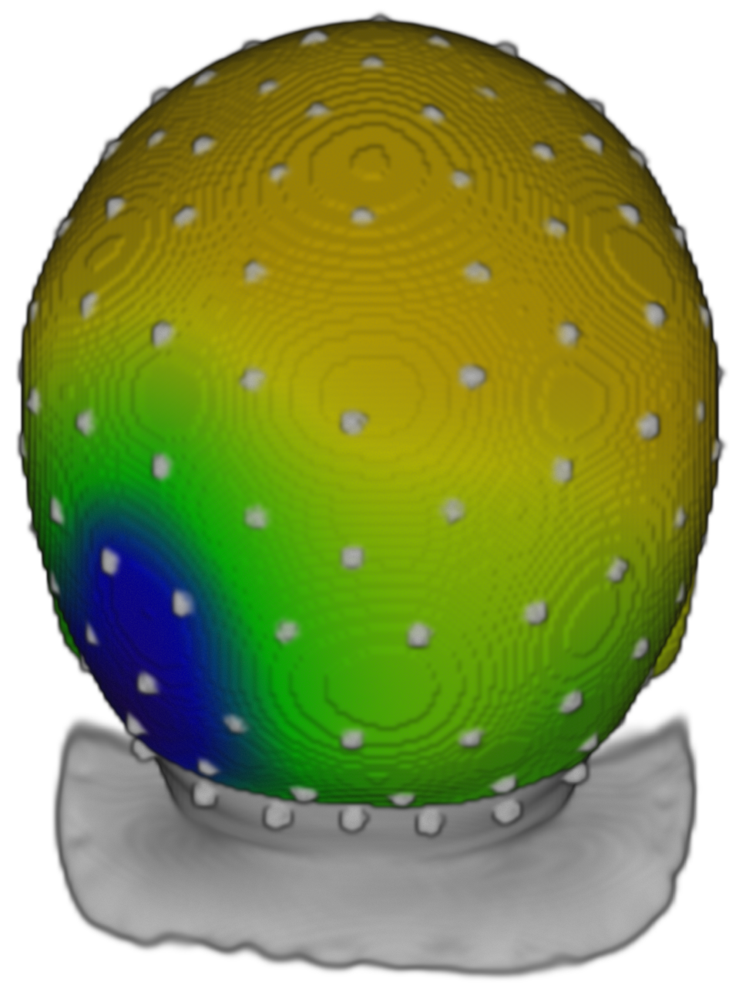
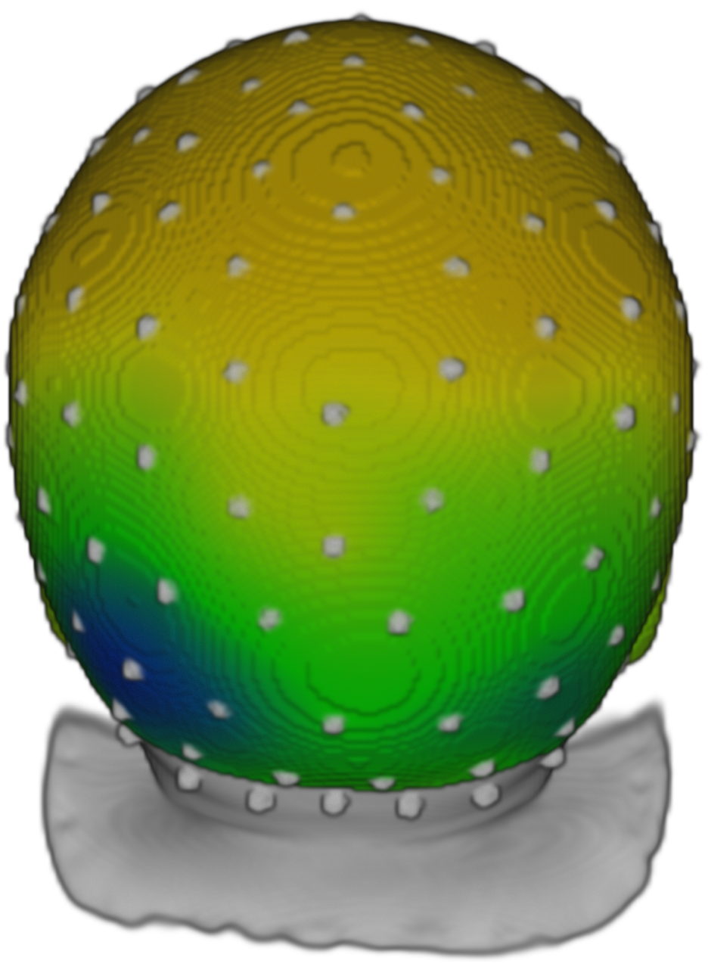
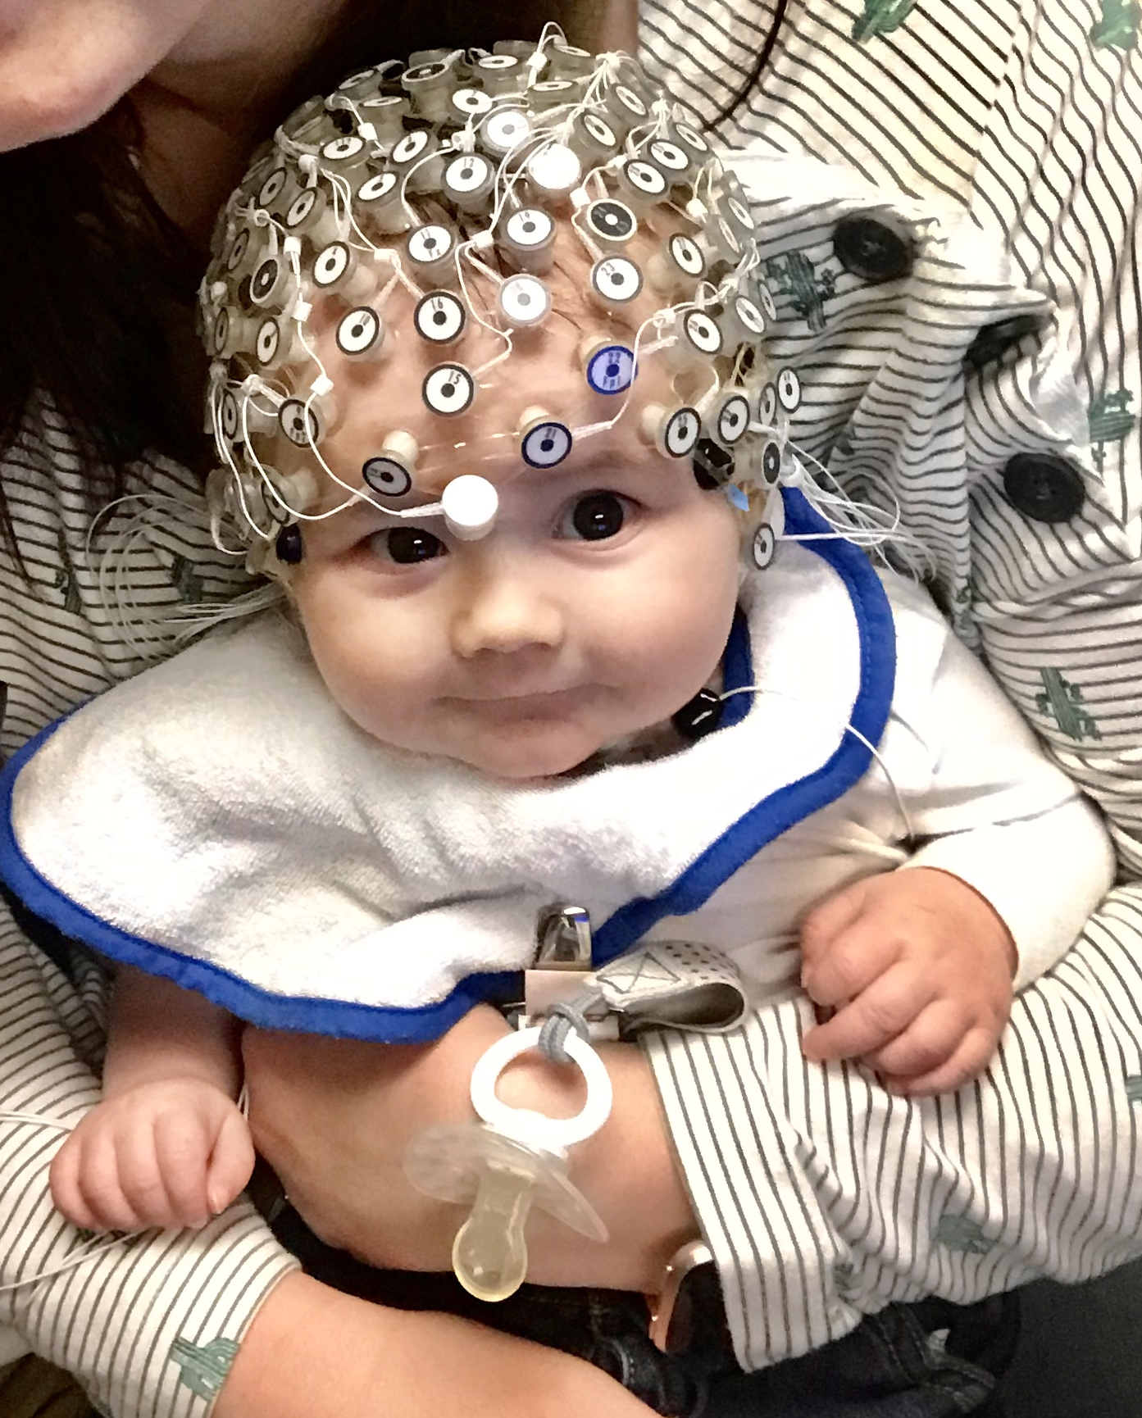
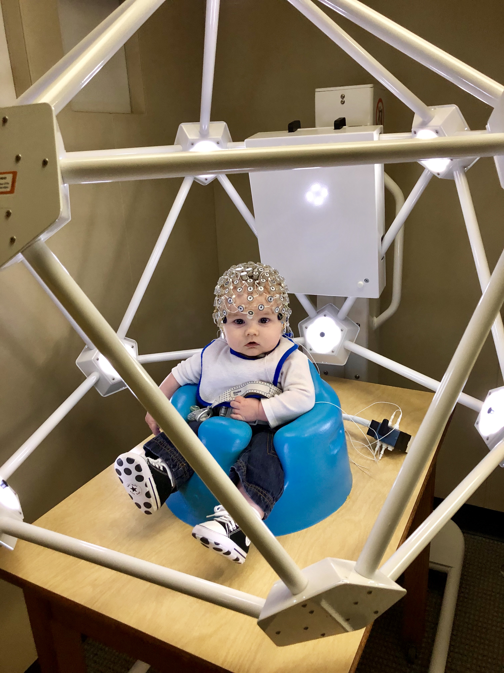
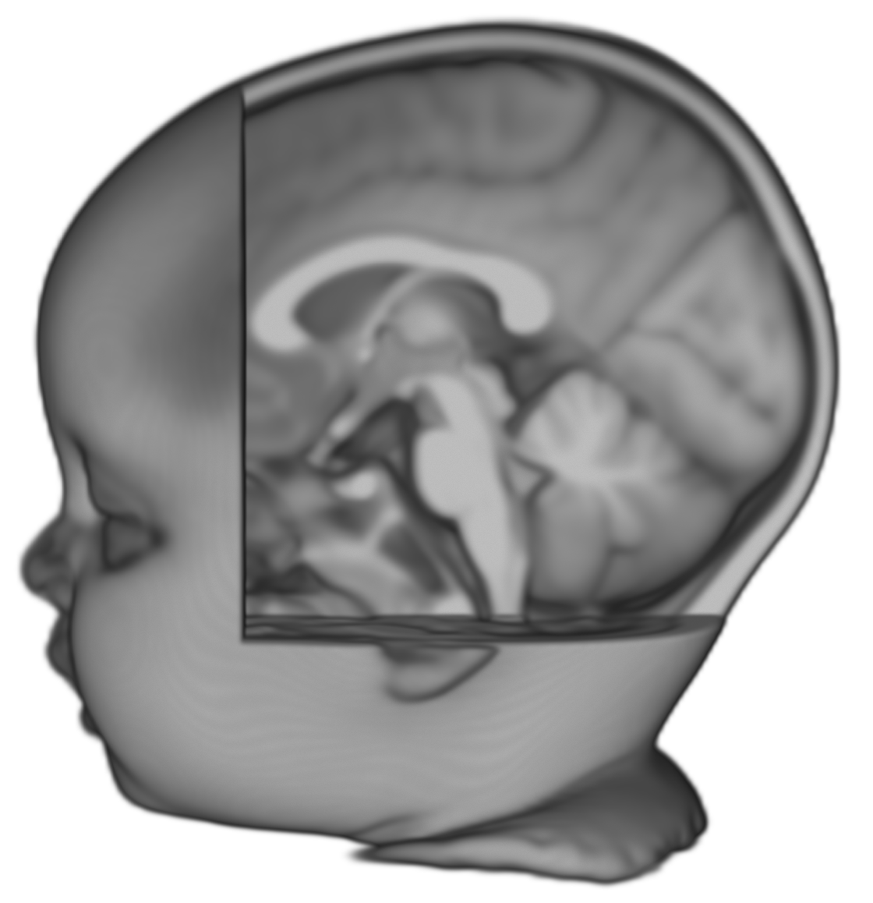
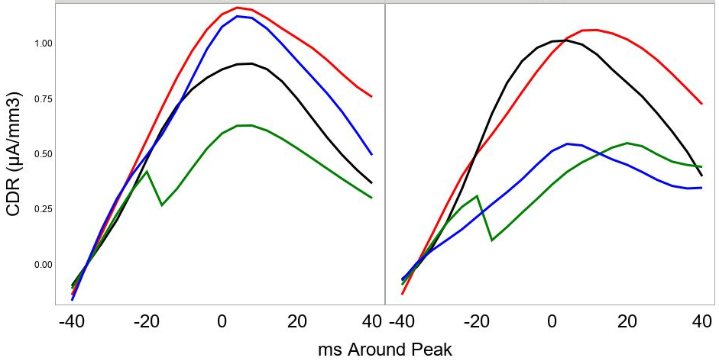
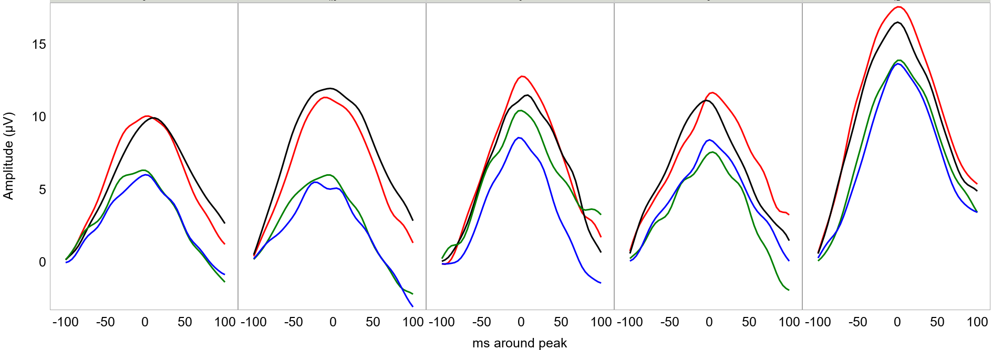
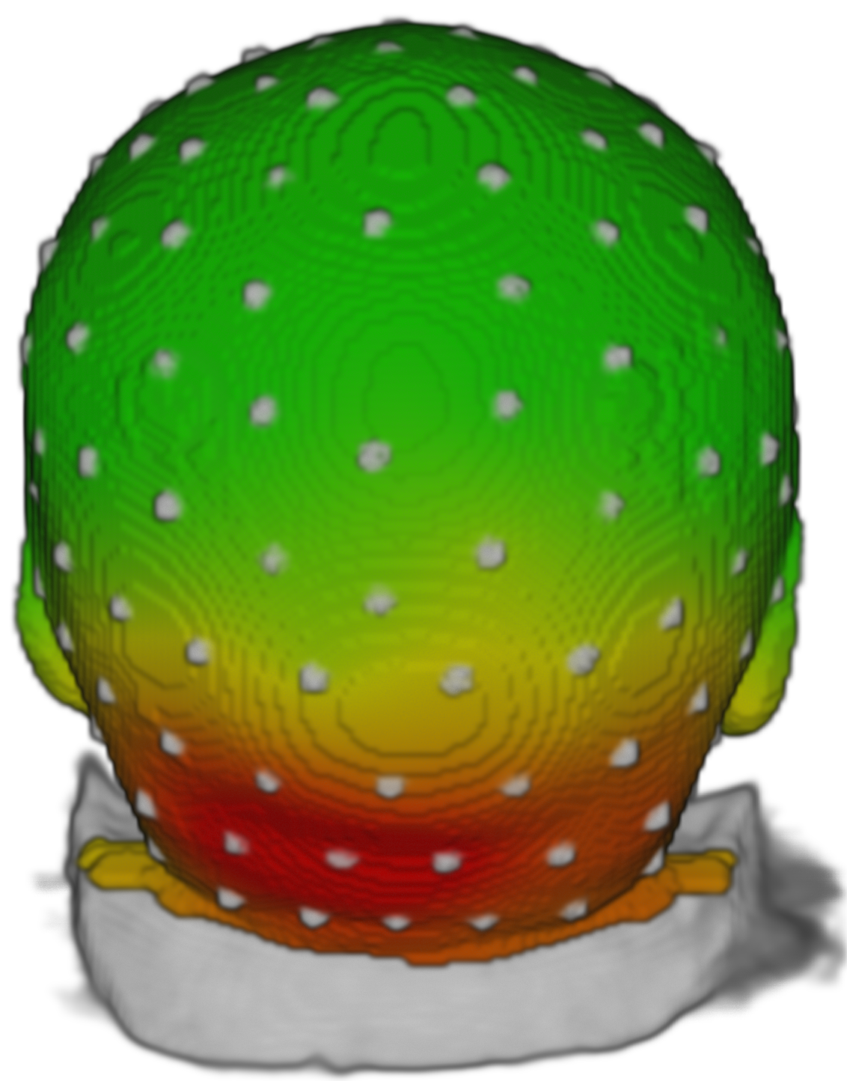
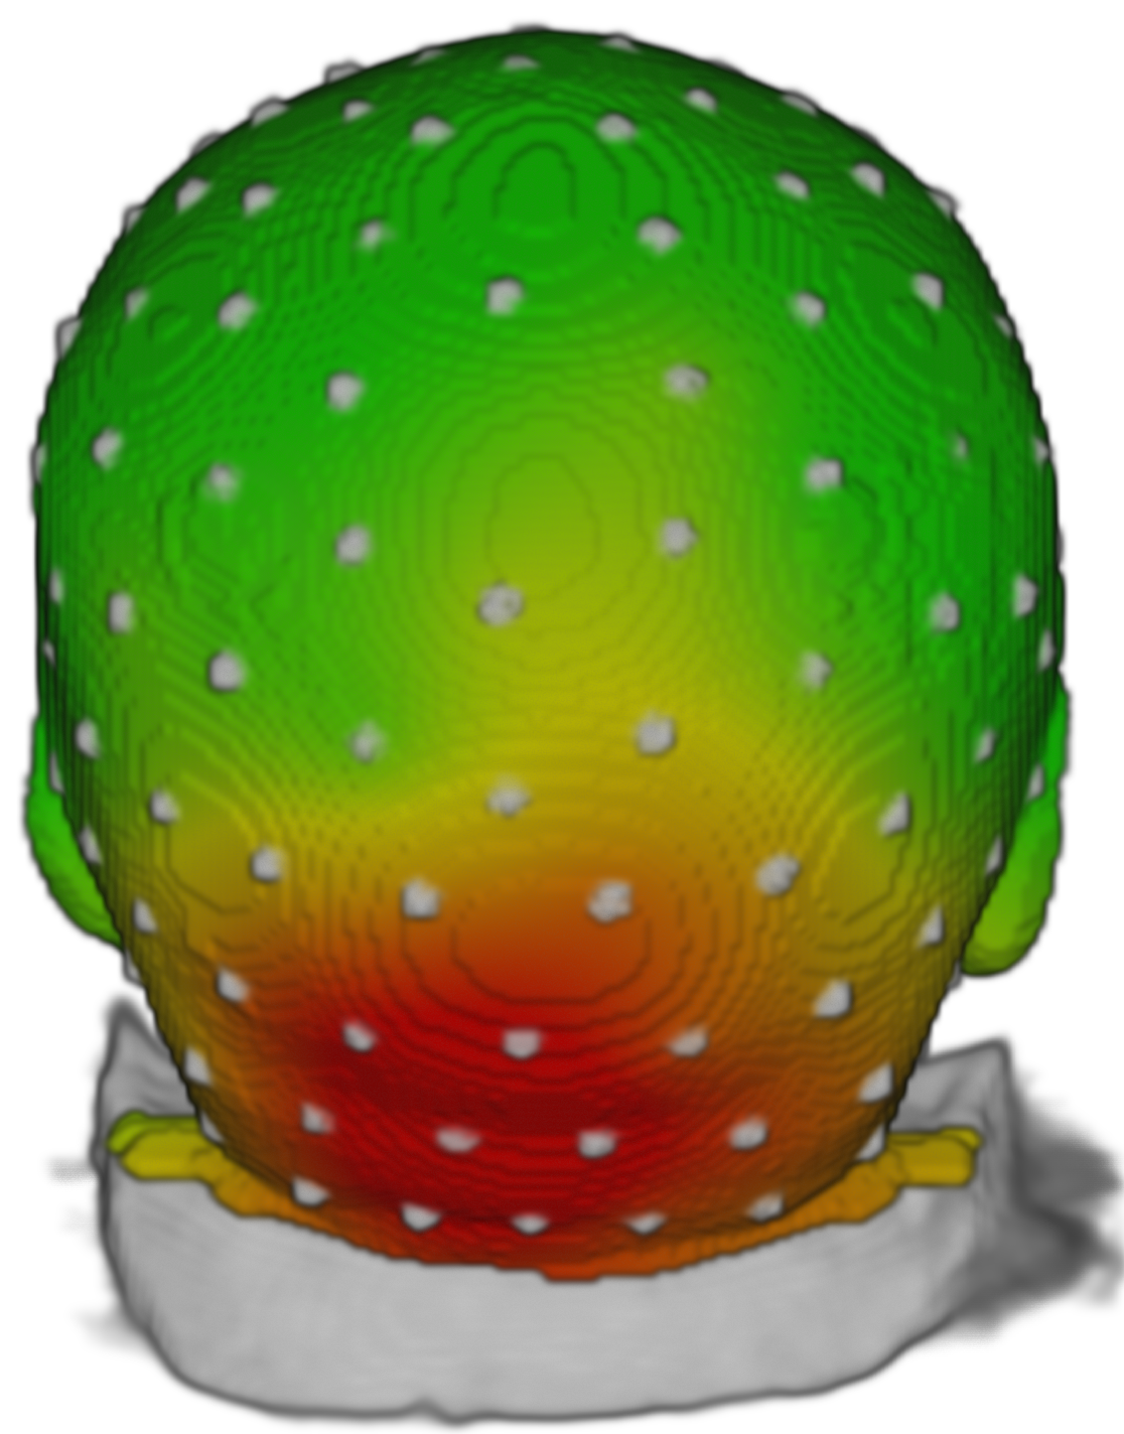
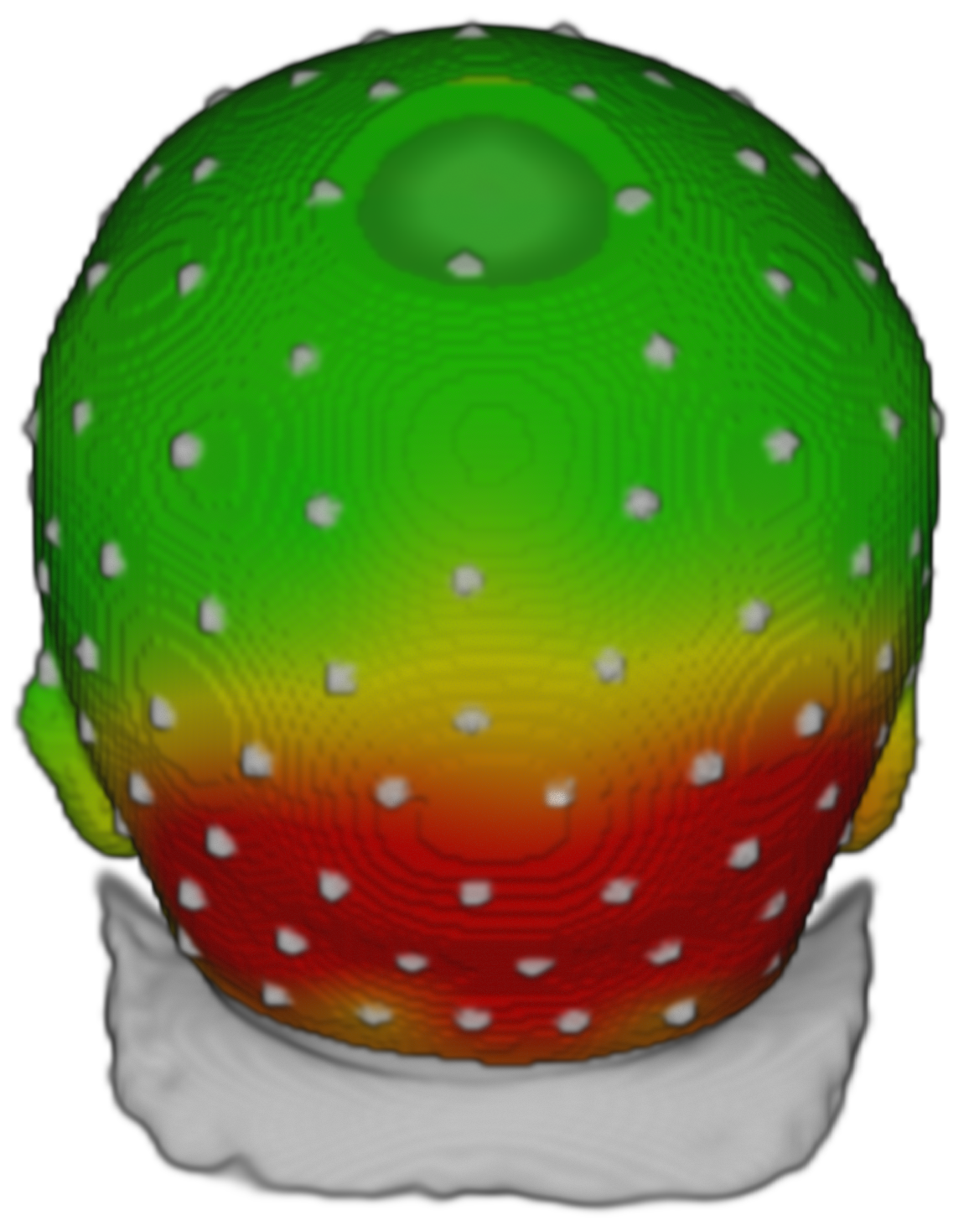
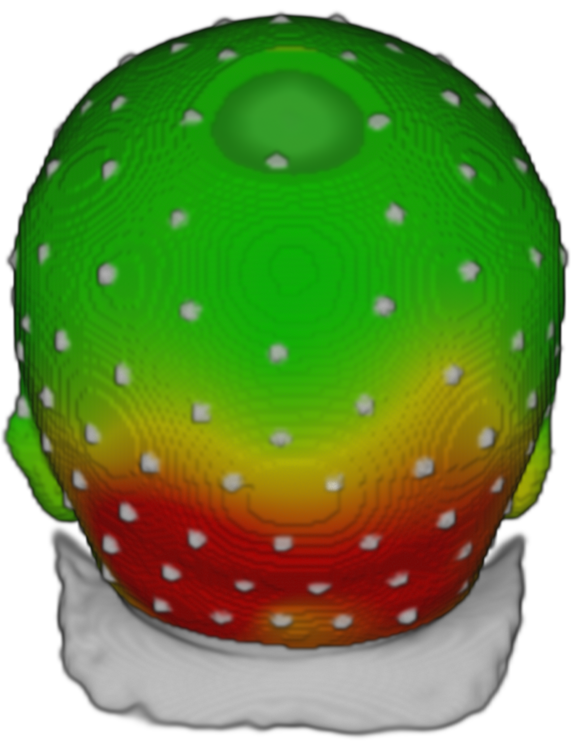
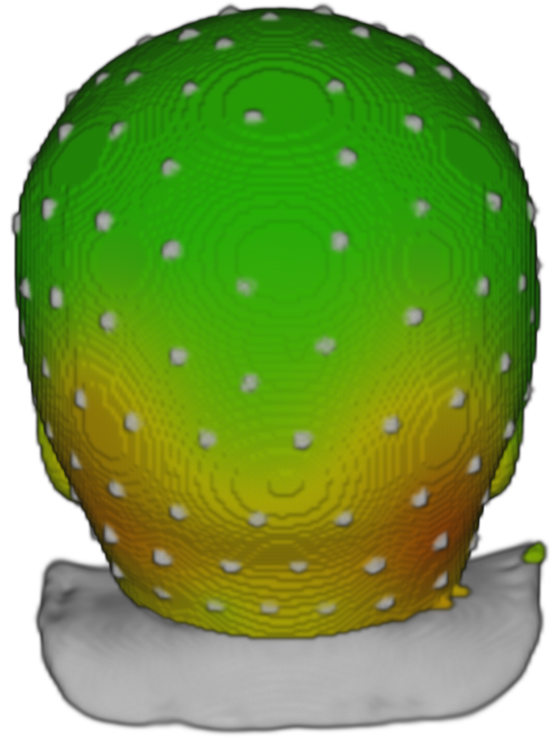
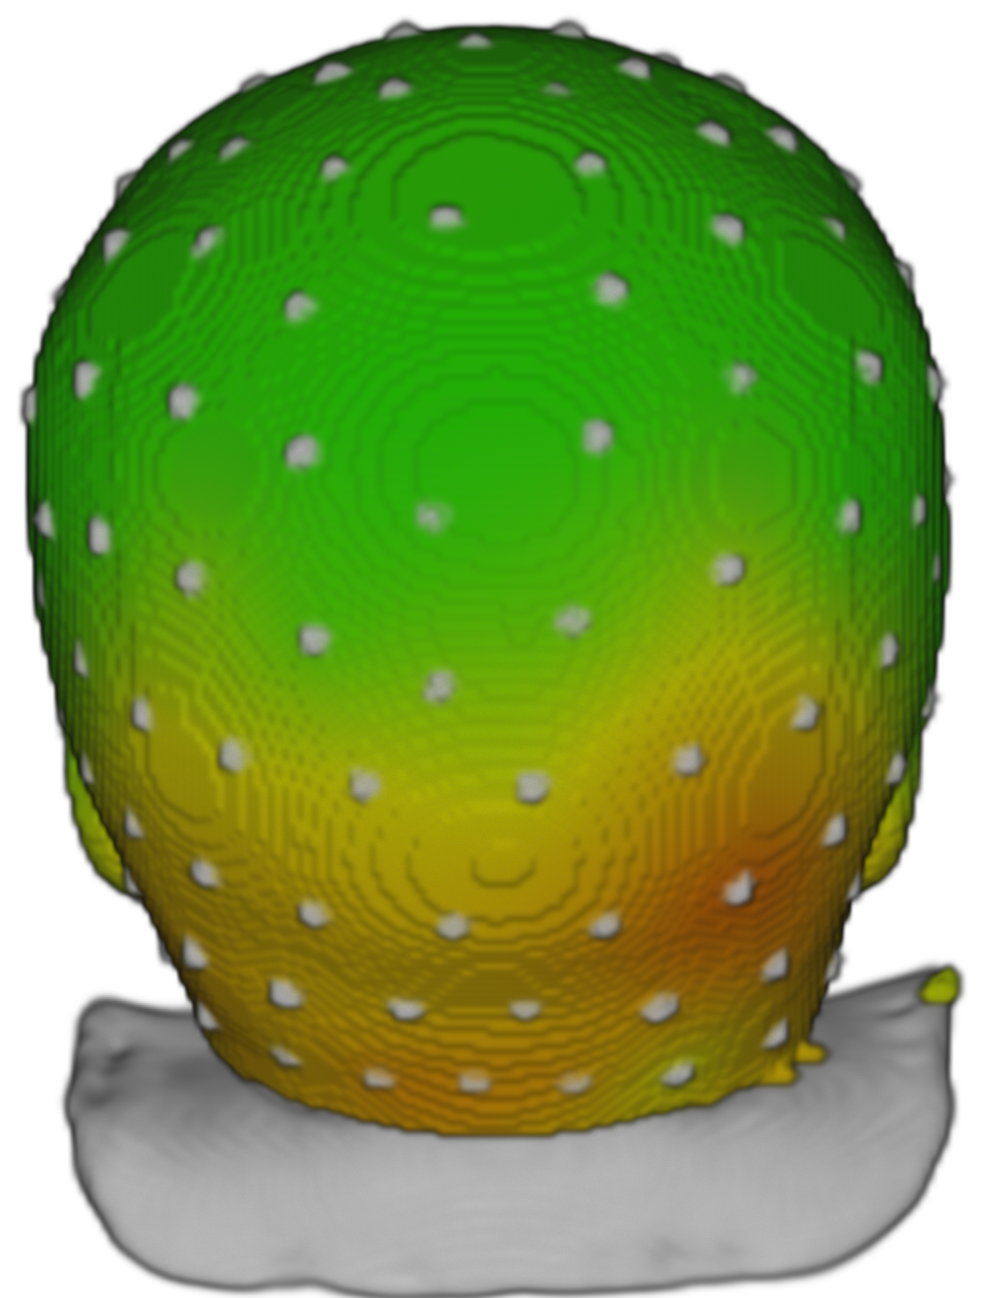
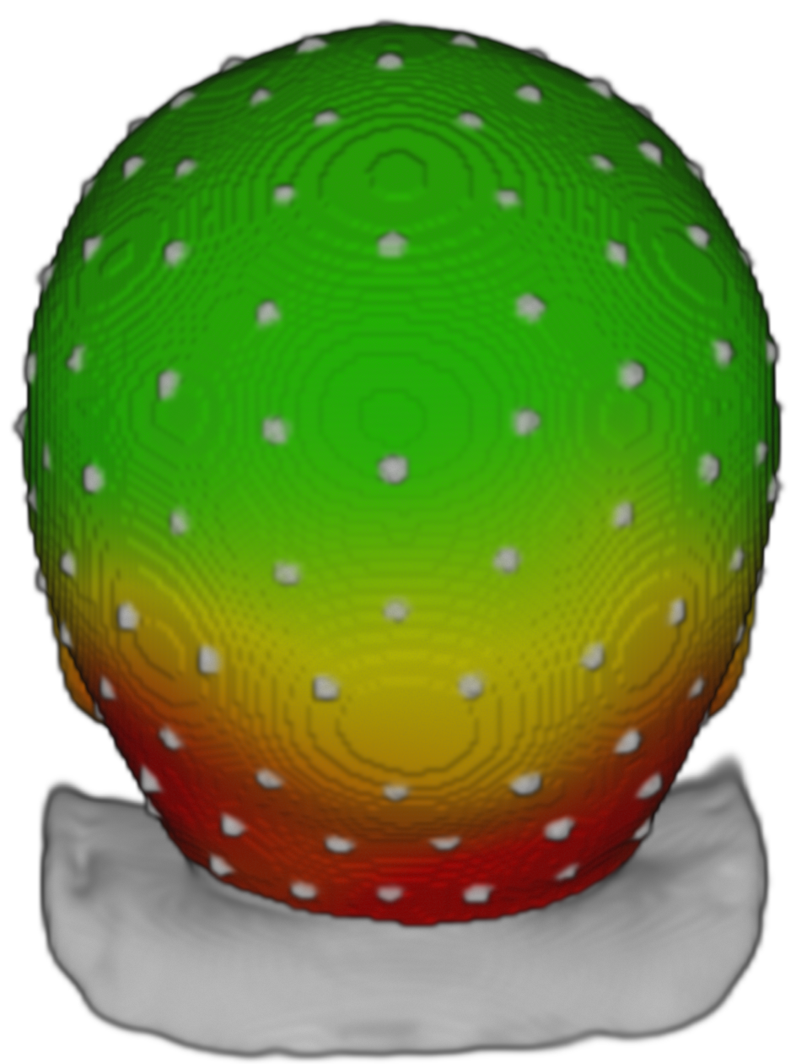
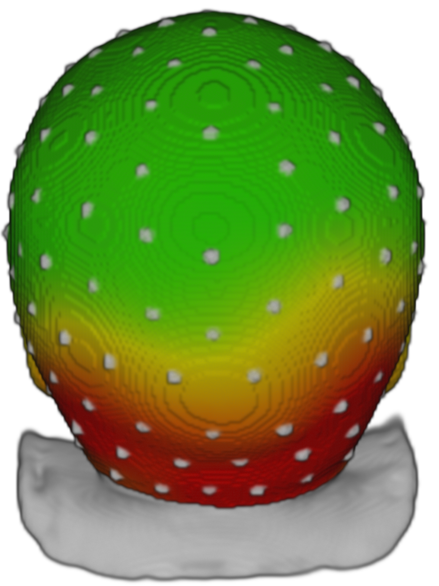
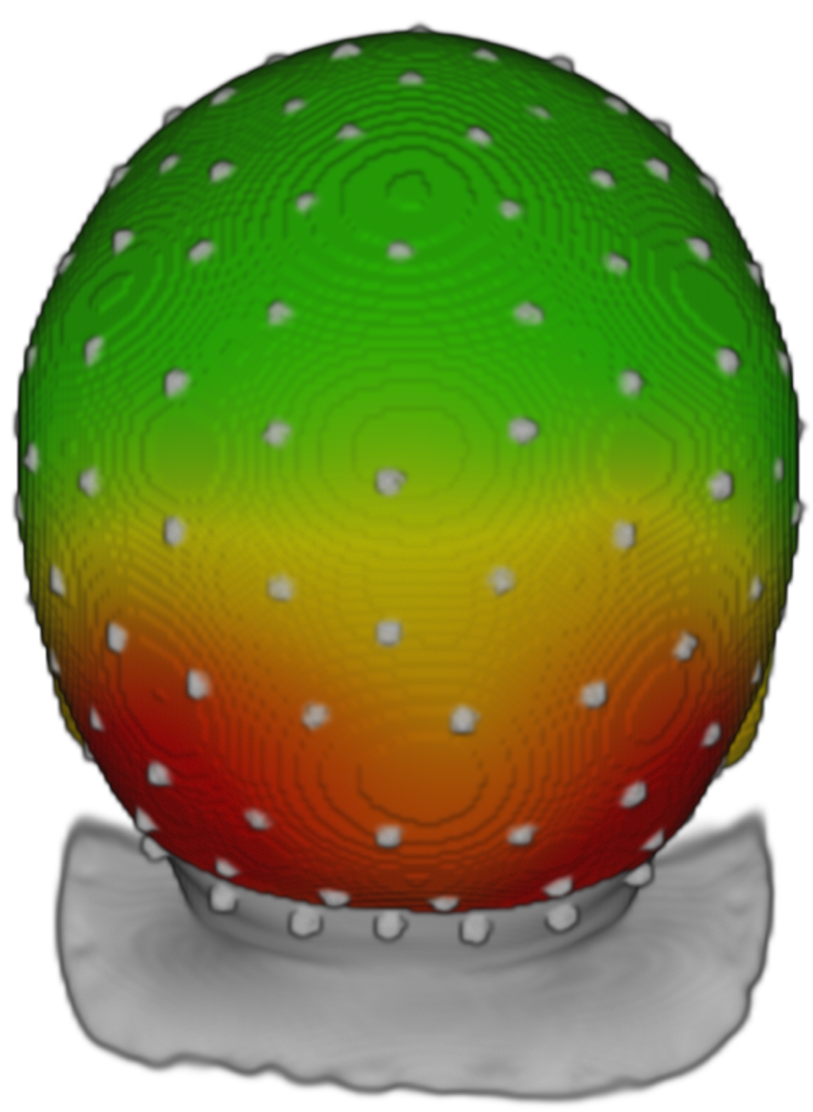
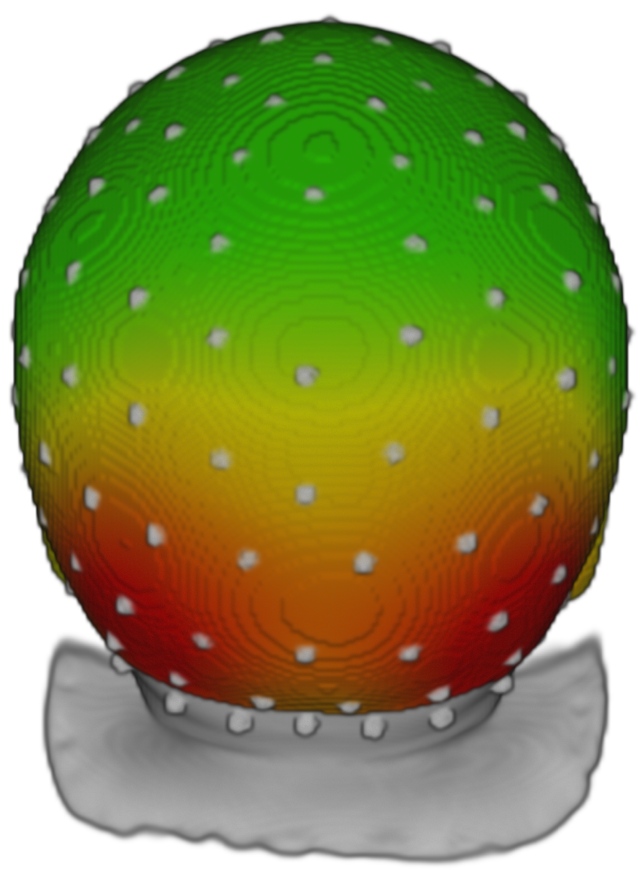
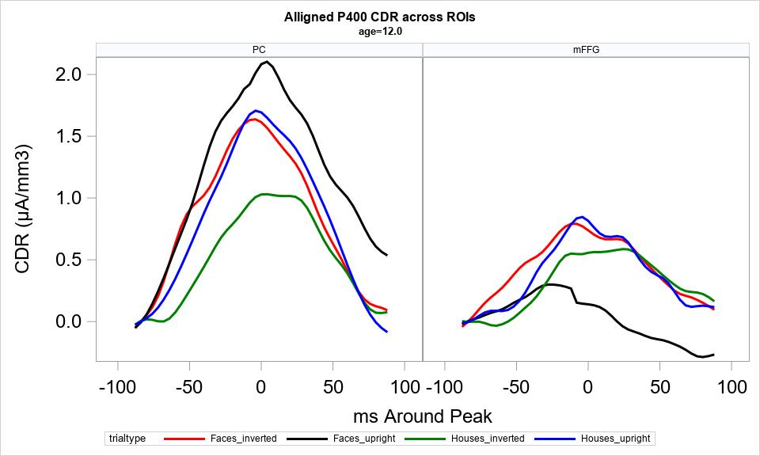
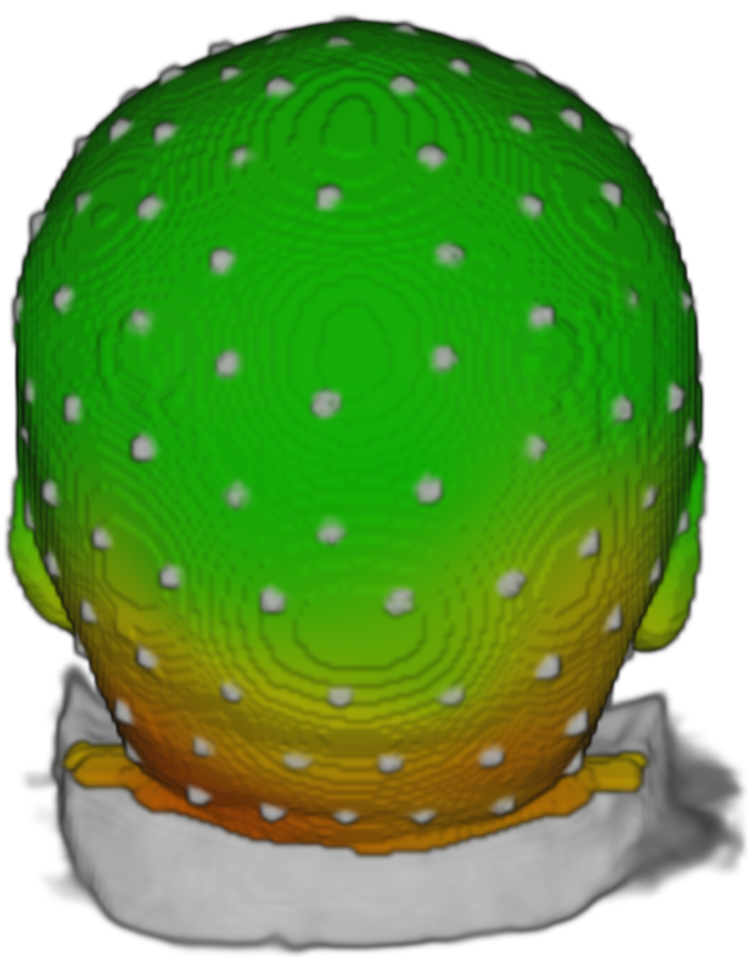
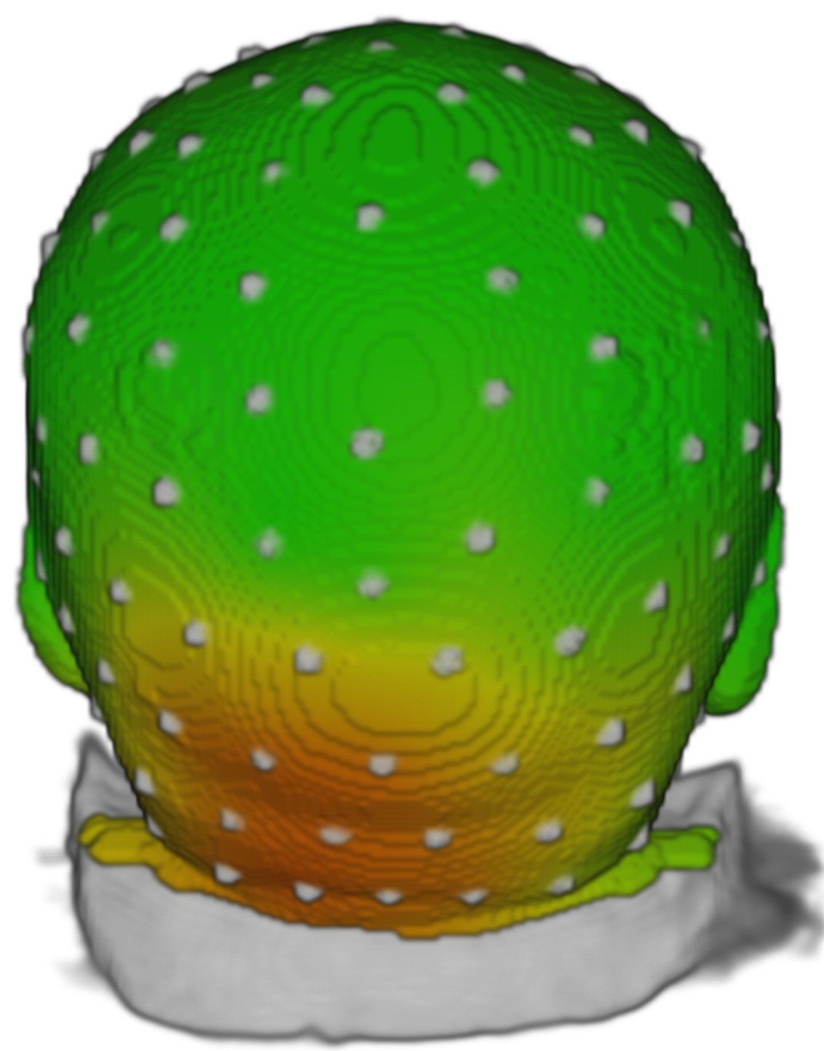
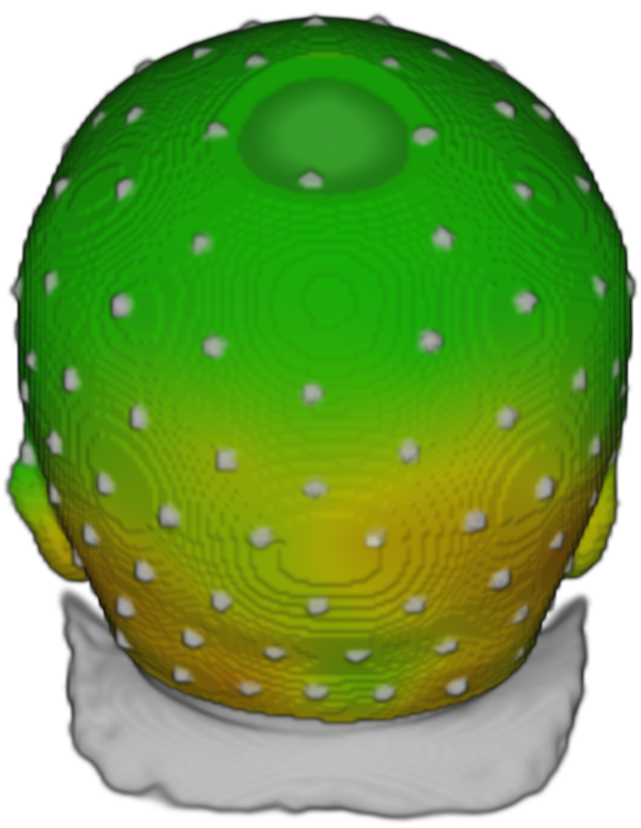
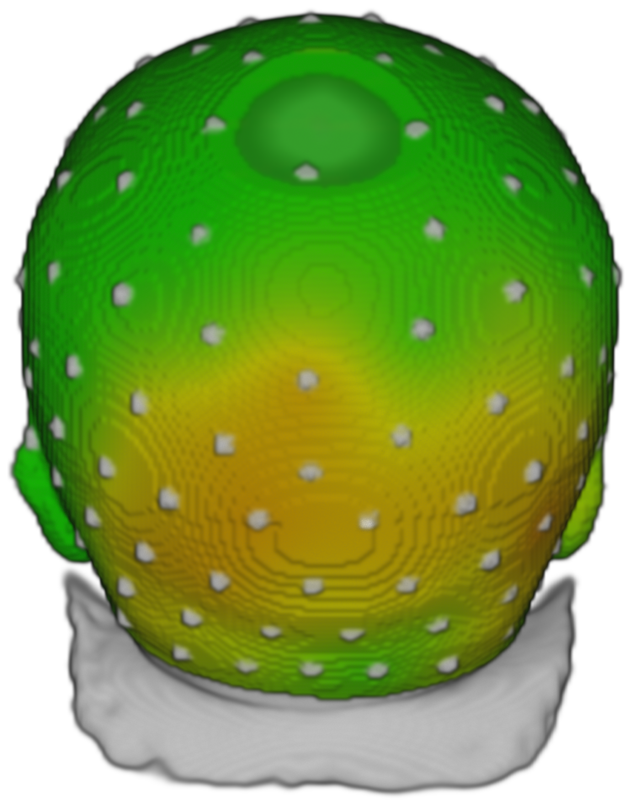
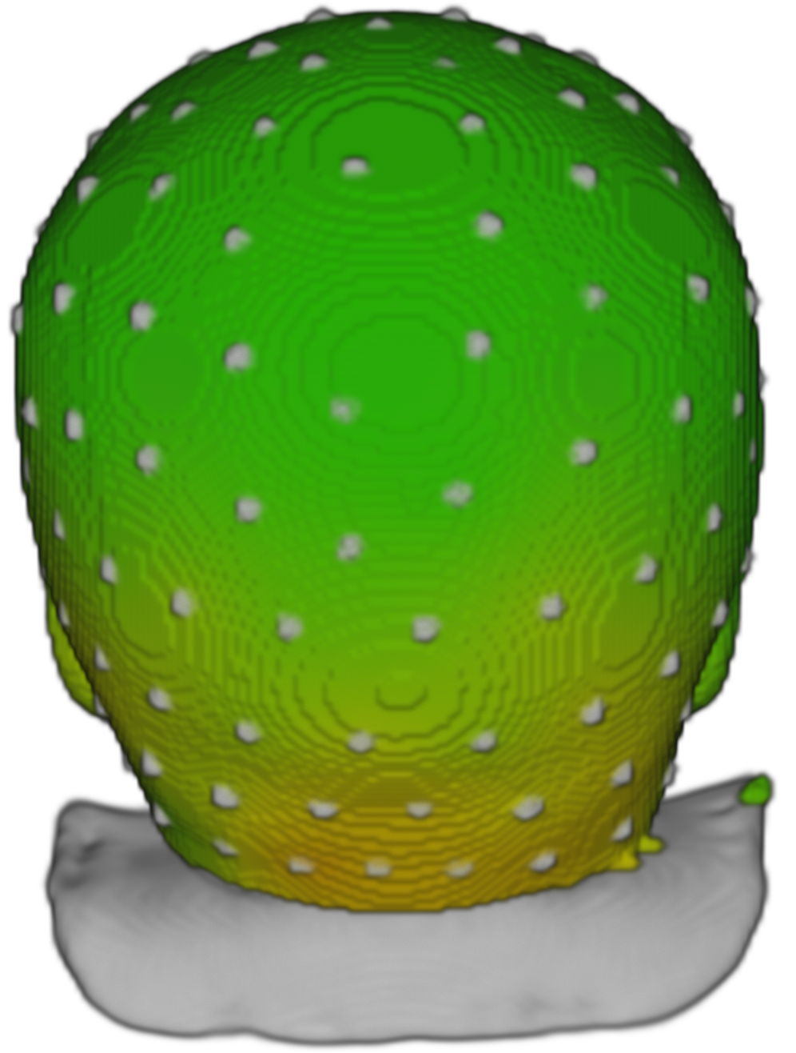
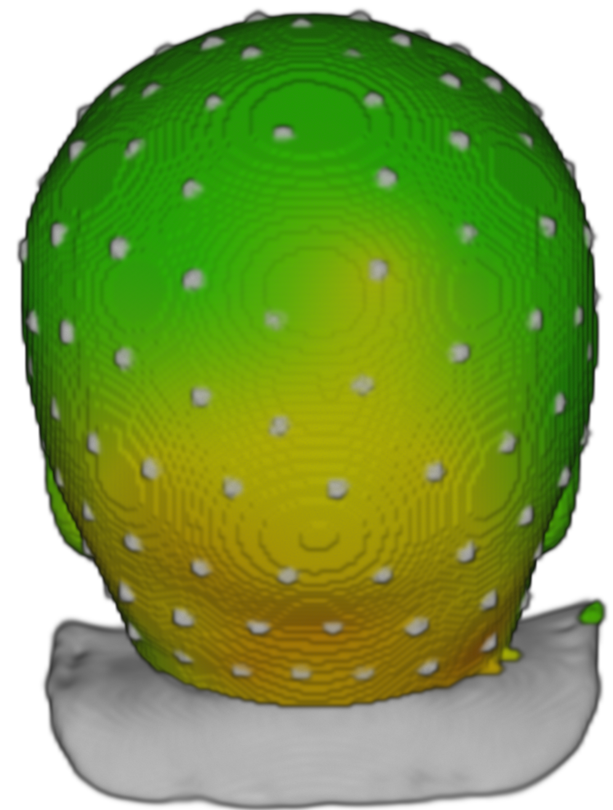
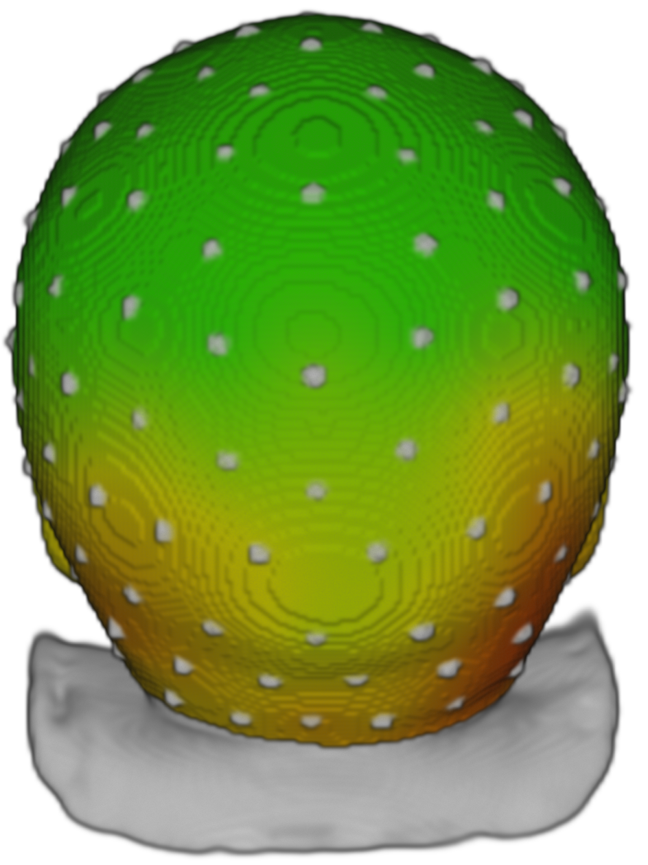
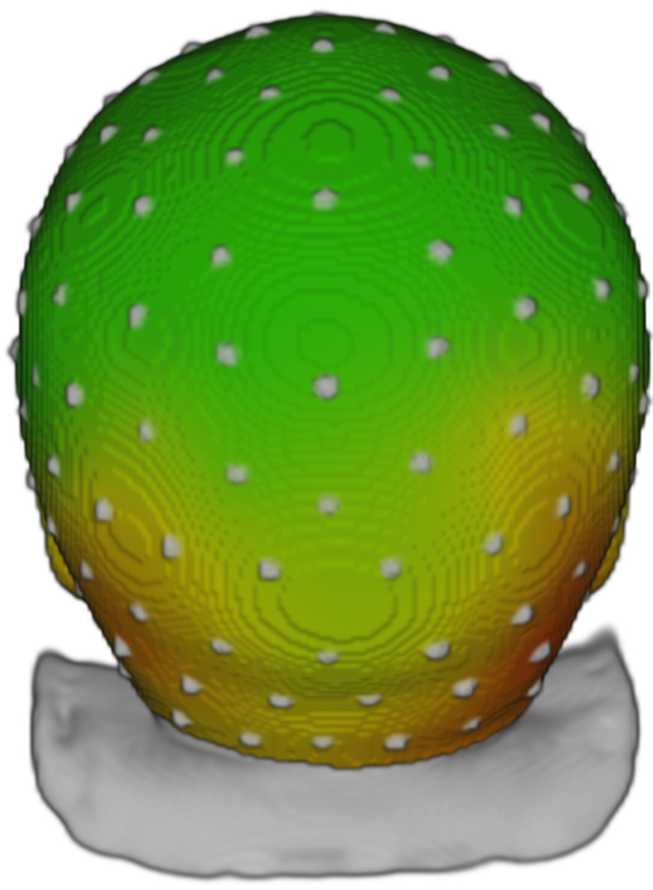
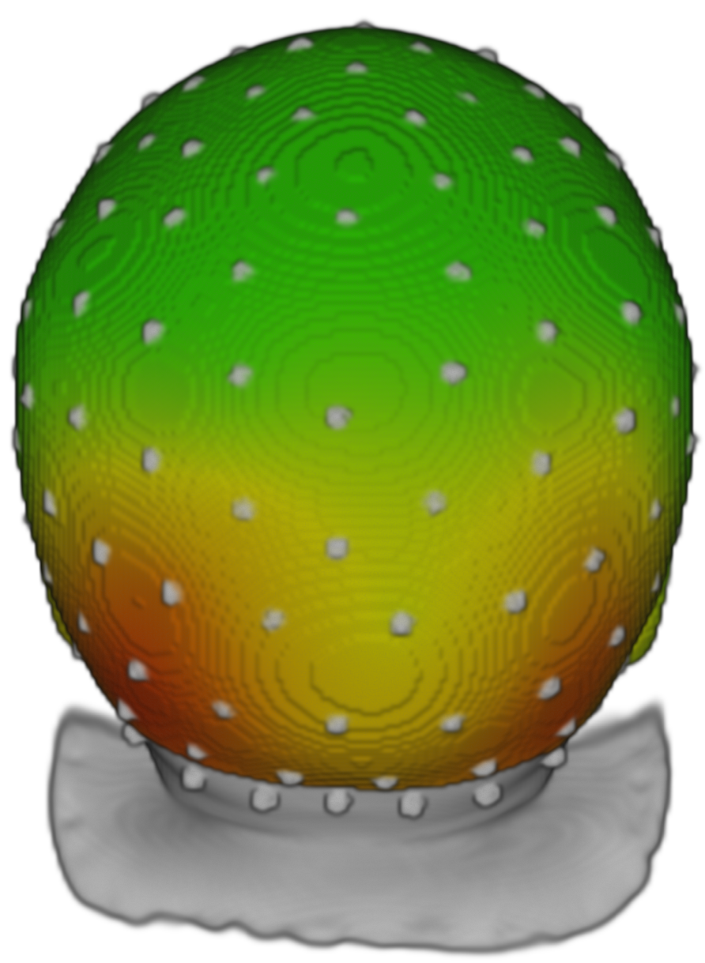
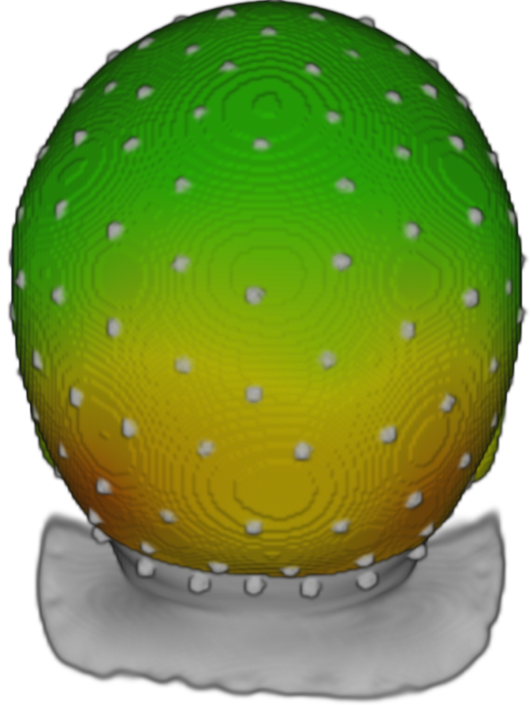
The Role of Low-level Visual Cues on the Neural Responses to Faces in Infants
Stefania Conte, John E. Richards
University of South Carolina
contact: contes@mailbox.sc.edu
Introduction
Methods
ERP Results
The face inversion effect has been considered the marker for expert perceptual processing (Valentine, 1988). It affects face-specific components of event-related brain potentials (ERPs). In adults, the N170 component shows larger amplitude and delayed latency to inverted than upright faces¹. Such inversion effect does not occur for non-face stimuli^{1,2}.
Two distinct ERP components, the N290 and the P400, become increasingly sensitive to upright human faces between 3 and 12 months of age^{3,4,5}. An inversion effect for human faces has been reported to modulate the amplitude of the N290 in 3- month-old infants⁶ and the P400 latency⁷. Similarly to the adult N170, the neural generator of the N290 component has been localized in the middle and posterior fusiform gyri^{4,8}. The posterior cingulate cortex has been reported to generate the response to faces of the P400 ERP^{8,9}.
We systematically investigated the development of the inversion effect on the N290 and P400 responses to faces and houses during the first year of life. We assessed developmental changes in the source localization of the inversion effects using age-appropriate head models. We hypothesized that faces would elicit larger N290 and P400 responses compared to houses. Developmental change could influence the characteristics of the inversion effect on both ERP components and their neural generators.
Participants
N290
Age group | 3 mos | 4.5 mos | 6 mos | 8 mos | 12 mos
N | 7 | 10 | 7 | 9 | 14
Age (days) | 103 ± 8.6 | 143.6 ± 7.9 | 192.7 ± 8.1 | 252.2 ± 23.3 | 379.4 ± 15.8
3 mos
4.5 mos
6 mos
8 mos
12 mos
UF
IF
UH
IH
Stimuli and Procedures
UF
UH
IF
IH
500
500 – 1500
Upright Inverted
Upright Inverted
Upright Inverted
Upright Inverted
Upright Inverted
Time (ms)
500
Face
House
EEG recording
128 channels
Geodesic Photogrammetry System
Age-appropriate MRI templates^{4,8,9}
UF < UH
p < .0001
UF < IF
p = .0002
IF > IH
p < .0001
UF < IF
p < .0001
UH > IH
p < .0001
UH < IH
p = .0048
UF > UH
p = .0063
UF < UH
p < .0001
IF < IH
p < .0001
Conclusion
Source Analysis Results
Preliminary findings suggest a larger negativity in response to upright faces than inverted faces in young infants (i.e., 3- and 4.5-month-olds). By 12 months of age the N290 shows larger negativity in response to faces than houses, regardless of the stimulus orientation.
Larger P400 amplitudes are recorded in response to faces than houses across ages. Only 12-month-old infants show a face-specific inversion effect with larger P400 amplitude in response to inverted than upright faces.
The middle Fusiform Gyrus (mFG) shows larger responses to upright faces than houses at 12 months of age. The P400 source shows an inversion effect for faces in the mFG and for both faces and houses in the posterior Cingulate Cortex (pCC).
N290
P400
12 mos
UF
IF
UH
IH
UH > IH
p < .0001
UF > UH
p < .0001
pCC
mFG
3 mos
4.5 mos
6 mos
8 mos
12 mos
Upright Inverted
Upright Inverted
Upright Inverted
Upright Inverted
Upright Inverted
P400
Face
House
References
Rossion, B., Delvenne, J. F., Debatisse, D., Goffaux, V., Bruyer, R., Crommelinck, M., & Guérit, J. M. (1999). Spatio-temporal localization of the face inversion effect: An event-related potentials study. Biological Psychology, 50(3), 173–189.
Eimer, M. (2000). Effects of face inversion on the structural encoding and recognition of faces - Evidence from event-related brain potentials. Cognitive Brain Research, 10(1–2), 145–158.
De Haan, M., Johnson, M. H., & Halit, H. (2003). Development of face-sensitive event-related potentials during infancy: A review. International Journal of Psychophysiology, 51(1), 45–58.
Guy, M. W., Zieber, N., & Richards, J. E. (2016). The Cortical Development of Specialized Face Processing in Infancy. Child Development, 87(5), 1581–1600.
Guy, M. W., Richards, J. E., Tonnsen, B. L., & Roberts, J. E. (2018). Neural correlates of face processing in etiologically-distinct 12-month-old infants at high-risk of autism spectrum disorder. Developmental Cognitive Neuroscience, 29, 61–71.
Peykarjou, S., & Hoehl, S. (2013). Three-Month-Olds’ Brain Responses to Upright and Inverted Faces and Cars. Developmental Neuropsychology, 38(4), 272–280.
Halit, H., De Haan, M., & Johnson, M. H. (2003). Cortical specialisation for face processing: Face-sensitive event-related potential components in 3- and 12-month-old infants. NeuroImage, 19(3), 1180–1193.
Conte, S., Richards, J. E., Guy, M. W., Xie, W., & Roberts, J. E. (2020). Face-sensitive brain responses in the first year of life. NeuroImage, 211, 116602.
Xie, W., McCormick, S. A., Westerlund, A., Bowman, L. C., & Nelson, C. A. (2019). Neural Correlates of Facial Emotion Processing in Infancy. Developmental Science.
12 mos
UF > UH
p = .0095
IF > UF
p = .0060
UH > IH
p = .0007
pCC
mFG
UF > UH
p < .0001
IF > UF
p < .0001
UF > UH
p < .0001
IF > IH
p < .0001
UF > UH
p < .0001
IF > IH
p < .0001
UF > UH
p < .0001
IF > IH
p = .0039
UF > UH
p < .0001
IF > IH
p < .0001
UF > UH
p < .0001
IF > IH
p < .0001
UF < IF
p = .0047

