Slide 1

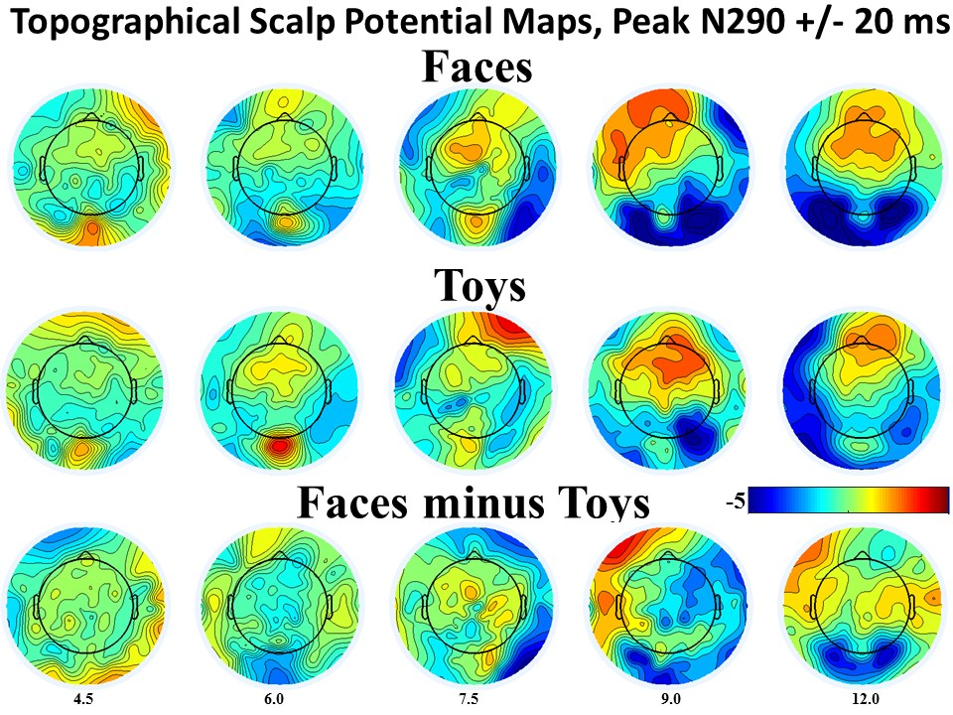
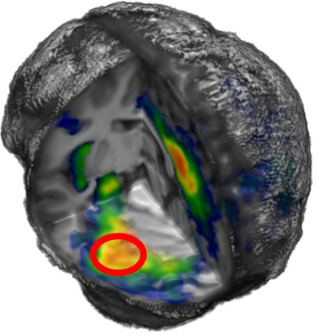
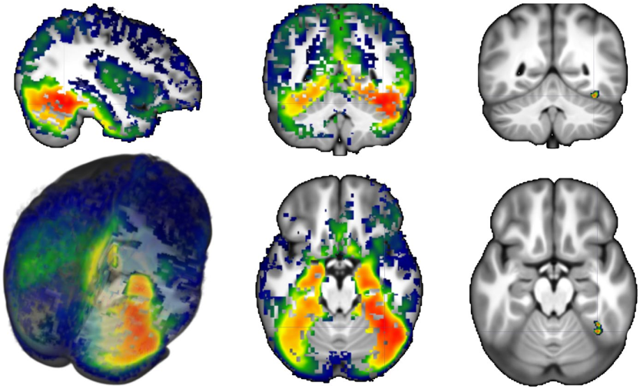
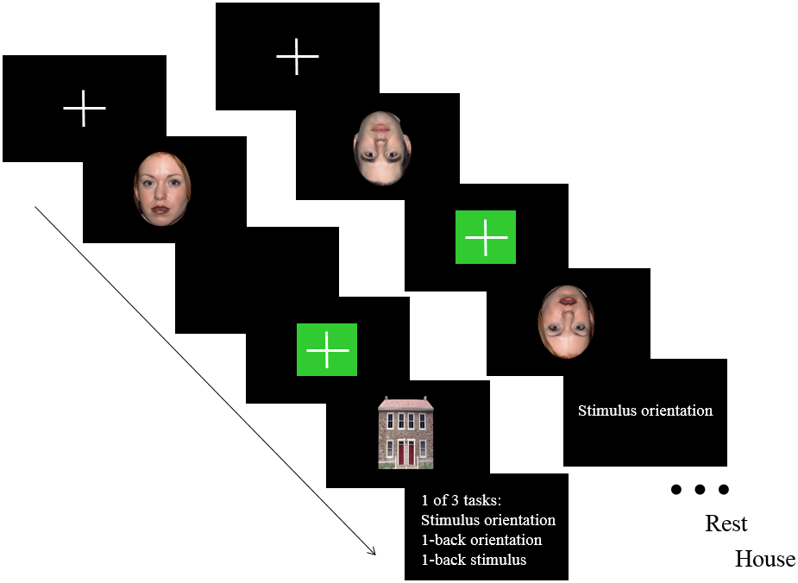
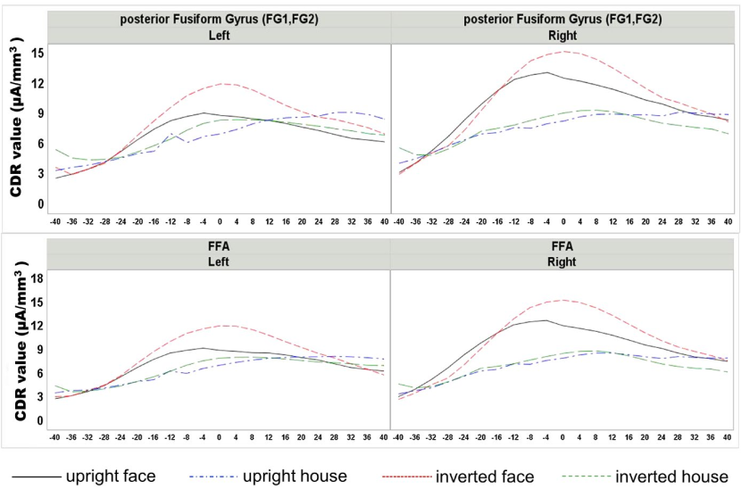
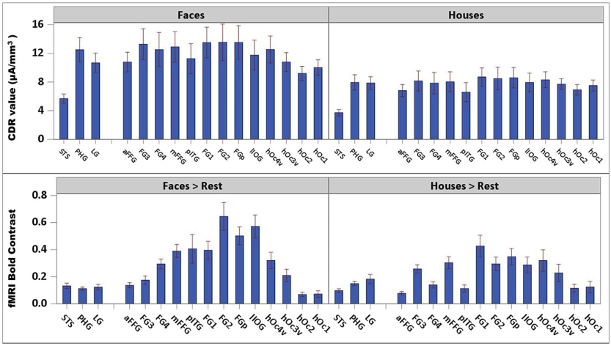
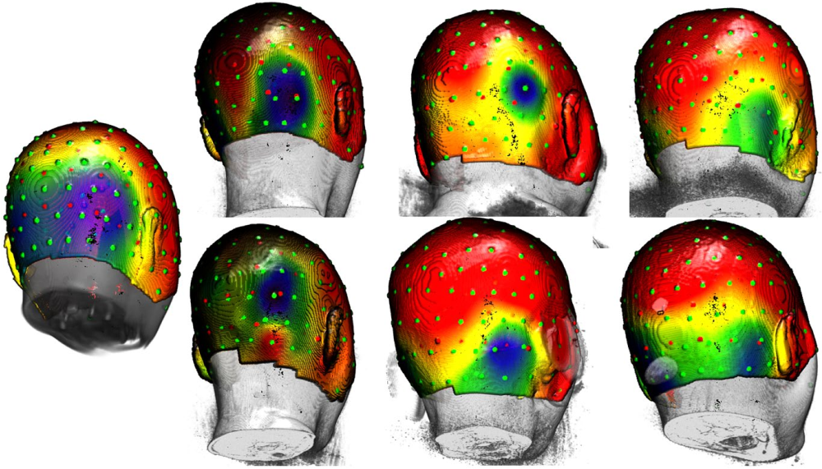
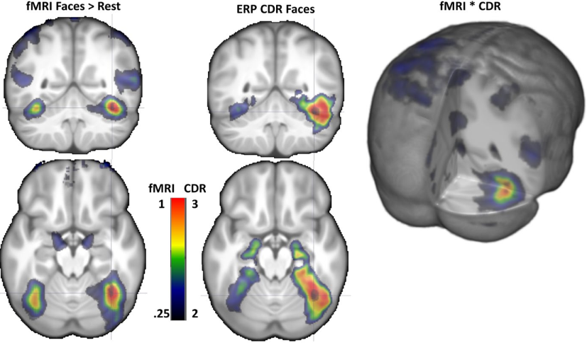
The neural sources of N170: Understanding timing of activation in face-selective areas
Chuanji Gao, Stefania Conte, John E. Richards, Wanze Xie, and Taylor Hanayik
Introduction
The N170 ERP component has been widely identified as a face‐sensitive neural
marker. Despite extensive investigations conducted to examine the neural sources of
N170, there are two issues in prior literature: (a) few studies used individualized
anatomy as head model for the cortical source analysis of the N170, and (b) the relationship between the N170 and face‐selective regions from fMRI studies is unclear.
Here, we addressed these questions by presenting pictures of faces and houses to the
same group of healthy adults and recording structural MRI, fMRI, and high‐density
ERPs in separate sessions.
Methods
Participants
34 volunteers (mean age, 23.4 years; SD, 5.2 years, 13 male) participated the ERP, structural MRI, and fMRI in separate sessions.
Procedure
Participants were presented with four categories of stimuli: upright faces,
inverted faces, upright houses, and invert houses. A trial-by-trial design was used for the ERP experiment, whereas a block design was used for the fMRI experiment.
Results
Grand-averaged ERPs
3D rendering of the average CDR for faces
fMRI
CDR values at anatomical and functional ROIs
ERP
Individual differences in N170 scalp distribution
CDR and BOLD contrast
Conclusion
Source analysis based on the participant's anatomy showed
that the middle and posterior fusiform gyri were the primary neural sources for the face‐sensitive aspects of the N170. Source analysis based on regions of interest from the fMRI revealed that the fMRI‐defined fusiform face area was the major contributor to the N170. The current study suggests that the fusiform gyrus is a major neural contributor to the N170 ERP component and provides further insights about the
spatiotemporal characteristics of face processing.
Cortical sources for anatomical and functional ROIs
individualized head models based on structural MRI scans from each participant;
voxel-wise segmentation of all relevant materials;
finite element method
We analyzed current density reconstruction values (CDR) from source analysis for anatomical and function regions of interest (ROIs).
Acknowledgements
Gao, C., Conte, S., Richards, J. E., Xie, W., & Hanayik, T. (2019). The neural sources of N170: Understanding timing of activation in face‐selective areas. Psychophysiology, e13336.
This research was supported by a grant from the National
Institute of Child Health and Human Development
(NICHD‐R01‐HD18942) to John E. Richards.

