Slide 1
THE ROLE OF LOW-LEVEL VISUAL CUES ON THE NEURAL RESPONSES TO FACES IN INFANTS
Introduction
Background
Aims
Method
Stefania Conte, PhD
Postdoctoral Fellow
https://infantlab.sc.edu/
John E. Richards, PhD
Carolina Distinguished Professor
Sample
Stimuli and Procedure
Results
P1
N290
P400
Source analysis
Infant
Development
Laboratory
Conclusion
Contacts

Slide 2
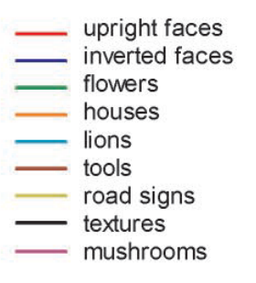
Background
Introduction
Itier & Taylor (2004)
Notes:
P1 and N170 for faces vs. non-faces

Slide 3
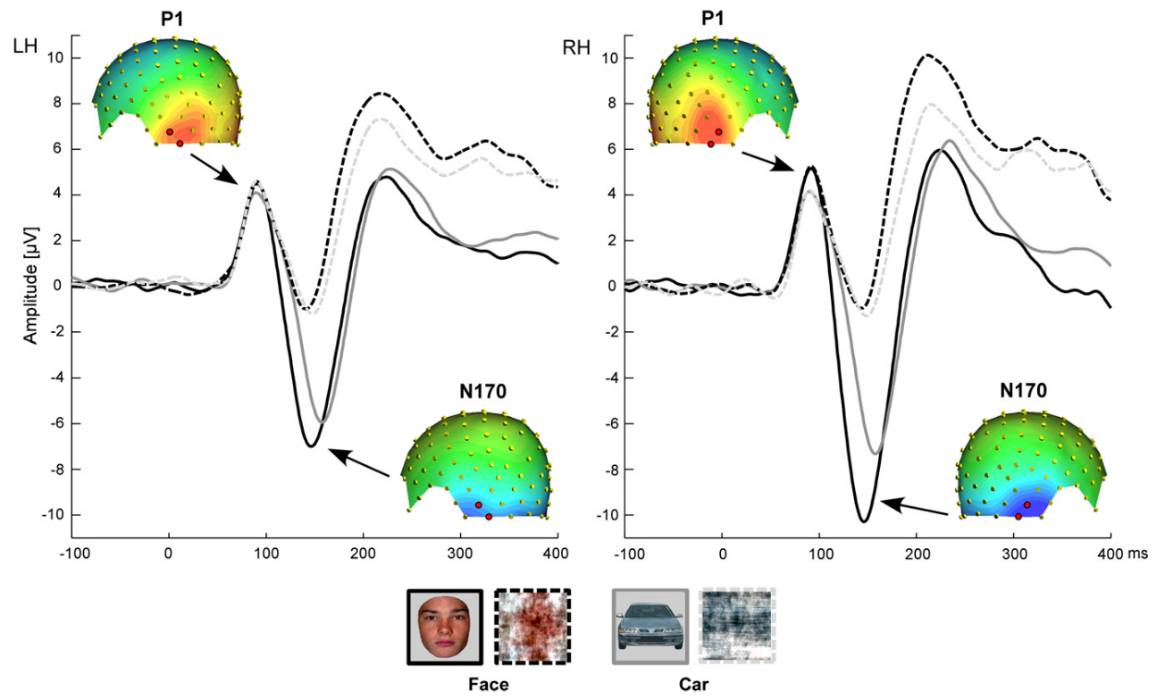
Introduction
Background
Rossion & Caharel (2011)
Notes:
N170 for intact faces vs. both intact houses and scrambled faces

Slide 4
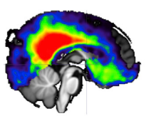
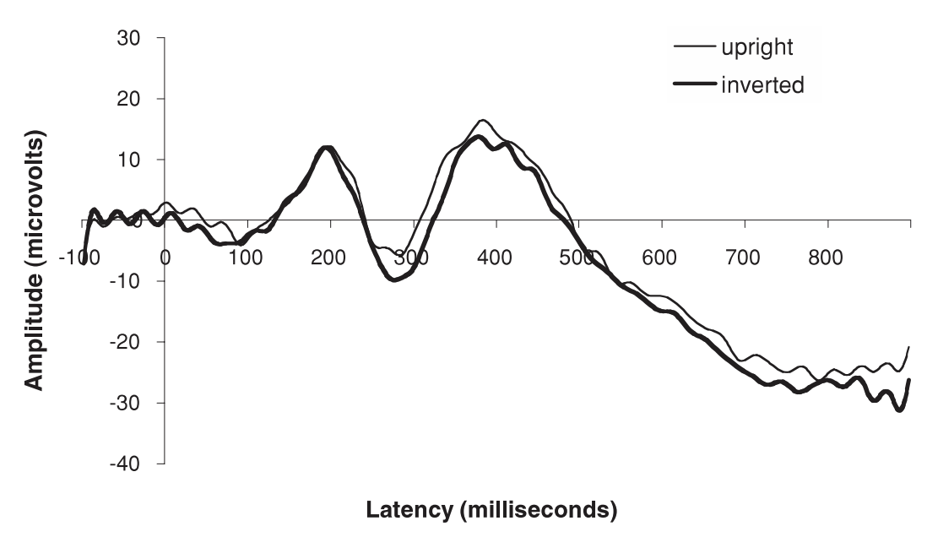
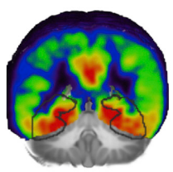
Introduction
Background
P400
Posterior Cingulate Cortex
N290
Middle and Posterior Fusiform Gyri
Johnson et al. (2005)
Conte et al. (2020)
Notes:
Functional responses to face in both N290 and P400 + their sources

Slide 5
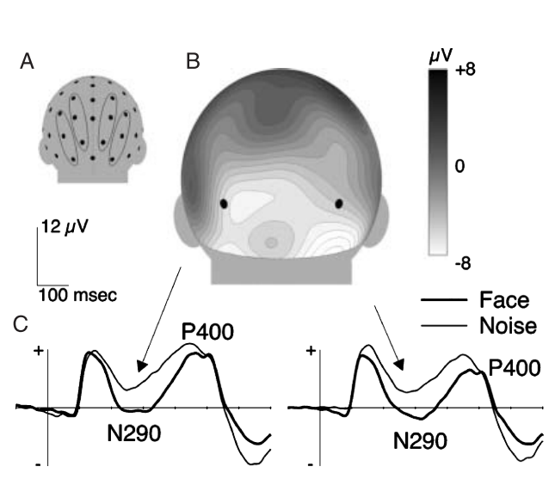
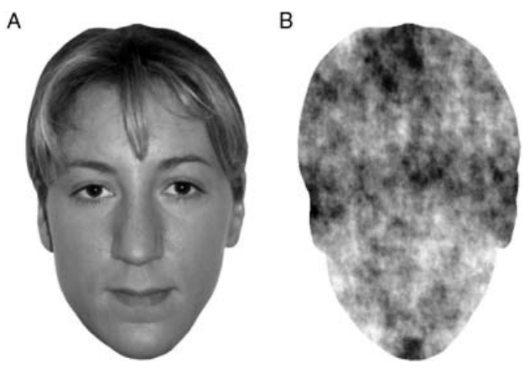
Introduction
Background
3 mos
Halit et al. (2004)
Notes:
N290 intact vs scrambled faces at 3 months

Slide 6
Introduction
Aims
P1 responses would be accounted for by low-level visual cues
The N290 activity would be specific for intact faces
P400 responses would be sensitive to both stimulus type and texture
Investigate with a full factorial design the neural response to faces and houses and their matched visual noise
Explore the development of the ERP responses in the first and second half of the first year of life
Medial occipital areas (i.e., Lingual Gyrus) would generate the P1 activity
Source localization of the N290 activity would be in the Fusiform Gyrus
Modulations of the P400 would occur in the Posterior Cingulate cortex
Identify the neural generators of each component using age appropriate head models for source analysis
Nonsignificant age difference in the early ERP response (i.e., P1)
Adult-like N290 and P400 functional characteristics by 12 months of age

Slide 7
Sample
6-month-old infants
M = 189.42 days SD = 5.43 days
Method
N = 14
12-month-old infants
M = 371.18 days SD = 10.92 days
N = 10

Slide 8
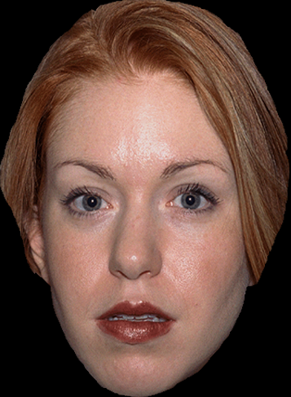
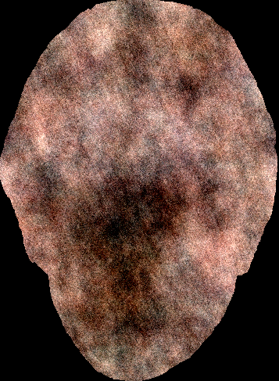
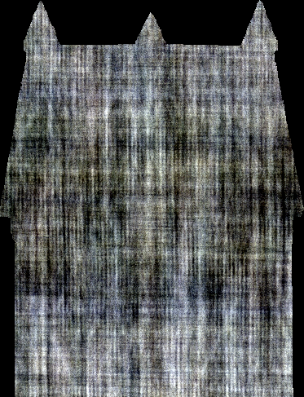
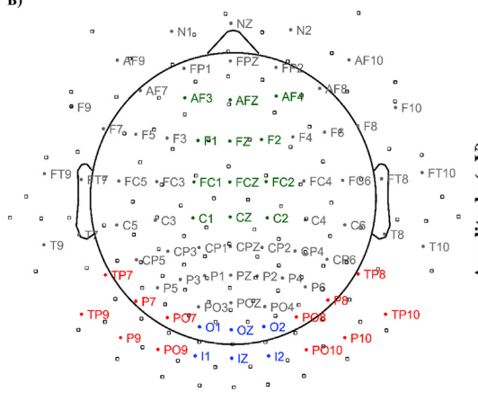
Method
Stimuli and Procedures
IF
IH
SF
SH
500
500 – 1500
Time (ms)
500
EEG ANALYSIS
Amplitude values around the peak of P1, N290, and P400 ERP components over medial occipital (blue) and occipital lateral (red) ROIs

Slide 9
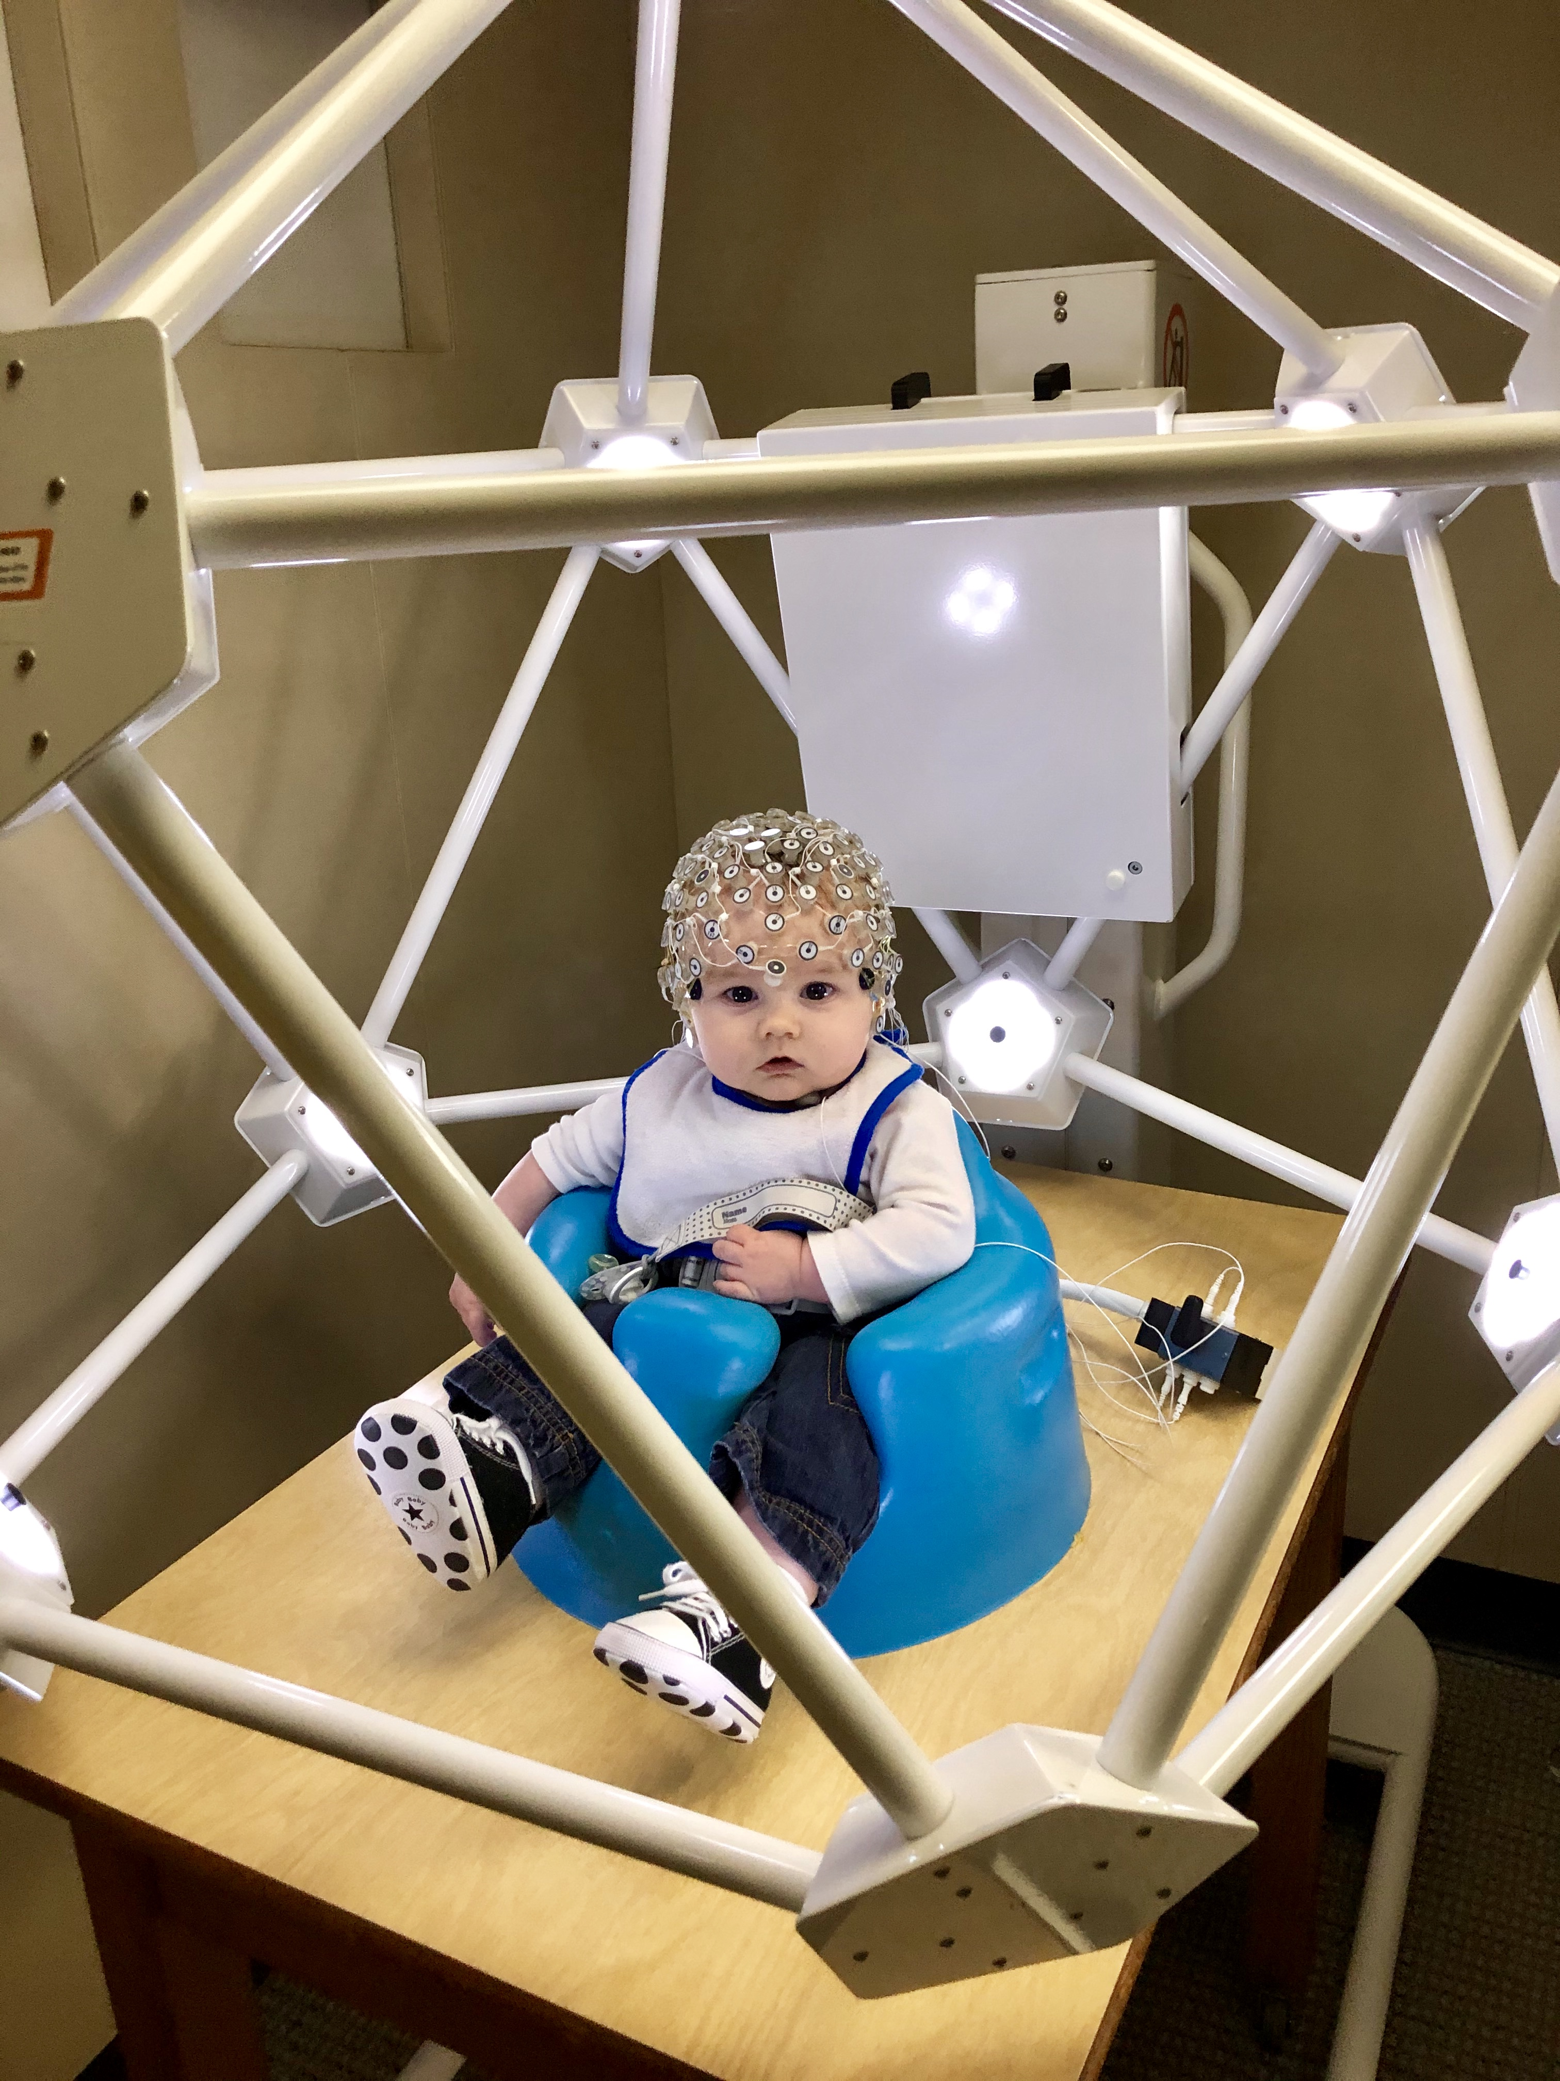
Method
Stimuli and Procedures
Geodesic Photogrammetry System (GPS) for accurate electrode locations
Amplitude around the peak of P1, N290, and P400
Age-appropriate MRI templates
Fine Element Method (FEM) to create meshes for gray matter, white matter, CSF, dura, skull, muscle, eyes, nasal cavity, scalp
SOURCE ANALYSIS
Current Density Reconstruction (CDR) values estimated with eLORETA
(Pascual-Marqui, 2007)

Slide 10
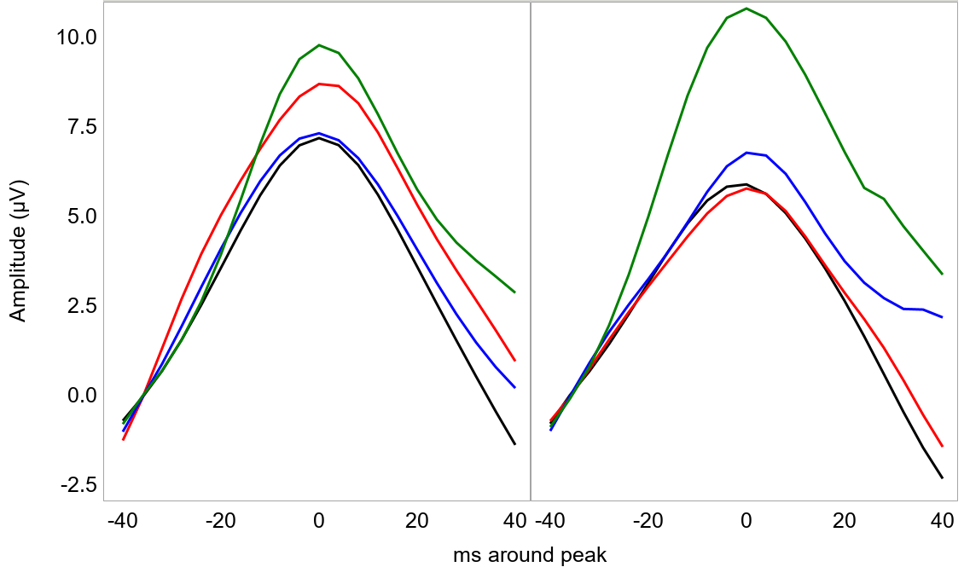
P1
6 mos
12 mos
IF
SF
IH
SH
Results
IF < SF, p = .0126
IH < SH, p = .0092
SF < SH, p < .0001
IH < SH, p < .0001

Slide 11
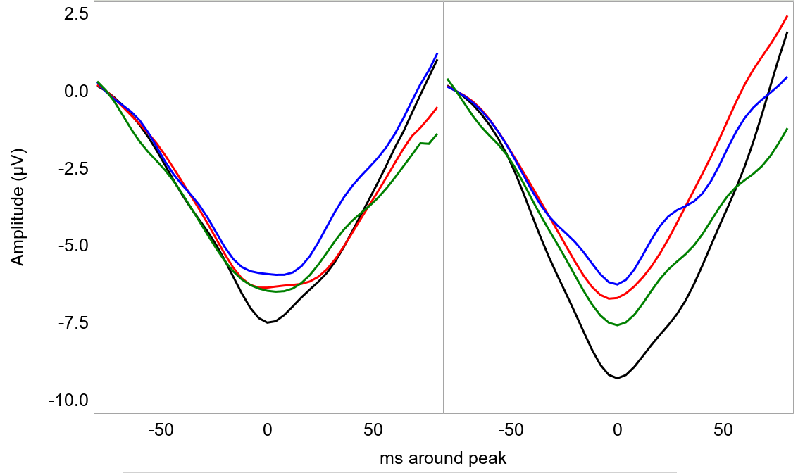
Results
N290
6 mos
12 mos
IF
SF
IH
SH
IF < IH, p < .0001
IF < IH, p < .0001
IF < SF, p < .0001

Slide 12
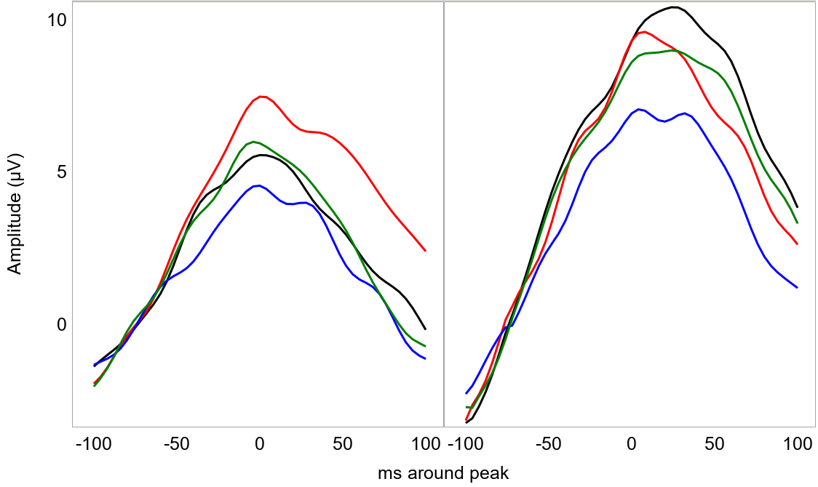
Results
P400
6 mos
12 mos
IF
SF
IH
SH
IF > IH, p = .0070
SF > SH, p = .0007
IF < SF, p < .0001
IH < SH, p = .0012
IF > IH, p < .0001
IH < SH, p < .0018

Slide 13
Results
Source Analysis – P1
6 mos
12 mos
Iz P1 ERP
r = .62
r = .80
r = .24
r = .57
CDR mFG CDR LG CDR aTP CDR pcC
LG
IF
SF
IH
SH
6 mos
12 mos
SF > SH, p = .0017
SF > IF, p < .0001
SH > IH, p < .0001
SF > SH, p < .0001
SH > IH, p < .0001

Slide 14
Results
6 mos
6 mos
Source Analysis – N290
IF
SF
IH
SH
pCC
mFG
6 mos
12 mos
all n.s.
IF > IH, p = .0002
SH > IH, p < .0001
PO N290 ERP
12 mos
r = .57
r = .51
r = .16
r = .68
CDR mFG CDR LG CDR aTP CDR pCC
IF
SF
IH
SH
pCC
mFG
IF > IH, p = .0006
IF > SF, p = .0056
SH > IH, p = .0116
IF > IH, p < .0001
IF > SF, p < .0001
SH > SF, p = .0050

Slide 15
Results
Source Analysis – P400
6 mos
12 mos
PO N290 ERP
r = .25
r = .58
r = -.17
r = .78
CDR mFG CDR LG CDR aTP CDR pCC
pCC
6 mos
IF
SF
IH
SH
12 mos
SF > SH, p < .0001
IH > SH, p < .0001
IF > IH, p < .0001
SH > IH, p < .0001

Slide 16
Preliminary results suggest that the P1 is sensitive to the stimulus texture, with larger amplitudes elicited by scramble stimuli
Preliminary Findings
The N290 shows larger negativity in response to intact faces than houses in both age groups. Only at 12 months of age the response to intact faces are also larger than the response to scrambled faces.
Conclusion
Larger P400 amplitudes are recorded in response to intact faces than houses and to scrambled than intact houses at both ages. At 6 months, the P400 shows larger amplitudes in response to scrambled faces than both intact faces and scrambled houses.
Stimulus texture is processed in the LG at both ages. The N290 source is localized in the mFG and pCC. Only the mFG shows larger responses to faces at both ages. The P400 is generated in the PC and shows larger response to intact faces than houses by 12 months of age.

Slide 17
References
Conte, S., Richards, J. E., Guy, M. W., Xie, W., & Roberts, J. E. (2020). Face-sensitive brain responses in the first year of life. NeuroImage, 211, 116602.
Goffaux, V., Gauthier, I., & Rossion, B. (2003). Spatial scale contribution to early visual differences between face and object processing. Cognitive Brain Research, 16(3), 416-424.
Guy, M. W., Zieber, N., & Richards, J. E. (2016). The Cortical Development of Specialized Face Processing in Infancy. Child Development, 87(5), 1581–1600.
Halit, H., De Haan, M., & Johnson, M. H. (2003). Cortical specialisation for face processing: Face-sensitive event-related potential components in 3- and 12-month-old infants. NeuroImage, 19(3), 1180–1193.
Halit, Hanife, Csibra, G., Volein, Á., & Johnson, M. H. (2004). Face-sensitive cortical processing in early infancy. Journal of Child Psychology and Psychiatry and Allied Disciplines, 45(7), 1228–1234.
Itier, R. J., & Taylor, M. J. (2004). N170 or N1? Spatiotemporal Differences between Object and Face Processing Using ERPs. Cerebral Cortex, 14(2), 132–142.
Johnson, M. H., Griffin, R., Csibra, G., Halit, H., Farroni, T., De Haan, M., ... & Richards, J. (2005). The emergence of the social brain network: Evidence from typical and atypical development. Development and psychopathology, 17(3), 599-619.
Rossion, B., & Caharel, S. (2011). ERP evidence for the speed of face categorization in the human brain: Disentangling the contribution of low-level visual cues from face perception. Vision Research, 51(12), 1297–1311.
Interested in our research?
Infant Development Laboratory
https://infantlab.sc.edu/
Questions?
contes@mailbox.sc.edu
Contacts

