Slide 1
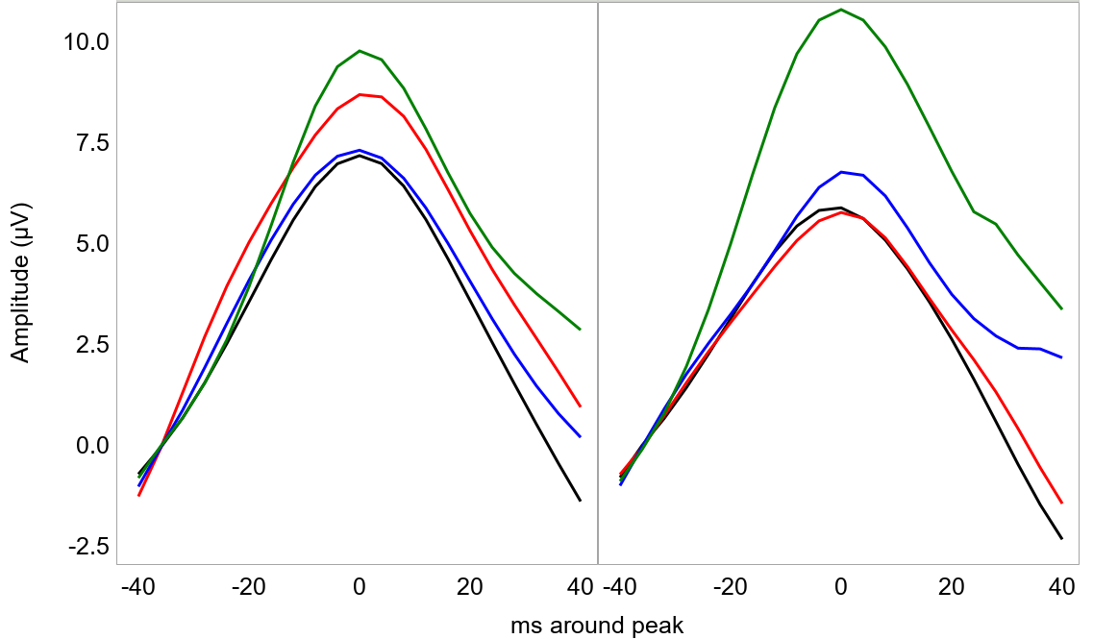
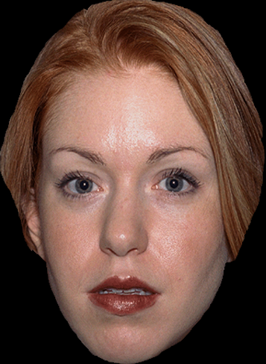
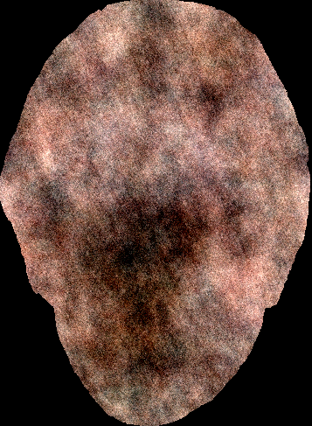
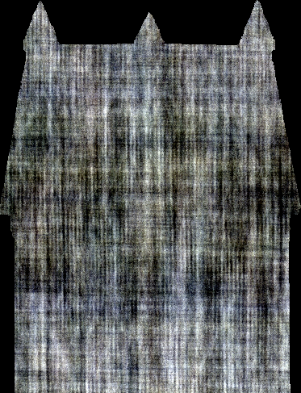
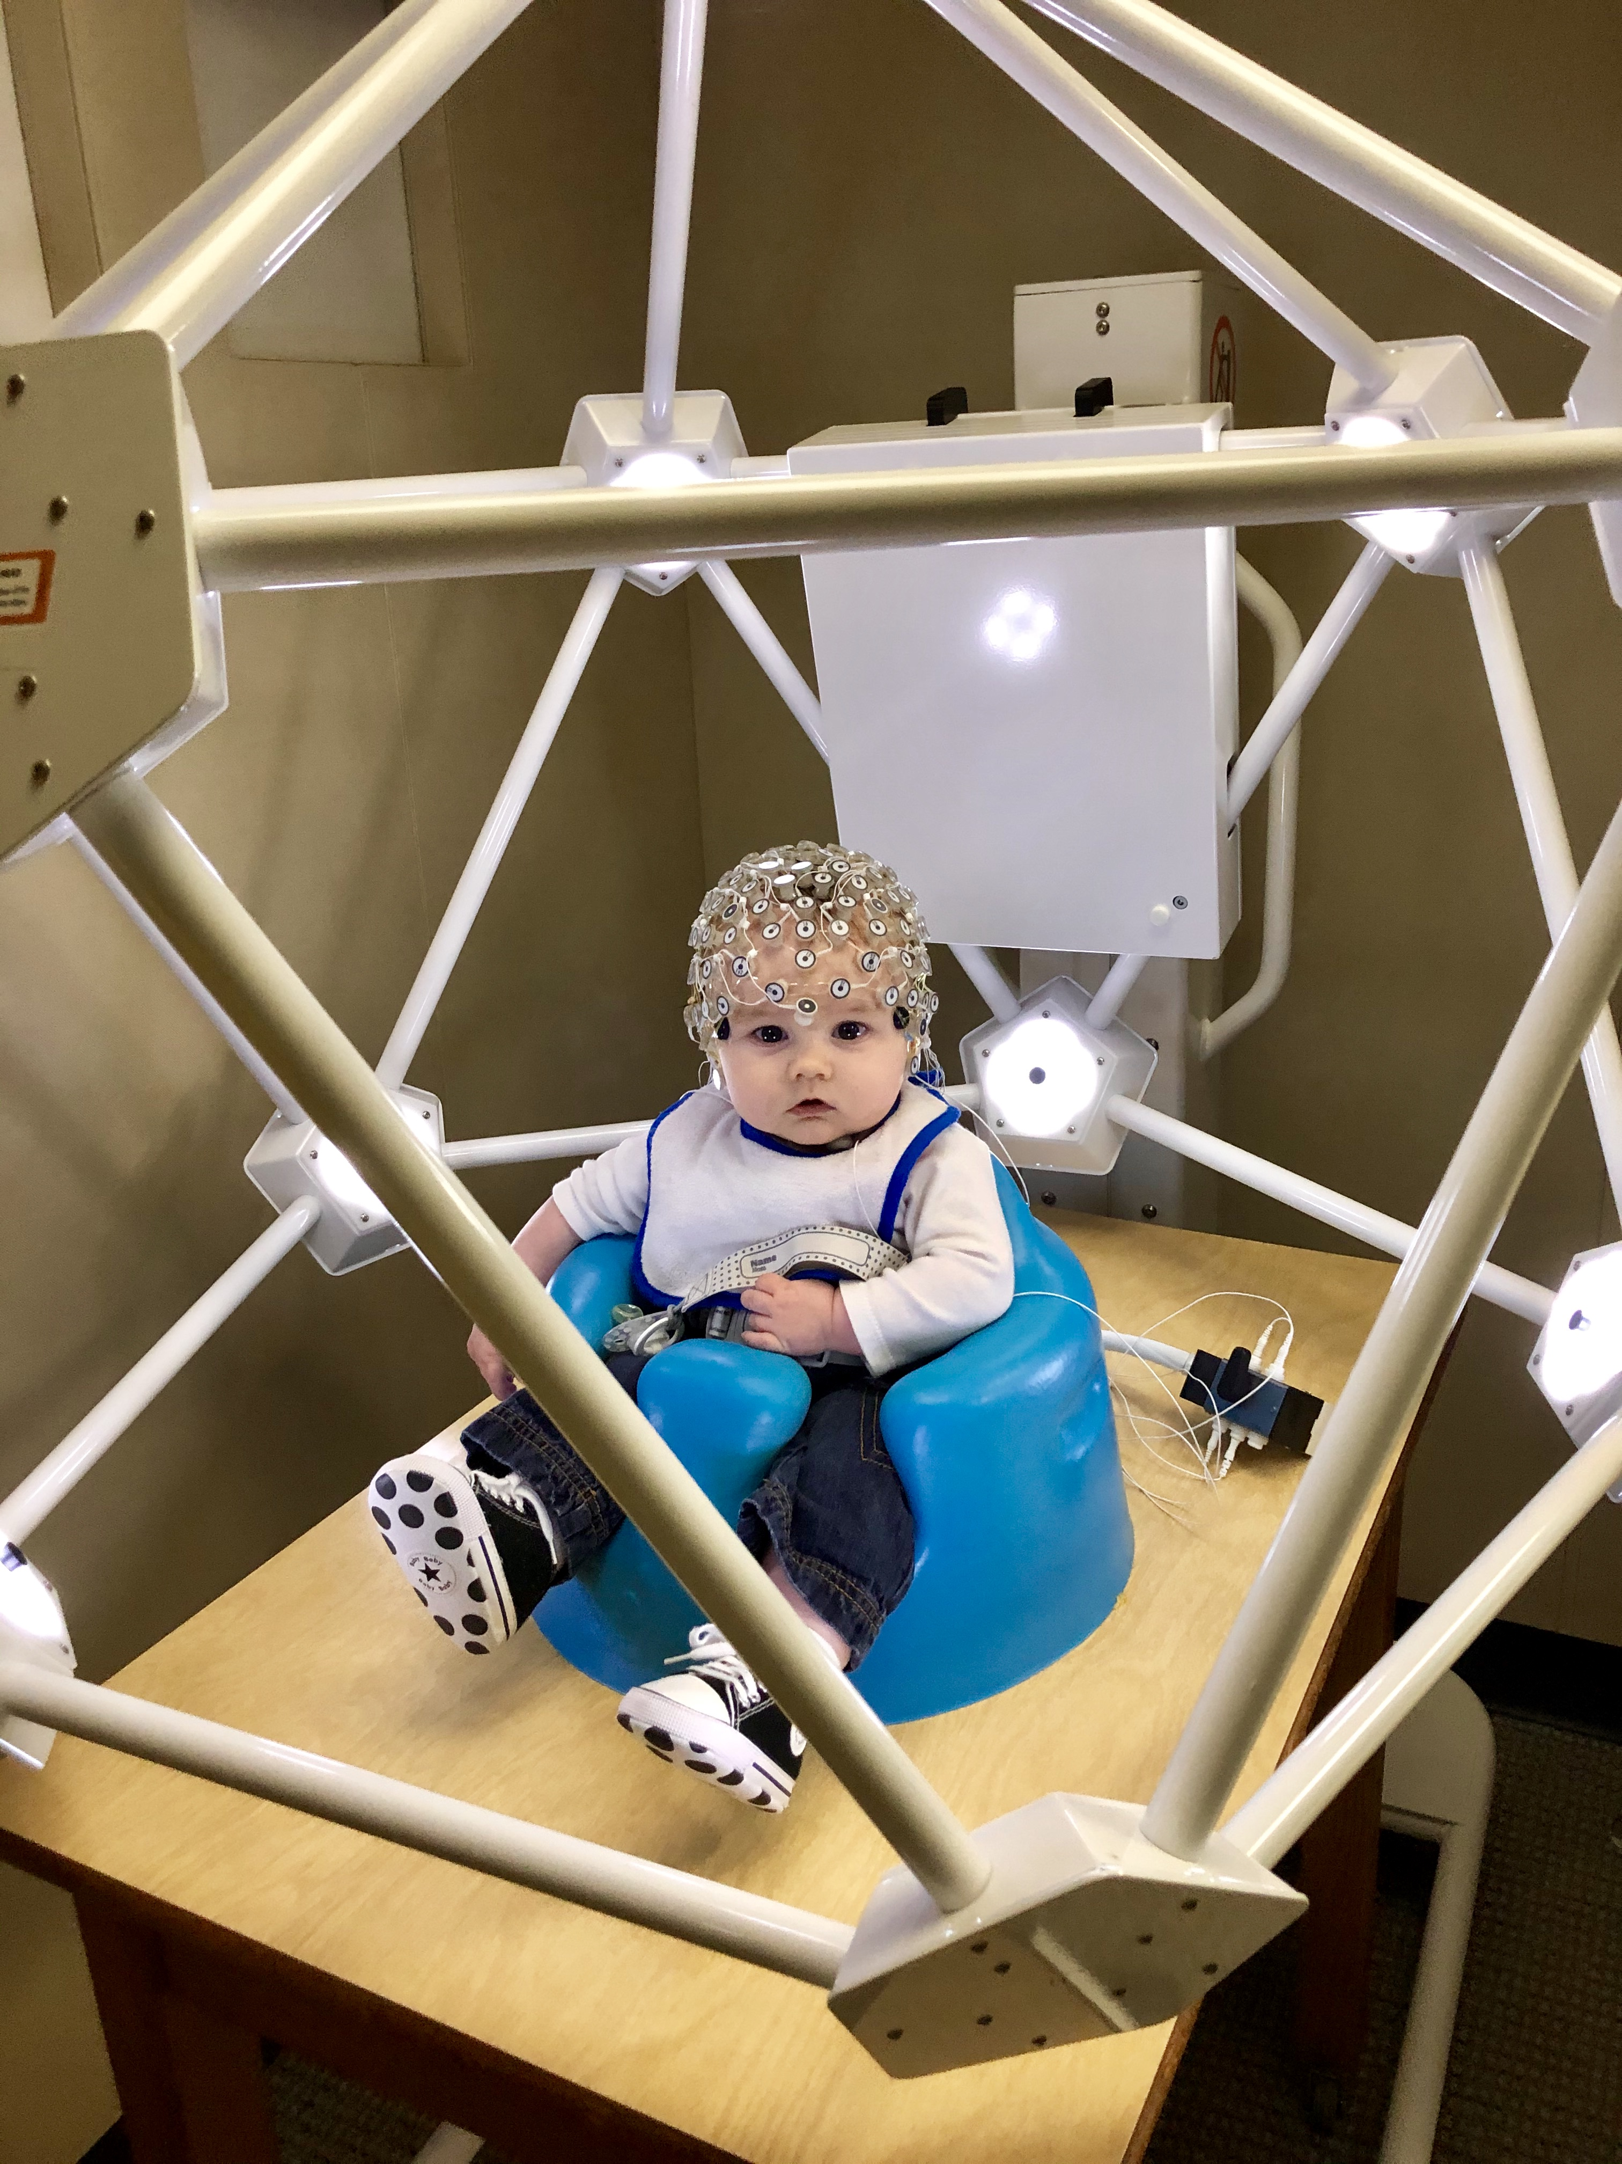
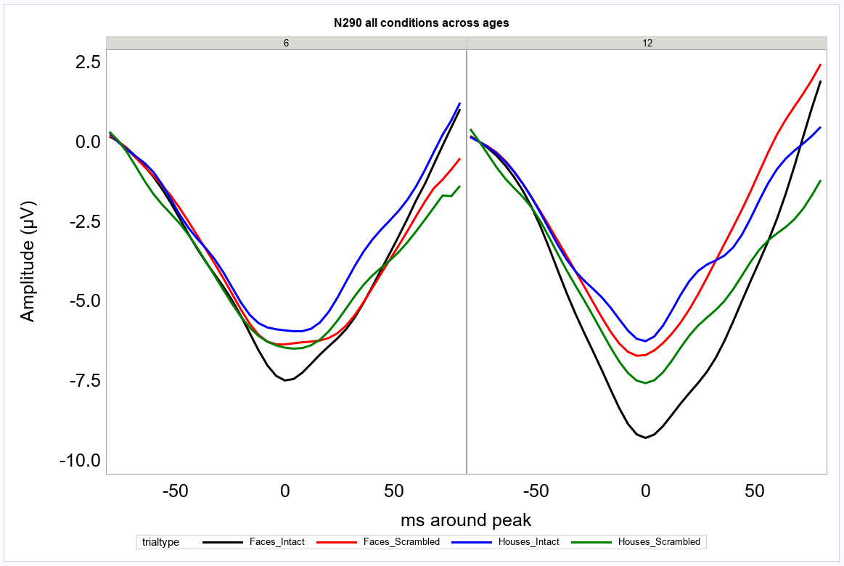
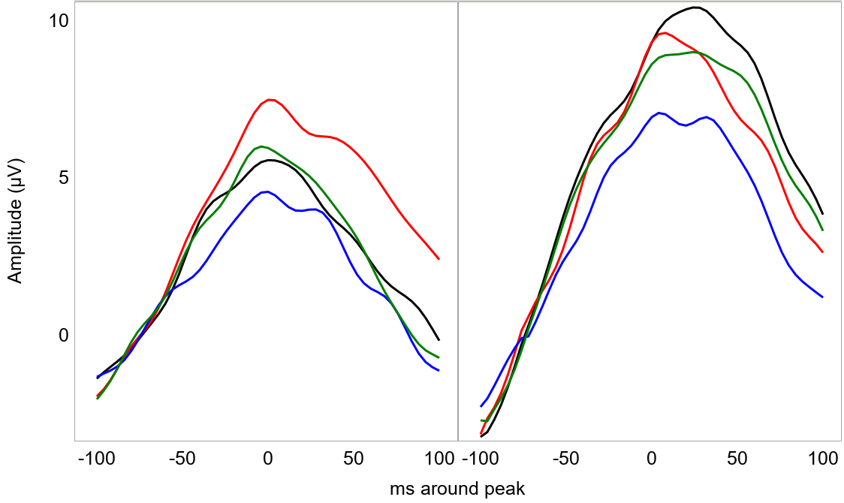
The Role of Low-level Visual Cues on the Neural Responses to Faces in Infants
Stefania Conte, John E. Richards
University of South Carolina
contact: contes@mailbox.sc.edu
Introduction
Methods
ERP Results
Several behavioral and neural evidence suggest that visual images of faces are processed by specialized neural and cognitive mechanisms. Event-related potentials (ERPs) recorded from adults have shown that faces elicit larger and quicker N170 responses when compared to non-faces stimuli. The P1 component has also been reported to be sensitive to faces^{1,2}. In adults, low-level visual cues (e.g., luminance, global contrast) drive the P1 face-sensitivity, while the N170 seems to reflect the actual perception of a face³. Two ERP components, the N209 and P400, are sensitive to face manipulations over the first year of life⁴. The amplitude of the N290 component showed larger response to faces when compared to ideally-matched control stimuli (i.e., phase-scrambled faces) in 3-month-old infants. No difference was found in the amplitude of the P400 component⁵.
We investigated infants’ P1, N290, and P400 responses to faces and houses and their phase-scrambled versions at 6 and 12 months of age. Scrambled stimuli were created using a Fourier phase randomization procedure. This procedure keeps the global low-level properties of the original images while degrading the texture. We predicted that the P1 responses would be accounted for by low-level visual cues. N290 and P400 responses should not be accounted for by low-level visual cues. Developmental changes could occur on the responses of the N290 and P400 components.
Participants
P1
N = 14 infants at 6 months of age (M = 189.42 days SD = 5.43 days)
N = 10 infants at 12 months of age (M = 371.18 days SD = 10.92 days)
6 mos
12 mos
IF
SF
IH
SH
Stimuli and Procedures
IF
IH
SF
SH
500
500 – 1500
Time (ms)
500
EEG recording
128 channels
Geodesic Photogrammetry System
Age-appropriate MRI templates^{6,7}
IF < SF, p = .0126
IH < SH, p = .0092
SF < SH, p < .0001
IH < SH, p < .0001
N290
6 mos
12 mos
IF
SF
IH
SH
Conclusion
Source Analysis Results
Preliminary results suggest that the P1 is sensitive to the stimulus texture, with larger amplitudes elicited by scramble stimuli
The N290 showed larger negativity in response to intact faces than houses in both age groups. Only at 12 months of age the response to intact faces was also larger than the response to scrambled faces.
Larger P400 amplitudes were recorded in response to intact faces than houses and to scrambled than intact houses at both ages. At 6 months, the P400 showed larger amplitudes in response to scrambled faces than both intact faces and scrambled houses.
Stimulus texture is processed in the Lingual Gyrus (LG) at both ages. The N290 source is localized in the middle Fusiform Gyrus (mFG) and posterior Cingulate Cortex (pCC). Only the mFG shows larger responses to faces at both ages. The P400 is generated in the pCC and shows larger response to intact faces than houses by 12 months of age.
P1
LG
SF > SH, p = .0017
SF > IF, p < .0001
SH > IH, p < .0001
LG
SF > SH, p < .0001
SH > IH, p < .0001
6 mos
12 mos
IF < IH, p < .0001
N290
IF < IH, p < .0001
IF < SF, p < .0001
pCC
mFG
pCC
mFG
P400
6 mos
12 mos
6 mos
12 mos
IF
SF
IH
SH
all n.s.
IF > IH, p = .0002
SH > IH, p < .0001
IF > IH, p = .0006
IF > SF, p = .0056
SH > IH, p = .0116
IF > IH, p < .0001
IF > SF, p < .0001
SH > SF, p = .0050
References
Goffaux, V., Gauthier, I., & Rossion, B. (2003). Spatial scale contribution to early visual differences between face and object processing. Cognitive Brain Research, 16(3), 416-424.
Itier, R. J., & Taylor, M. J. (2004). N170 or N1? Spatiotemporal Differences between Object and Face Processing Using ERPs. Cerebral Cortex, 14(2), 132–142.
Rossion, B., & Caharel, S. (2011). ERP evidence for the speed of face categorization in the human brain: Disentangling the contribution of low-level visual cues from face perception. Vision Research, 51(12), 1297–1311.
Halit, H., De Haan, M., & Johnson, M. H. (2003). Cortical specialisation for face processing: Face-sensitive event-related potential components in 3- and 12-month-old infants. NeuroImage, 19(3), 1180–1193.
Halit, Hanife, Csibra, G., Volein, Á., & Johnson, M. H. (2004). Face-sensitive cortical processing in early infancy. Journal of Child Psychology and Psychiatry and Allied Disciplines, 45(7), 1228–1234.
Guy, M. W., Zieber, N., & Richards, J. E. (2016). The Cortical Development of Specialized Face Processing in Infancy. Child Development, 87(5), 1581–1600.
Conte, S., Richards, J. E., Guy, M. W., Xie, W., & Roberts, J. E. (2020). Face-sensitive brain responses in the first year of life. NeuroImage, 211, 116602.
P400
pCC
pCC
SF > SH, p < .0001
IH > SH, p < .0001
IF > IH, p < .0001
SH > IH, p < .0001
IF > IH, p = .0070
SF > SH, p = .0007
IF < SF, p < .0001
IH < SH, p = .0012
6 mos
12 mos
IF > IH, p < .0001
IH < SH, p < .0018

